Slide 1
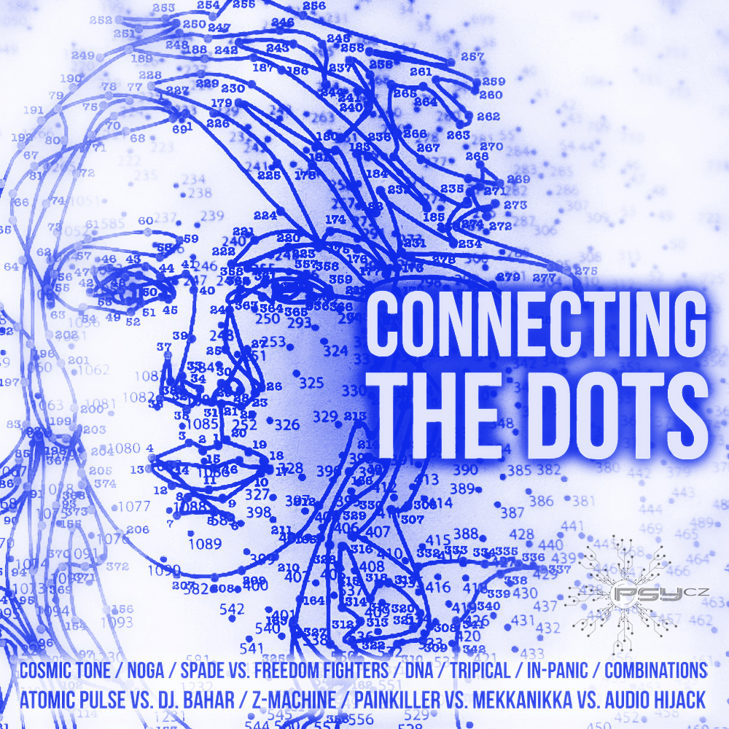

Brig Gen (r) John GALATAS, MD, MA, MC (Army)
Consultant in Allergy & Clinical Immunology
CBRNE Planner & Instructor
Senior Asymmetric Threats Analyst
Athens, Greece
PART 2
11 November 2013
Global Threat Assessment
Houston, TX

Slide 2




combined
GTA
natural
man-made

Slide 3

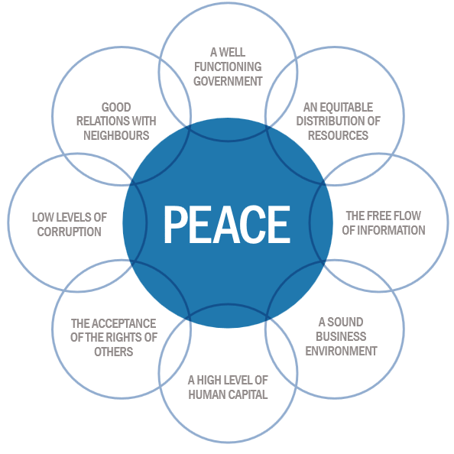
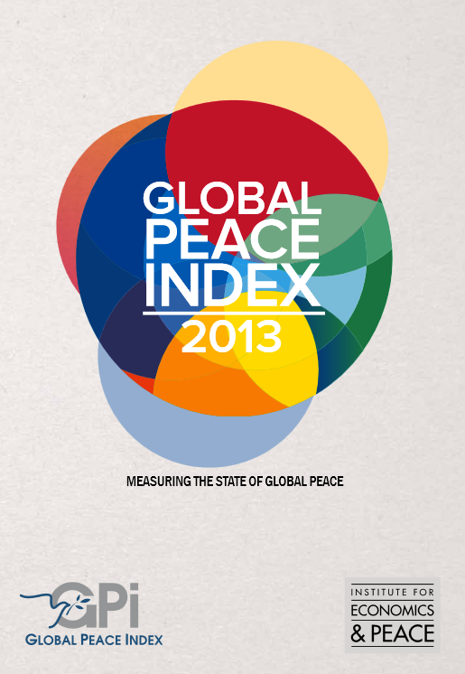
The Pillars of Peace
http://reliefweb.int/sites/reliefweb.int/files/resources/Global%20Peace%20Index%202013.pdf

Slide 4
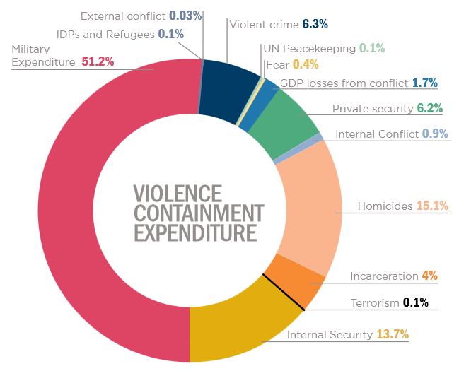
The Pillars of Peace …
$9.46 trillion/year
~11% of World GPD

Slide 5
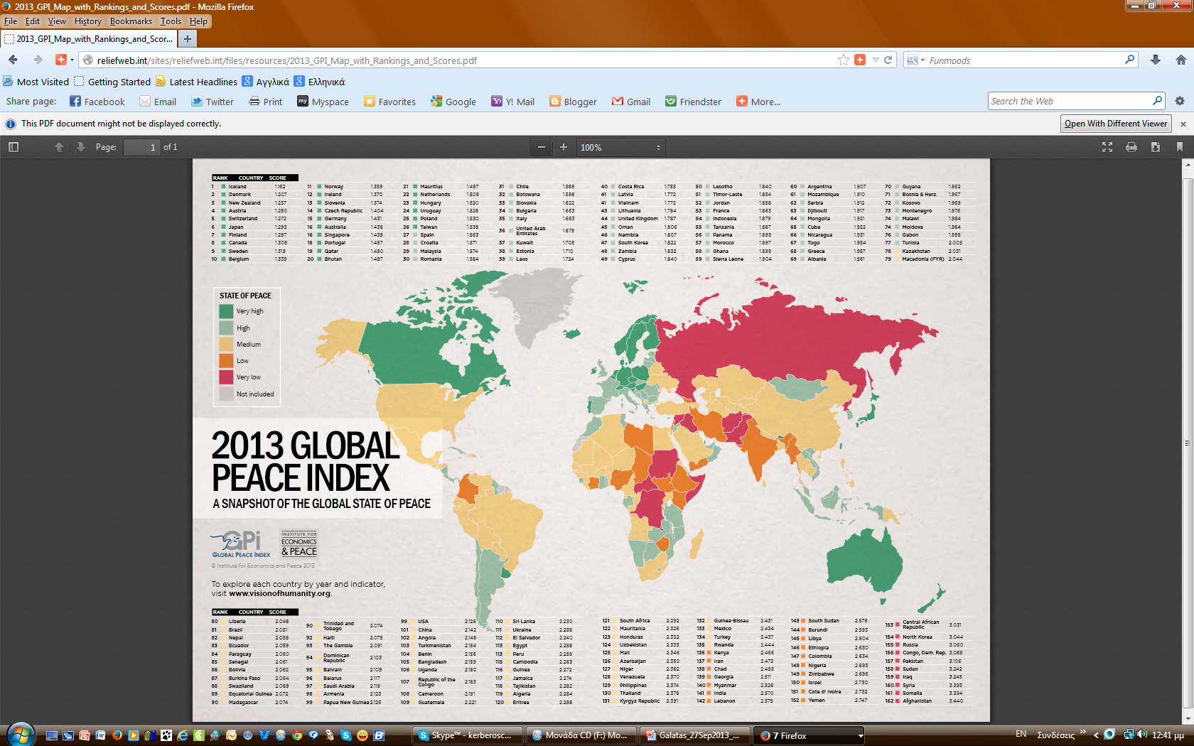

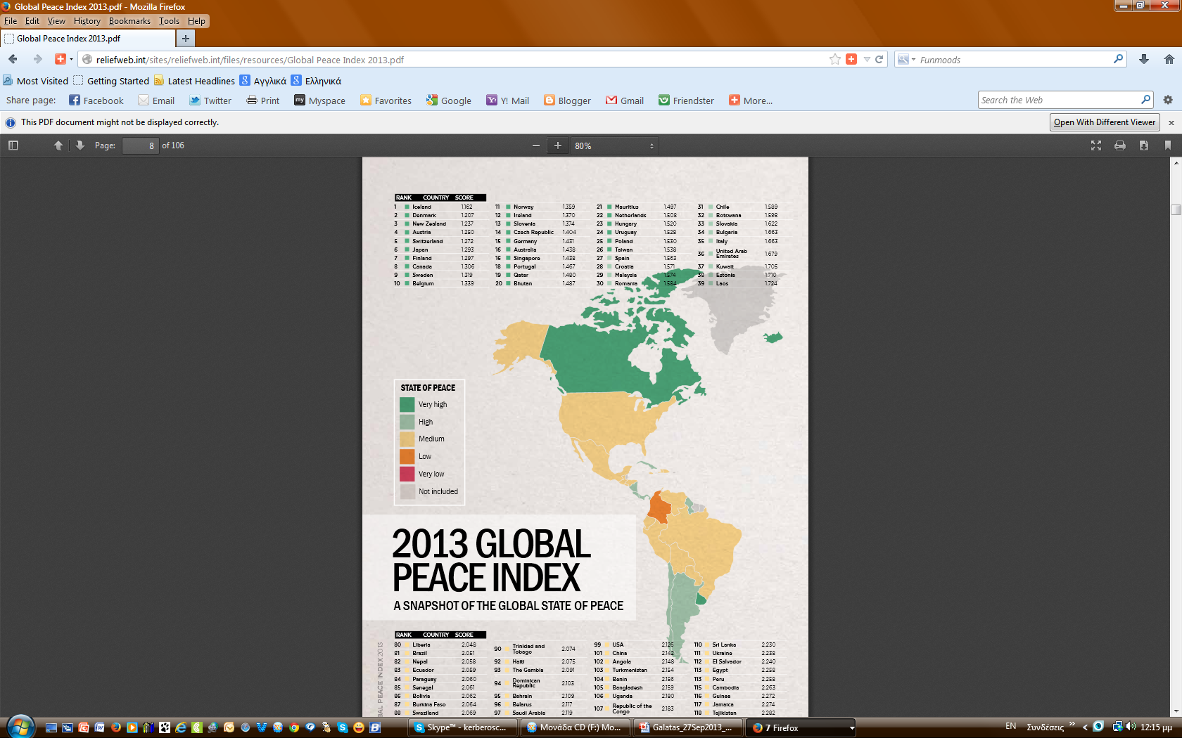
Global peace
GPI comprises 22 indicators of the existence or absence
violence or fear of violence divided in 3 broad categories:
Ongoing domestic & international conflict;
Societal safety & security;
Militarization
1
155
8
44
99
68
134
162
137
101
141
81
16

Slide 6

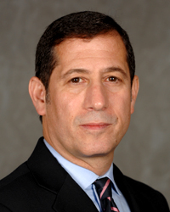

Terrorism
There is neither an academic nor an international legal consensus regarding the definition of "terrorism“
A 2003 study by Jeffrey Record for the US Army quoted a source* that counted 109 definitions of terrorism that covered a total of 22 different definitional elements
Bruce Hoffman has noted: “Terrorism is a pejorative term. It is a word with intrinsically negative connotations that is generally applied to one's enemies and opponents, or to those with whom one disagrees and would otherwise prefer to ignore. (...) Hence the decision to call someone or label some organization 'terrorist' becomes almost unavoidably subjective, depending largely on whether one sympathizes with or opposes the person/group/cause concerned. If one identifies with the victim of the violence, for example, then the act is terrorism. If, however, one identifies with the perpetrator, the violent act is regarded in a more sympathetic, if not positive (or, at the worst, an ambivalent) light; and it is not terrorism.”
Bruce Hoffman, Inside terrorism, 2 ed., Columbia University Press, 2006, p.41
* Schmid, A.P. and A.J. Jongman et al (1988). Political Terrorism. Amsterdam: North-Holland Publishing Company.

Slide 7
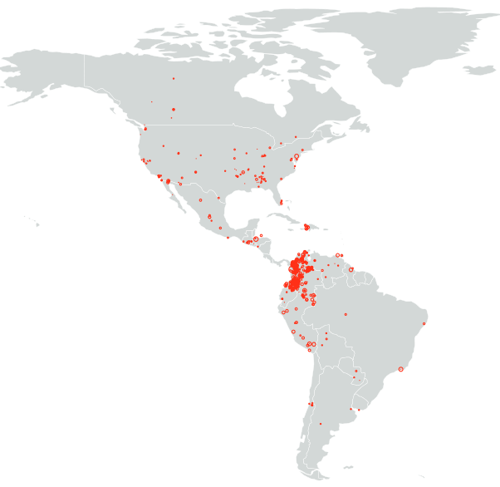
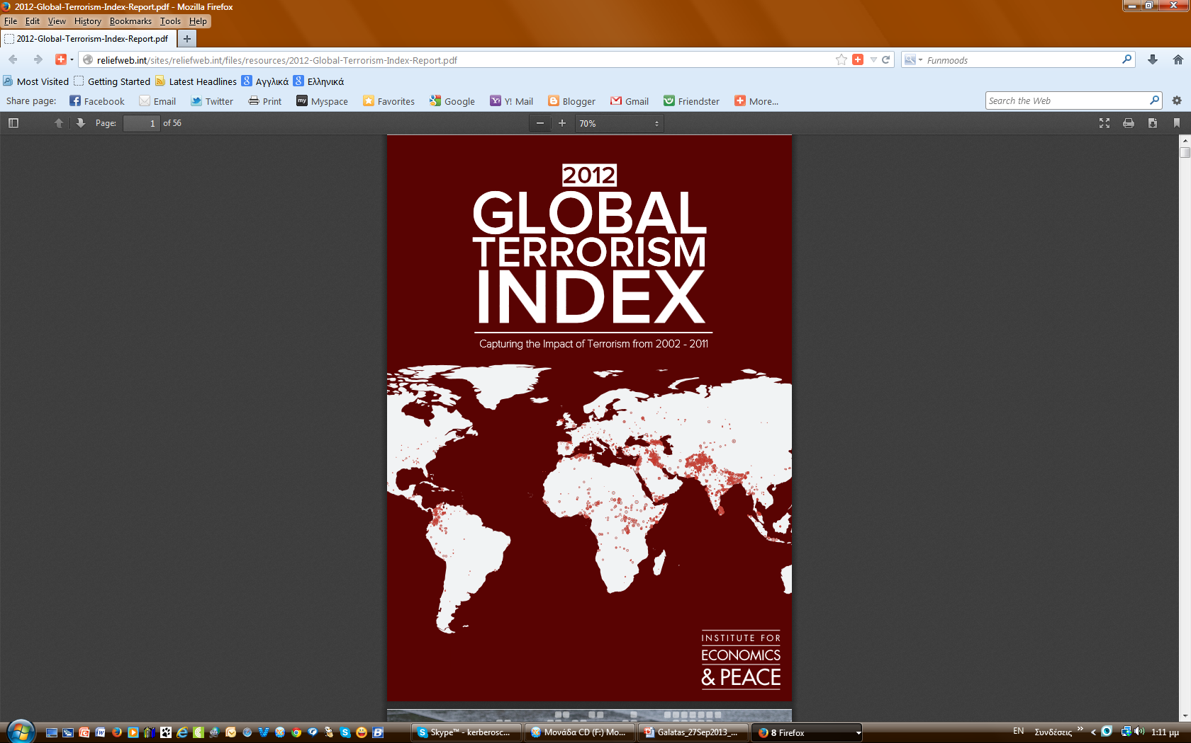
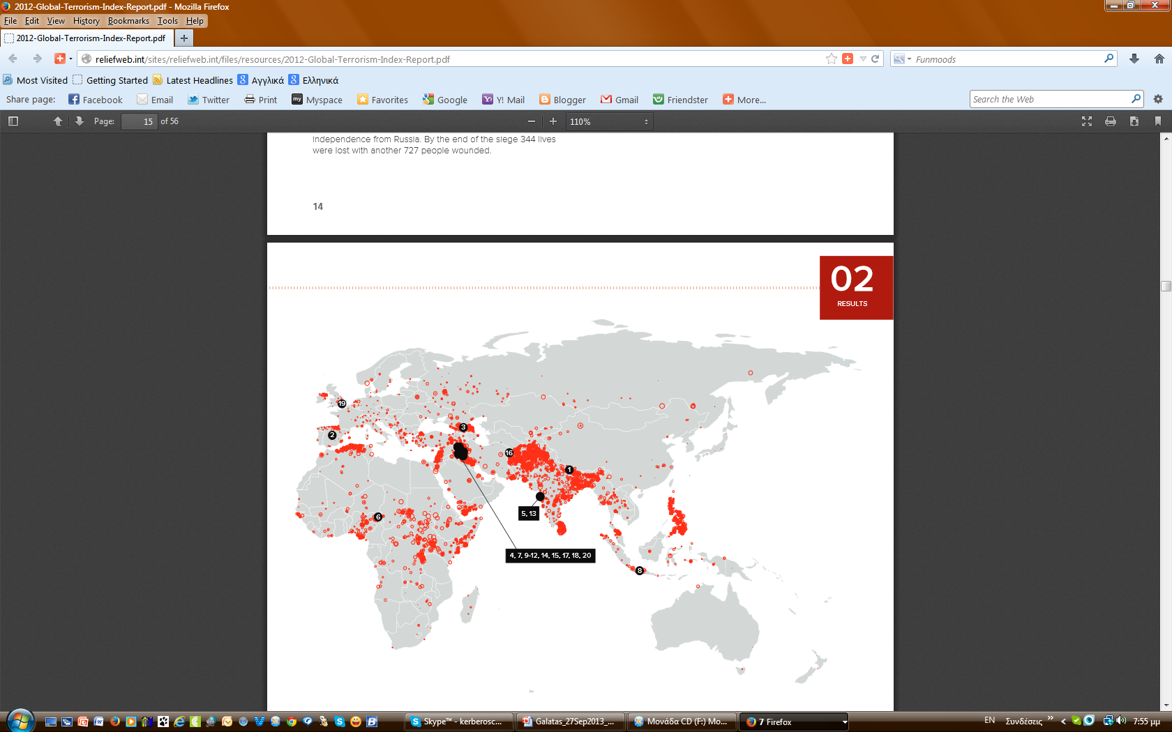
Terrorism
2002-2011
http://reliefweb.int/sites/reliefweb.int/files/resources/2012-Global-Terrorism-Index-Report.pdf

Slide 8
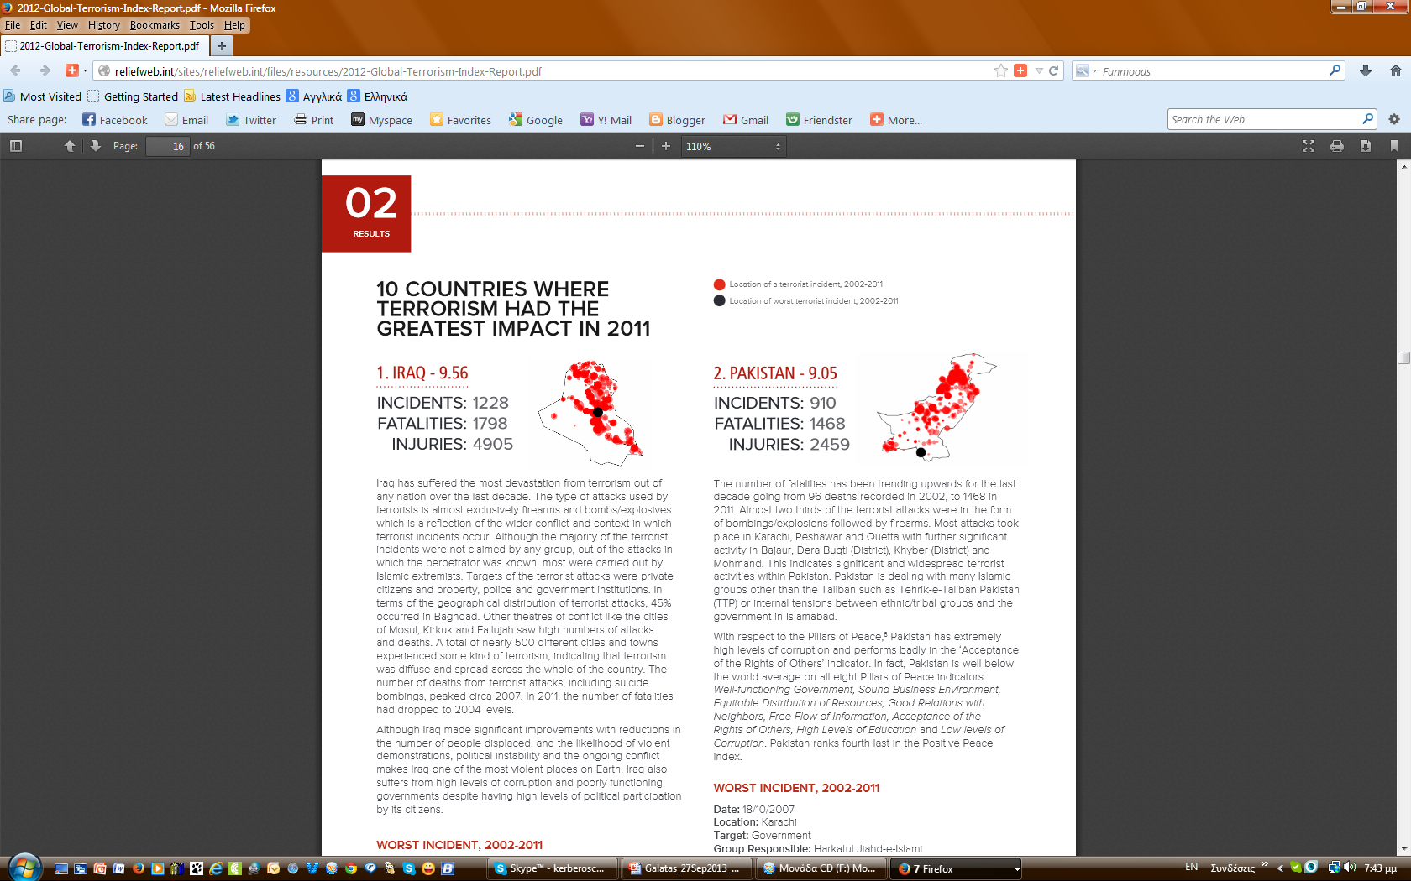
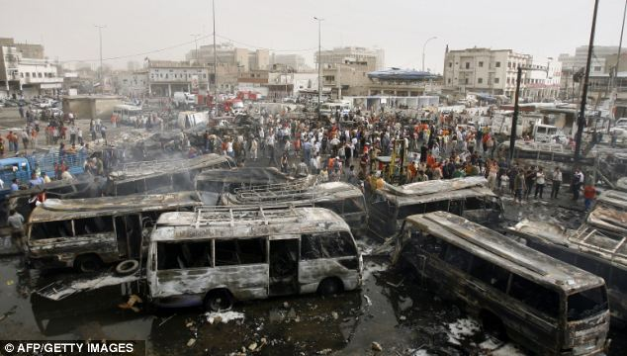
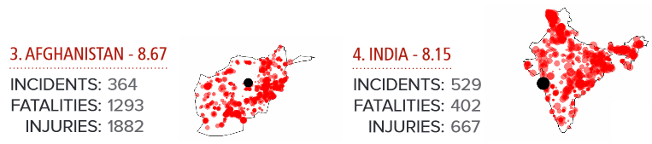
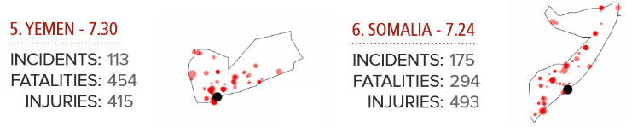
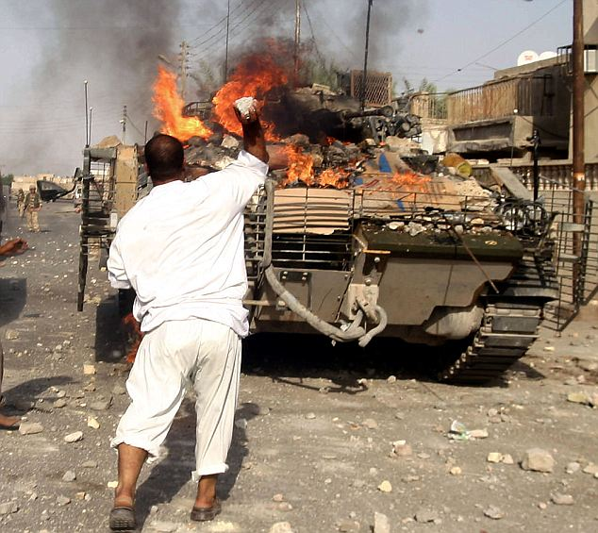
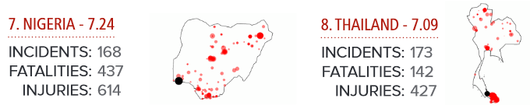
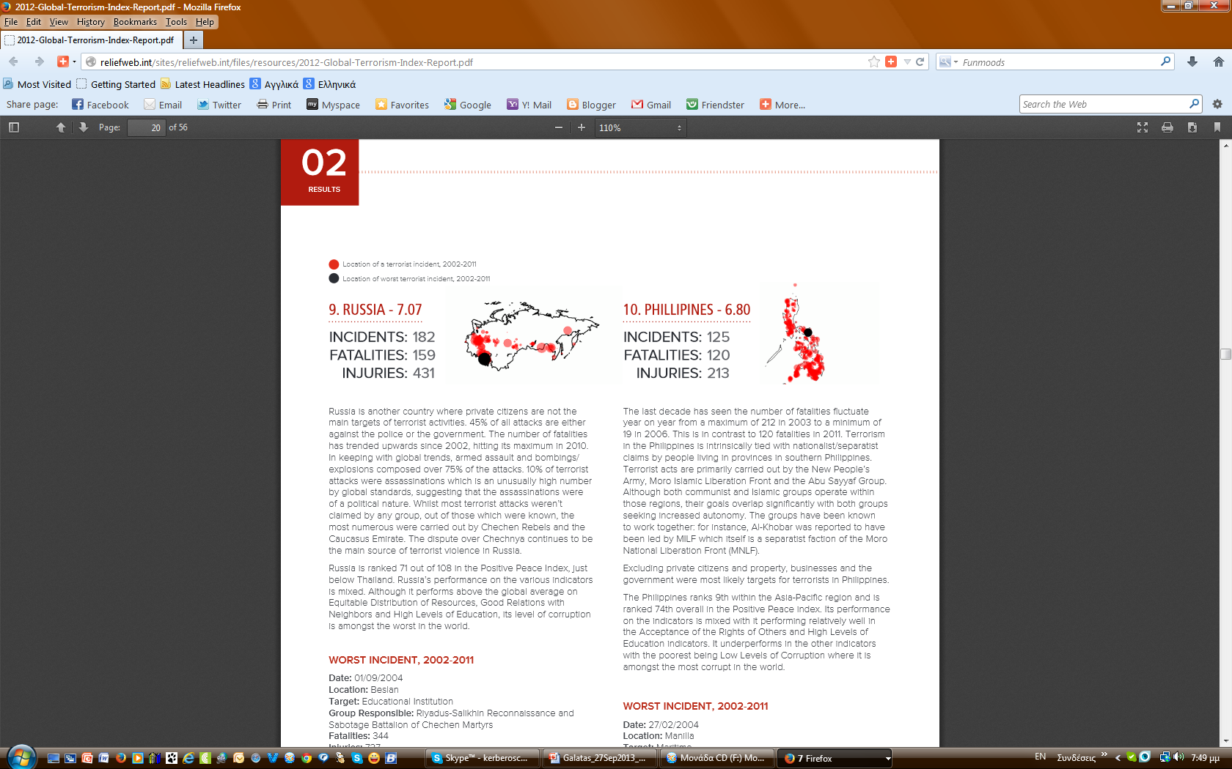
Terrorism
Location of terrorist incident (2002-2011)
Location of worst T-incident (2002-2011)

Slide 9
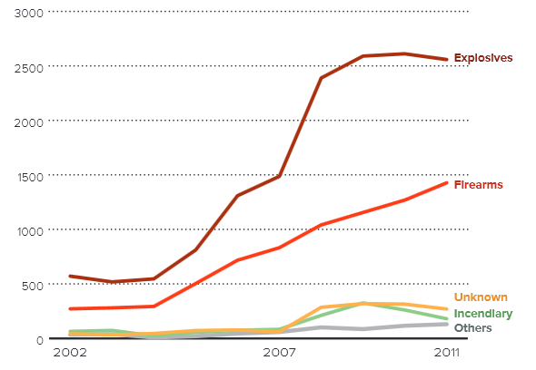
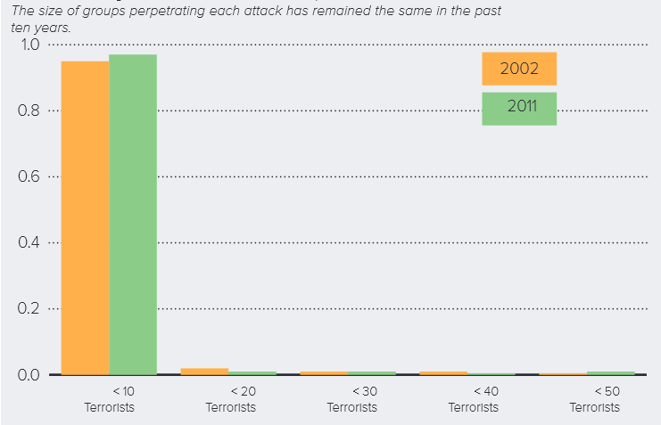
Terrorism
Types of weapons used
Number of terrorists involved
Small attacks involving <10 terrorists has been increasing and accounts for almost 100% of attacks;
BUT the category of >50 combatants has increased suggesting larger groups may be forming
 April 2011 – Communist Party of India – Maoist
(CPI-M) conducted a terrorist act that
involved 1000 armed rebels

Slide 10
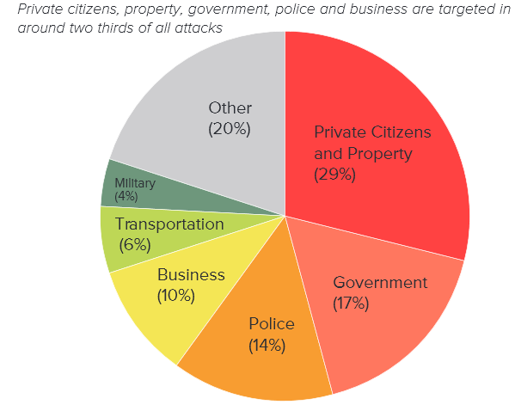
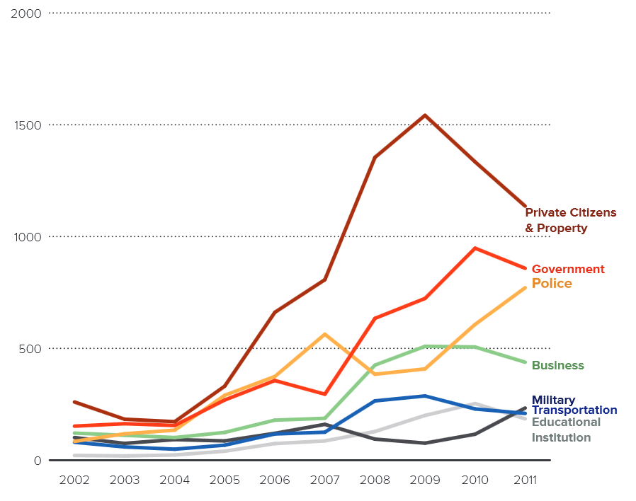
Terrorism
Targets
Trends in targets
640%
X9 times

Slide 11
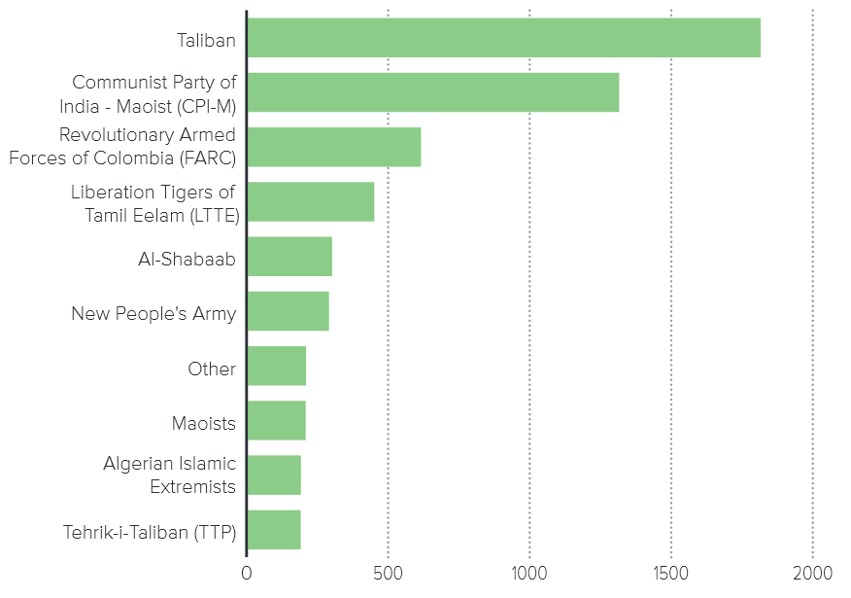
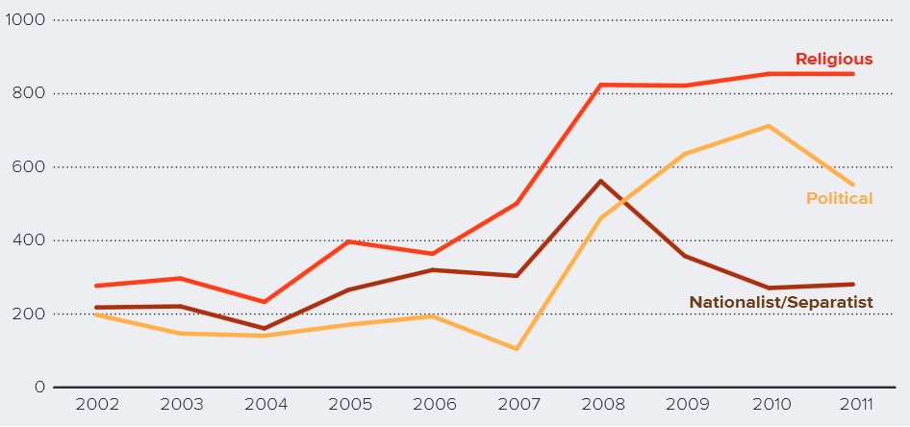
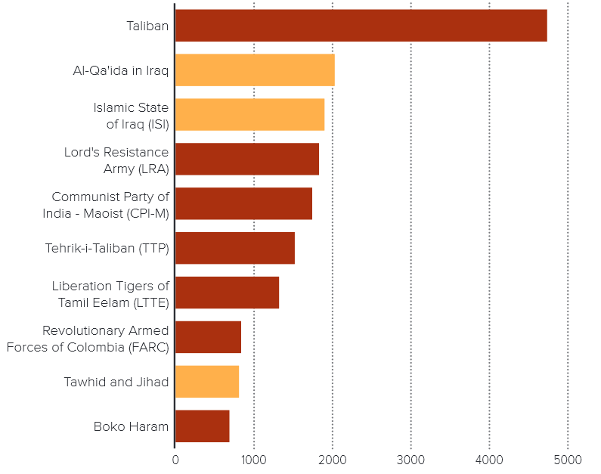
Terrorism
Incidents by terrorist organization
Incidents by ideology
Fatalities by terrorist organization
Tawhid and Jihad, Al-Qa’ida in Iraq, and Islamic State of Iraq were all headed by Abu Musab al-Zarqawi. These three are essentially the same organization;
If the three organizations are treated as one then the fatalities committed would be the same as the Taliban.

Slide 12
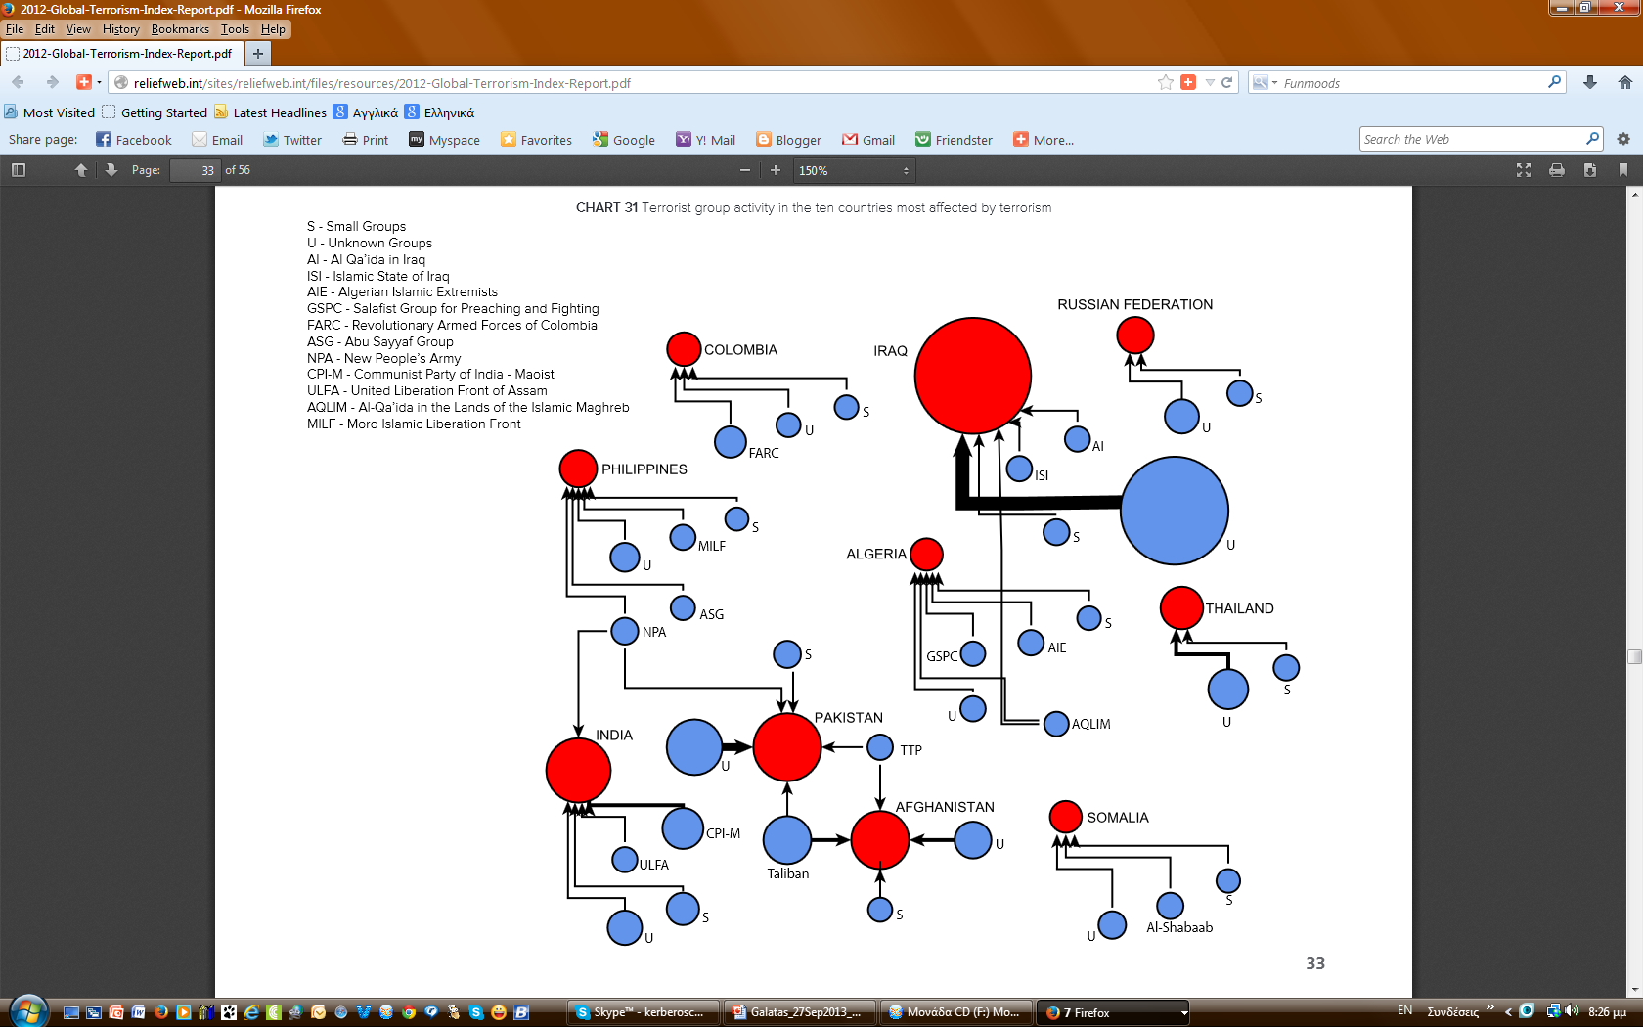
Terrorism
TOP-10 countries terrorist group activity

Slide 13
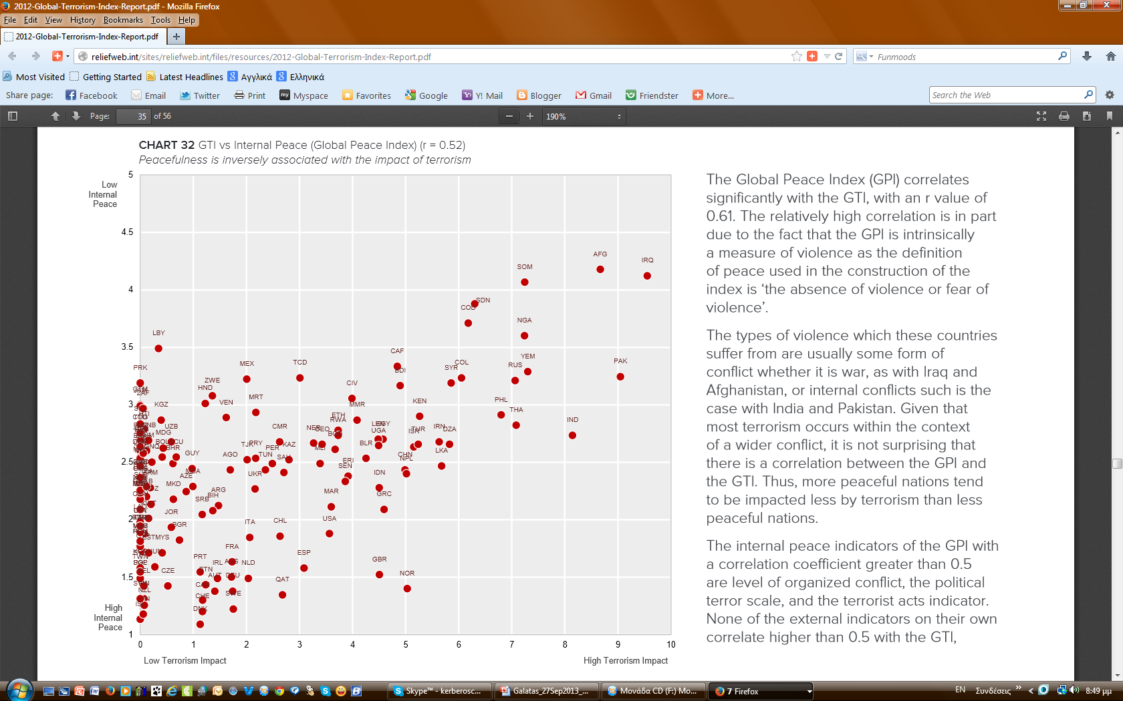
Terrorism
Global Peace Index vs Global Terrorist Index
GPI correlates significantly with the GTI;
 in part due to the fact that the GPI is intrinsically a measure of
violence as the definition of peace used in the construction of the
index is “the absence of violence or fear of violence”;
The types of violence which these countries suffer from are usually some form of conflict whether it is war, as with Iraq and Afghanistan, or
internal conflicts such is the case with India and Pakistan;
Given that most terrorism occurs within the context of a wider conflict, it is not surprising that there is a correlation between the GPI and the GTI;
More peaceful nations tend to be impacted less
by terrorism than less peaceful nations.

Slide 14
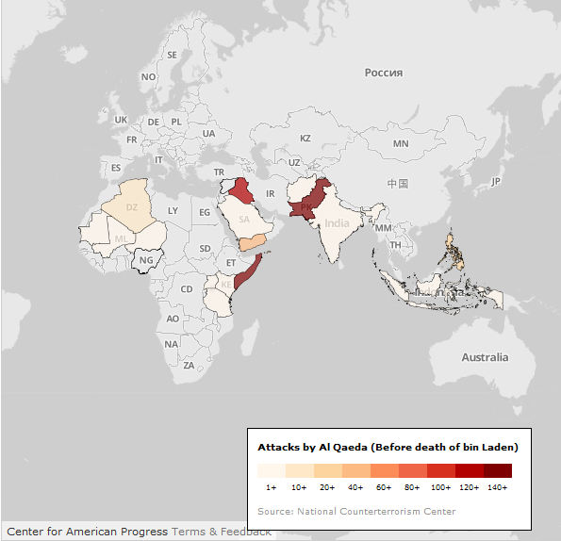
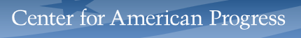

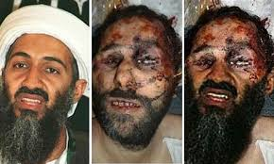
Terrorism & ObL
May 2, 2010 to May 2, 2011
 Drop 16%
in successful attacks by AQ network in the year following OBL’s death compared to the year before;
 Drop 65%
in successful attacks by AQ network outside of Africa in the year following OBL’s death compared to the year before;
 Drop 35%
in casualties caused by AQ network in the year following OBL’s death compared to the year before;
81
successful attacks by AQ network in Pakistan since OBL’s death, down from 159 the year before;
22
AQ network senior-level operatives/leaders captured or killed since May 2011;
0
successful attacks by AQ network in US since OBL’s death.
May 2, 2011 to the present

Slide 15
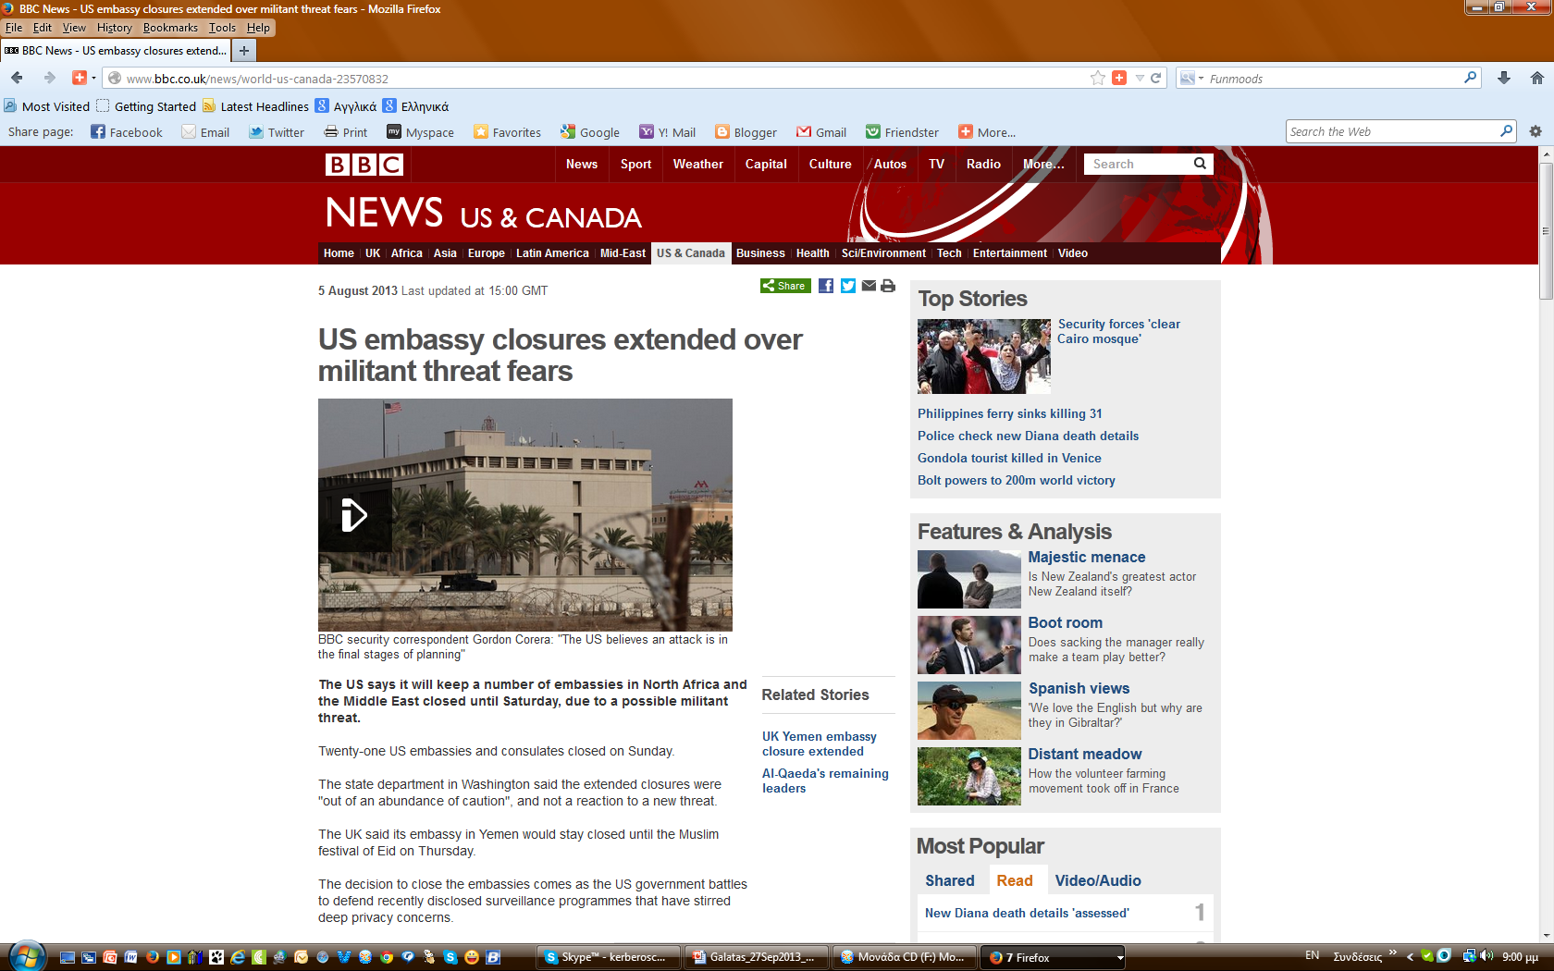
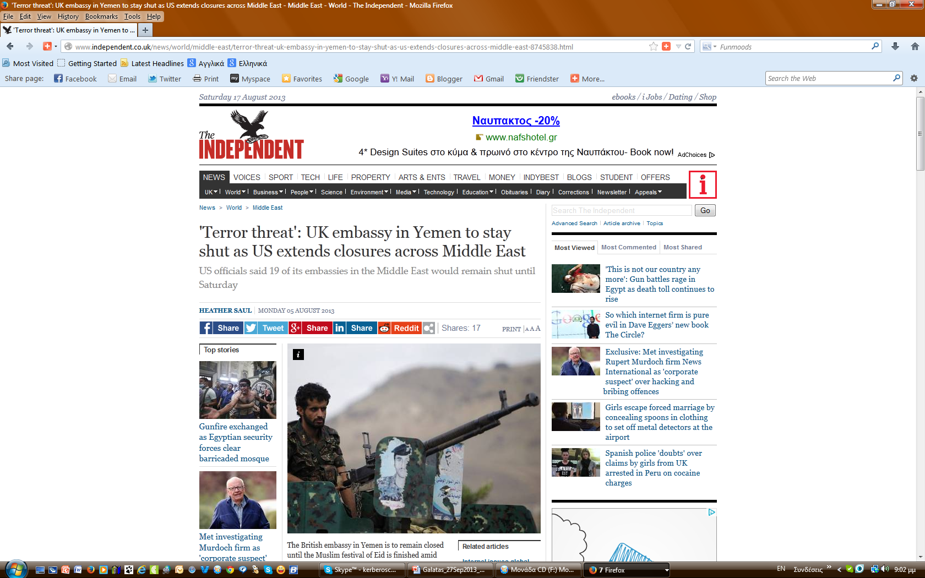
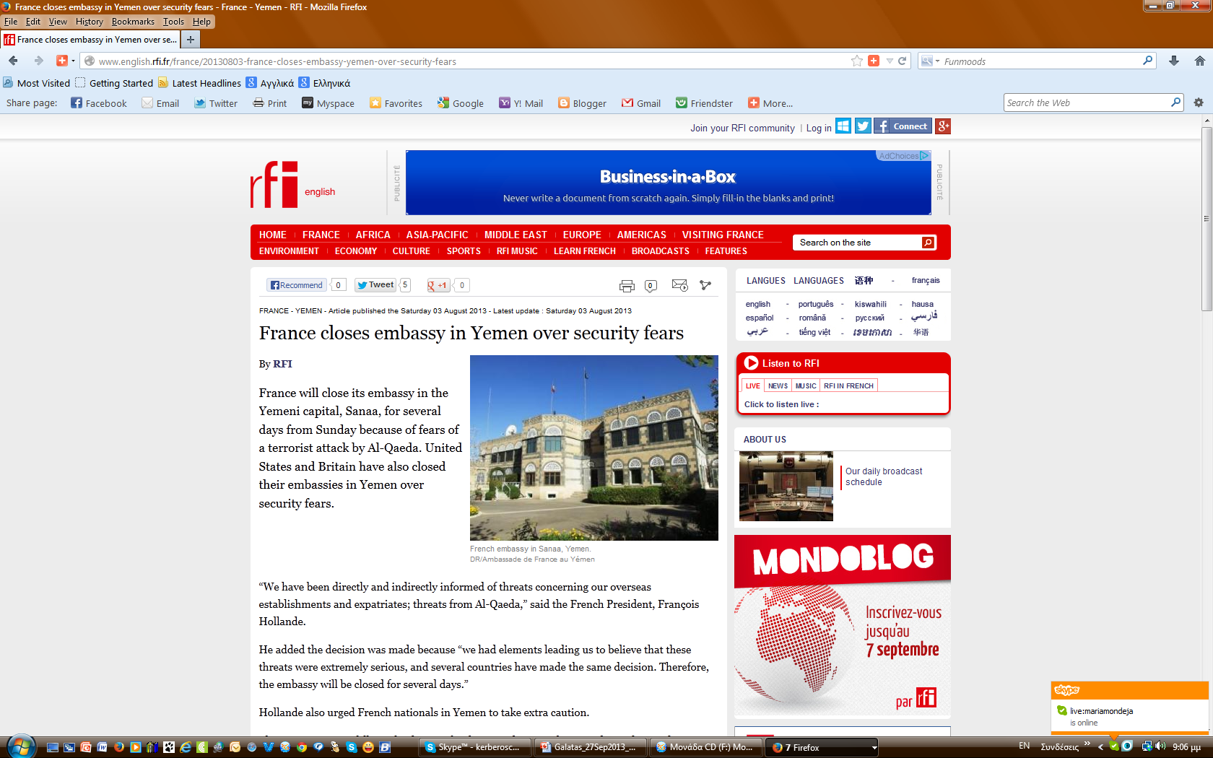
(virtual?) Terrorism
AQ is not dead

Slide 16
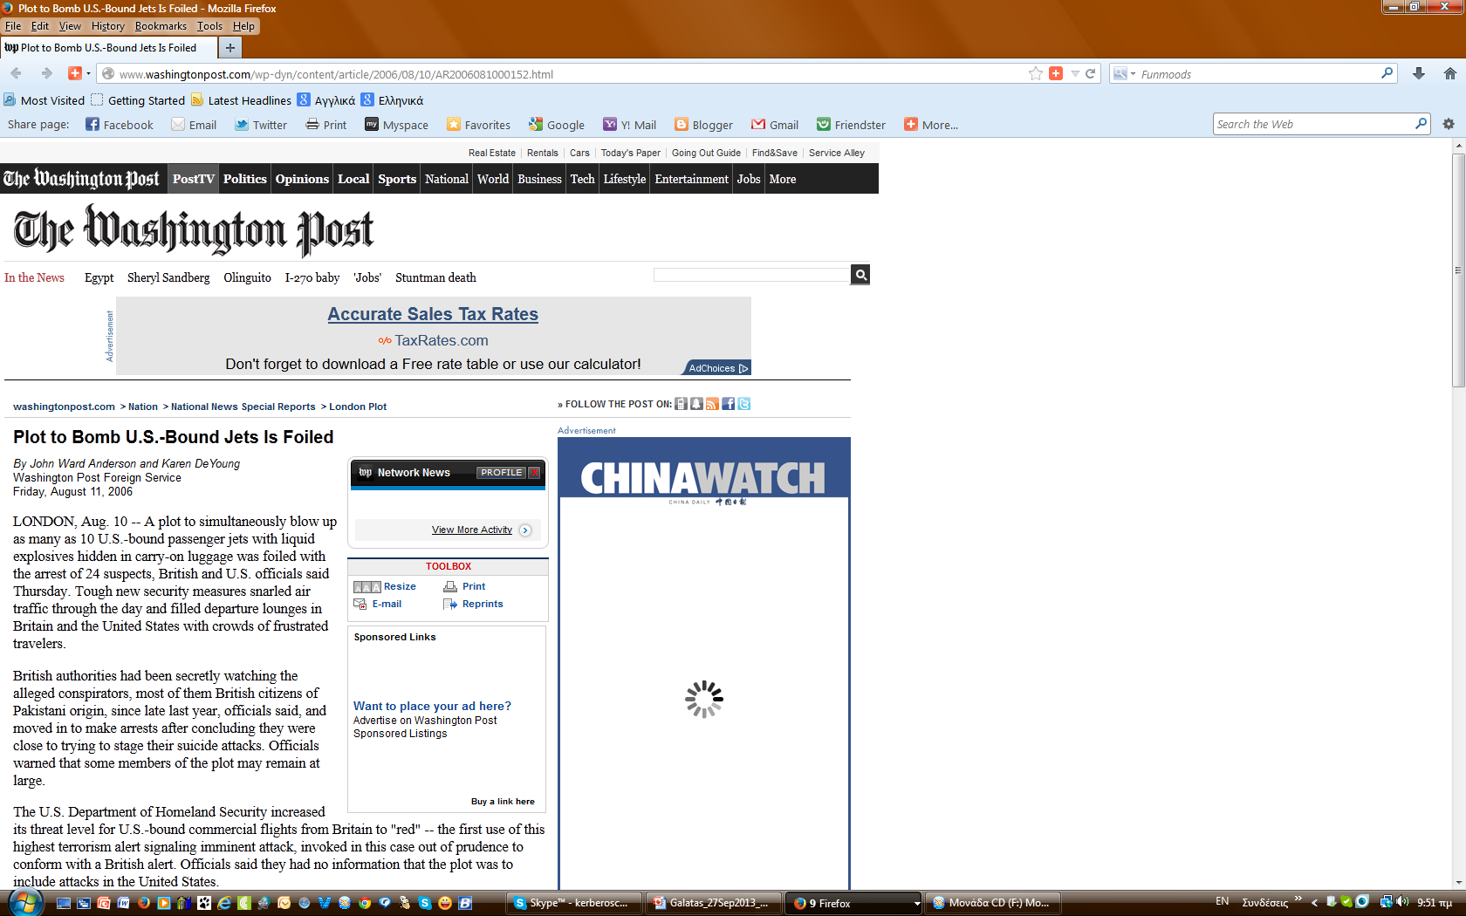
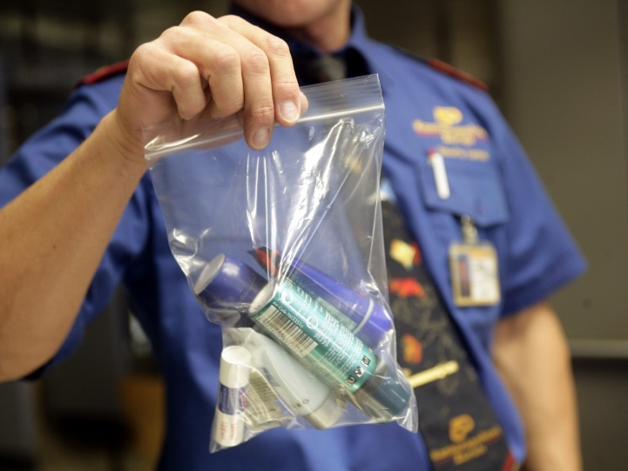
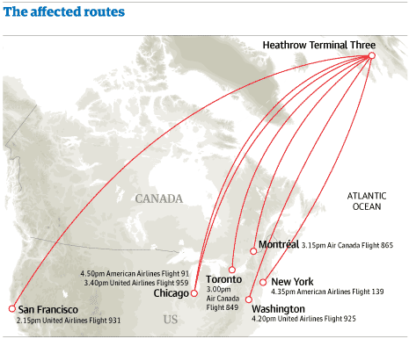
(virtual?) Terrorism
2006

Slide 17

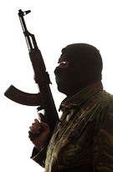

(re-emerging) Terrorism
A lone wolf is someone who commits or prepares for, or is suspected of committing or preparing for, violent acts in support of some group, movement, or ideology, but who does so alone, outside of any command structure and without material assistance from any group.
In the U.S. legal context, the lone wolf is associated with the U.S. terror-law FISA, bearing in
mind that U.S. terror-law comprises non-violent, as well as violent acts. Moreover, a lone wolf can
be so defined on the mere basis of suspicion ("reasonable belief", not actual charges). Probable
cause is not required.
* Foreign Intelligence Surveillance Act of 1978
http://en.wikipedia.org/wiki/Lone_wolf_%28terrorism%29

Slide 18
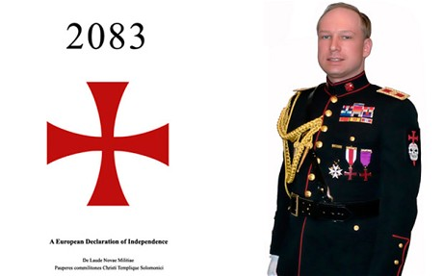
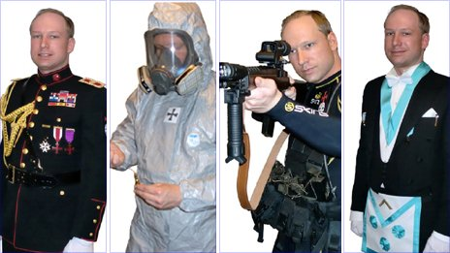
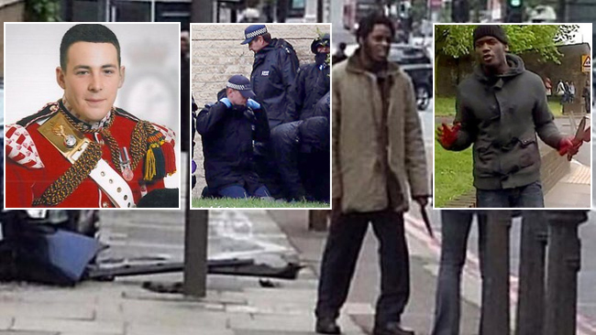
(re-emerging) Terrorism
Lone wolves in Europe
1993-1997 in Austria
Franz Fuchs engaged in a campaign against foreigners, and organizations and individuals he believed to be friendly to foreigners. He killed four people and injured 15, some seriously, using three improvised explosive devices and five waves of 25 mail-bombs in total.
April 1999 in London
David Copeland targeted blacks, Asians and gays with nail bombs, killing three and injuring 129. His aim was to start a race war. He was sentenced to at least 50 years and is now in a secure mental hospital.
May 6, 2002 in the Netherlands
Nine days before elections, Dutch politician Pim Fortuyn was murdered by Volkert van der Graaf, an environmental activist who declared he saw Pim Fortuyn as a threat to Dutch society.
March 2, 2011 in Germany
Arid Uka shot and killed two US soldiers and seriously wounded two others in the 2011 Frankfurt Airport shooting.
►July 22, 2011 in Norway
Anders Behring Breivik killed eight people with a heavy car-bomb placed in the heart of the Norwegian government headquarters in Oslo. An hour later, he appeared at the summer camp of the Worker's Youth League (Labor Party) at the island of Utoya, 35km west of Oslo. There were 500 people on the island. Impersonating a police officer, he shot for approximately 90 minutes, killing 69 people.
March 2012 in France
Mohammed Merah targeted French soldiers and Jewish civilians during the 2012 Midi-Pyrénées shootings.
►May 22, 2013 in London
Michael Adebowale hacking to death soldier Lee Rigby using meat cleaver and a knife. Extreme Islamist beliefs is the motive of the attack.
May 26, 2013 in Paris
A man stabbed a soldier Cédric Cordier in the throat outside Paris. The Soldier was hospitalized but officials said his throat wound was not life-threatening.

Slide 19
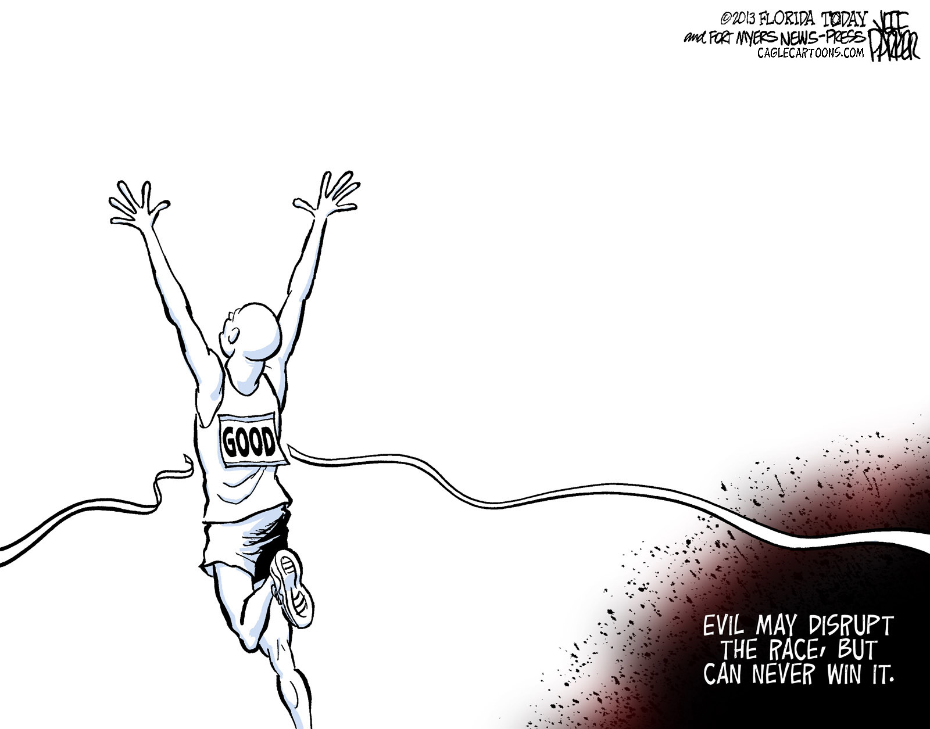
(re-emerging) Terrorism
Lone wolves in the United States
McVeigh was convicted and executed for the April 19, 1995 Oklahoma City bombing, which killed 168 people and injured hundreds with a truck bomb.
1978-1995
Theodore Kaczynski, known as the "Unabomber", engaged in a mail bombing campaign that killed three and wounded 23. He threatened to continue the bombings unless his anti-industrial manifesto was published by the New York Times, which acquiesced.
1996-1998
Eric Robert Rudolph, a Christian Identity adherent, engaged in a series of bombings against civilians in the Southern United States, resulting in the deaths of three people and injuries to at least 150 others. His targets included abortion clinics, gay nightclubs, and the 1996 Olympics in Atlanta
November 5, 2009
Nidal Malik Hasan shot and killed 13 people in an attack at Fort Hood that wounded 30 others.
February 18, 2010
Joseph Andrew Stack III flew a small personal plane into an office complex containing an IRS office in Austi, Texas after posting a manifesto on his website stating his anti-government motives and burning his house. One person other than Stack died; 13 were injured.
►April 15, 2013
Dzhokhar and Tamerlan Tsarnaev set off two pressure cooker bombs at the finish line of the 2013 Boston Marathon and killed three people.

Slide 20

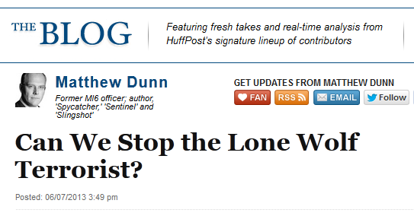
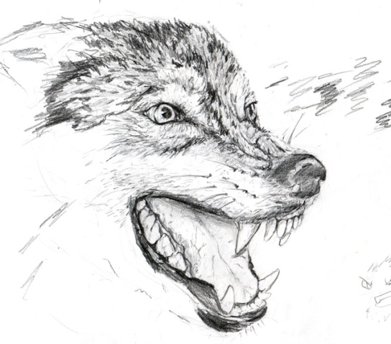
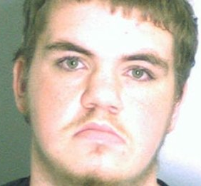

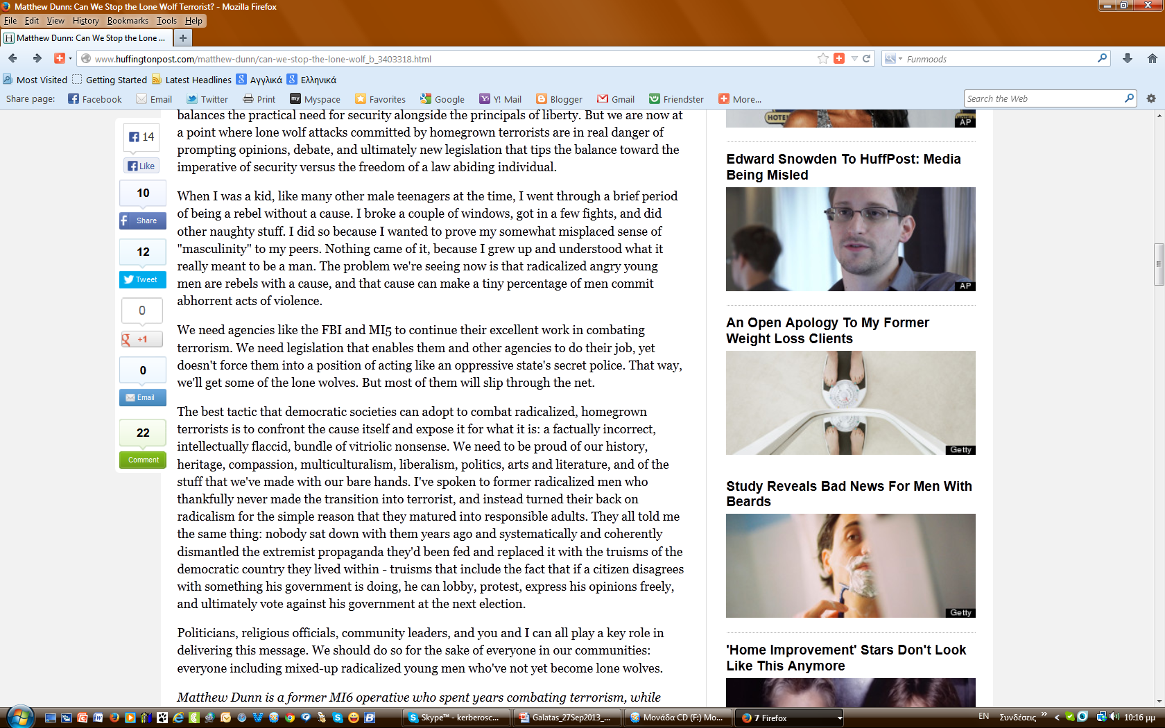
(new?) Terrorism
21 Aug 2013
20-year-old slipped into an elementary school (Decatur, GA) armed with an AK-47 and nearly 500 rounds of ammunition.
Michael Brandon Hill
SCHOOL TERRORISM ?

Slide 21
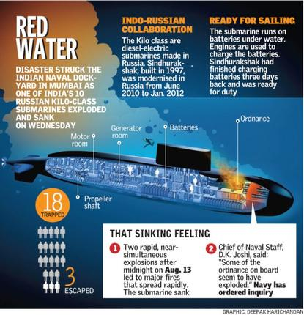
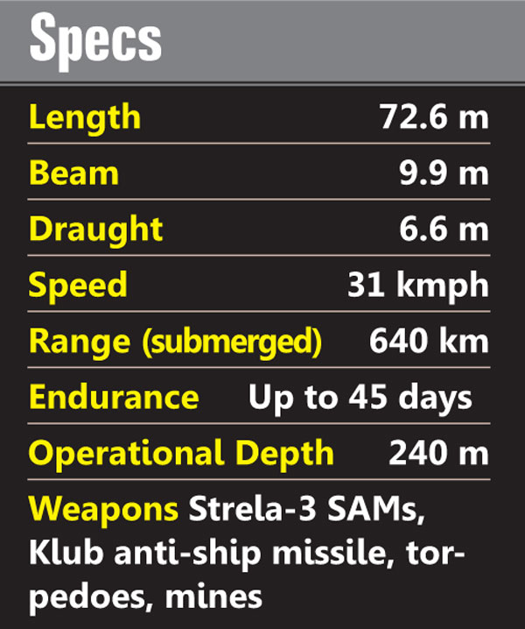
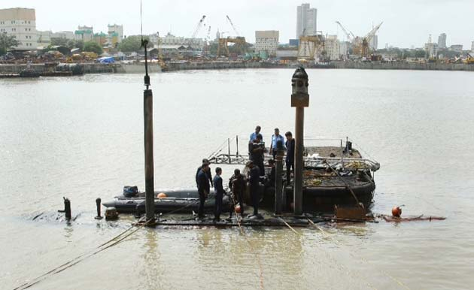
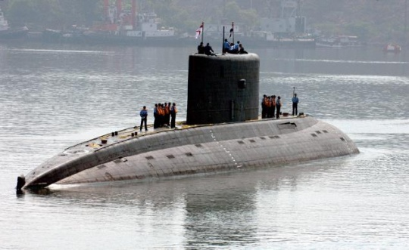

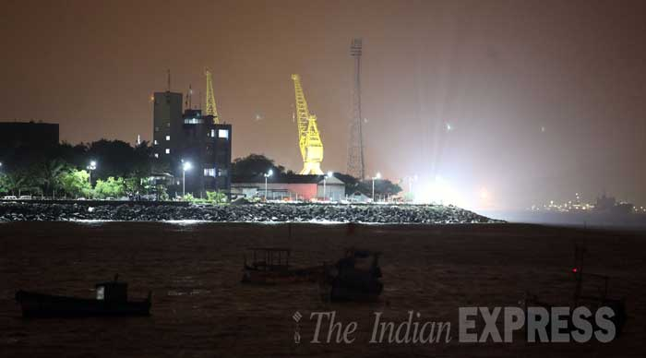
Terrorism
KILO class
13 August 2013
?

Slide 22
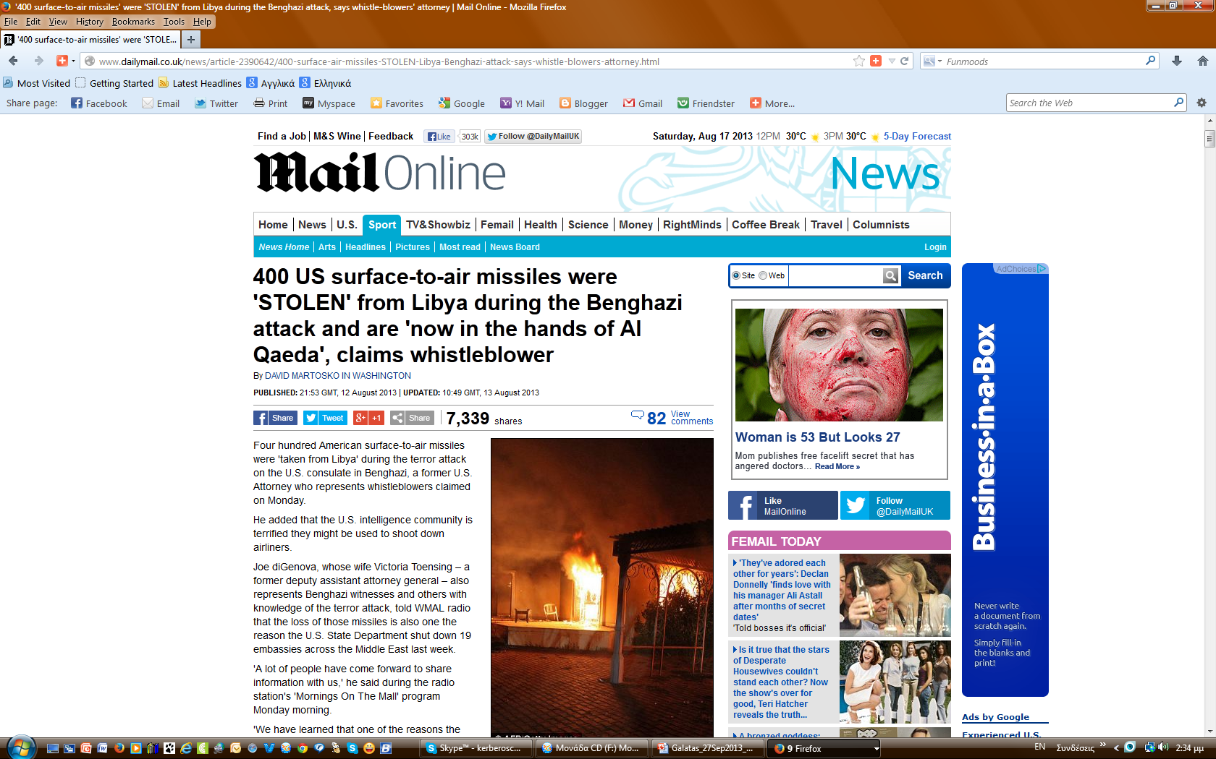



Terrorism
?

Slide 23






The unexpected that always happens…
16 Sept 2013
Washington DC
Twelve people were killed Monday after Texan shooter Aaron Alexis (also killed) opened fire in a rampage at a Navy Yard in the nation's capital
Terrorism?

Slide 24













Terrorism & White AQ
Aug 2013
16 Aug 2013 00:00
Breast implants
suicide bomb threat:
Heathrow on
high alert over
“credible” intelligence
Security has been beefed up after intelligence al-Qaeda is plotting attacks on airlines flying out of London
http://www.mirror.co.uk/news/uk-news/breast-implants-suicide-bomb-threat-2172911
Watch the video
http://www.channel4.com/news/syria-rebels-jihad-british-foreign-assad
http://www.stratfor.com/analysis/european-jihadists-continuation-historical-trend
10:17am UK, Friday 23 August 2013
FBI Director Fears
9/11-Style Attack On US
Robert Mueller says his biggest fear is another plane attack, or that terrorists will use a weapon of mass destruction on the US.
HIGH
http://news.sky.com/story/1132290/fbi-director-fears-9-11-style-attack-on-us

Slide 25







(Economic/financial terrorism)
HIGH
“varied, coordinated and sophisticated, or massive destabilizing actions [undertaken by transnational or non-state actors] to disrupt the economic stability of a state, groups of states,
or society.”
http://www.hlswatch.com/2011/10/21/economic-terrorism/

Slide 26



(Economic/financial terrorism)

Slide 27



Illegal immigration
http://www.theatlantic.com/business/archive/2012/04/americas-secret-growth-weapon-why-immigration-really-really-matters/256294/

Slide 28






Illegal immigration
World coastlines : #11
EU coastlines : #2
Source: CIA – The World Factbook

Slide 29






Illegal immigration
HIGH
January 2013
Hellenic Minister of Justice
Total number of prisoners : 12.475
Foreigners/illegal immigrants : 7.875 (60%)
http://www.eglimatikotita.gr/2013/04/63.html

Slide 30



Population displacement
ELEVATED
HIGH

Slide 31







Piracy – Maritime terrorism
►15 July 2013
143 incidents
7 hijackings
Piracy & Armed Robbery Map 2012
Piracy & Armed Robbery Map 2013

Slide 32



Piracy – Maritime terrorism
*
* Organization for Economic Cooperation and Development (34 countries)

Slide 33



Piracy – Maritime terrorism
Bulk
Carrier
26%
Low rampage
$159,52 mil

Slide 34



Piracy – Maritime terrorism
$16.4 million

Slide 35



Piracy – Maritime terrorism
*
Gulf of Guinea ► 83% of attacks lead to boarding;
Many vessels are attacked while at anchor, drifting,
or conducting ship-to-ship transfers of refined products cargo;
 Only 33% of vessels were attacked while
actively in transit in the GoG region;
Attacks off Somalia almost always occur while
they are underway.
BENIN
NIGERIA
GHANA
TOGO
CAMEROON
* London Market’s Joint War Committee

Slide 36




Piracy – Maritime terrorism
*
* Kidnap & Ransom

Slide 37


Piracy – Maritime terrorism
Nigeria
$23.5 million for 2 patrol boats;
USA
Provided two $460,000 US Coast Guard Defender Class speedboats to Benin’s navy and two $800,000 gunboats to Togo’s navy;
Germany
Donated $35 million worth of vessels to Ghana’s navy

Slide 38








Piracy – Maritime terrorism
5 Nov 2005
MSC Seabourn Spirit
Egypt ➔ Kenya ➔ Singapore
Off shore Somalia
150 passengers + 160 crew
Pirates on two skiffs with machine guns
& one RPG
Activation of response plan + LRAD*
First mate injured (RPG fragments)
28 Feb 2012
Cruiser Costa Allegra*
636 passengers + 413 crew
Fire at engine room immobilized ship
➲ 9 armed guards (Italian Special Forces)
30 Nov 2008
MSC Nautica
Rome ➔ Singapore
Pirate attack at Gulf of Aden
690 Americans, British & Australians + 368 crew
Activation of response plan (high speed maneuvers - successful
RPG shell
25 Apr 2009
MSC Melody
S Africa ➔ Italy
1.000 passengers + 500 crew
180 ΝΜ from Port Victoria (Seychelles)
Pirates on a small speed boat opened fire (~200 rounds)
On board armed guards returned (warning) fires
* Long Range Acoustic Device
* Costa Concordia

Slide 39










Maritime terrorism
27 Feb 2004
Manila Bay (Philippines)
SuperFerry 14
899 passengers + crew
IED explosion
Fatalities:116
T-group: Abu Sayyaf
31 Aug 2013
7 Oct 1985
Italian cruiser Achille Lauro
Alexandria (Egypt) ➔ Port Side
440 passengers
4 Palestinian terrorists (PFLP)
Dead: American-Jewish Leon Klinghoffer (on wheel chair)
Attack brain: Abu Abbas (2004 – Iraq)
11 July 1988
Cruiser City of Poros
471 passengers – Thessaloniki ➔ Piraeus
3 ΝΜ off shore Aegina Island
One of 3 terrorists opened fire against passengers
released a hand grenade and detonated an IED
resulting in fire on ship
Fatalities: 9 Injured: 60
T-group: Fatah – Revolutionary Council Abu Nidal
Before ship attack
Accidental detonation of IED in a car parked at
Port of Piraeus – 4 bombers killed
ELEVATED
S
GUARDED
WA

Slide 40







Tokyo sarin incident (1995)
French Algerian troops German troops
1995
22 April 1915
2nd Battle of Ypres (Belgium)
Germans opened up 5,700 canisters
containing168 tons of chlorine gas
3 million workers and students arrive into Tokyo via the subway
Monday morning 0755 on March 20, 1995 during rush hour
The terrorist group of Aum Syrinkio organized the release of Sarin into 5 subway cars on 3 separate subway lines
169 Hospitals visited by 5,654 patients
➲ 17 critical condition;
➲ 37 severe condition;
➲ 999 moderately ill (vision problems)
Death toll: 12 commuters
16 March 1988
Halabja massacre
Iraq-Iran war (1980s)

Slide 41

















Bioterrorism tsunami
THE BEGINNING…
27 Aug 2013
July 2013 multinational study
Worldwide location of risk areas in case of the intentional release of smallpox virus in London from
5 persons
Apr 2013
UK
Smallpox
Chickenpox
After 2 weeks
◄castor oil plant Ricinus communis
http://www.nature.com/srep/2013/130717/srep00810/full/srep00810.html

Slide 42







Agro-terrorism
The deliberate introduction of a disease
agent, either against livestock or into the food chain, for purposes of undermining stability and/or generating fear.
Hearings Before the Senate Subcommittee on Oversight of Government Management, Restructuring and the District of Columbia, 107th Cong. 1st Sess (2001) (testimony of Peter Chalk on Terrorism, Infrastructure Protection, and the U.S. Food and Agricultural Sector, p. 2).
Average distance 1 pound of meat travels from farm to table in the U.S. is 1,000 miles
Gilmore Commission Report. Forging America's New Normalcy: Securing our Homeland, Protecting our Liberty. Arlington, Va: RAND Corp; 2003: Chap 7.
Most Americans take it for granted that food is readily available and that their food is safe
Chalk P. Hitting America's Soft Underbelly: The Potential Threat of Deliberate Biological Attacks Against the U.S. Agricultural and Food Industry. Santa Monica, Calif: RAND National Defense Research Institute; 2004:33.

Slide 43












Agro-terrorism
Bioterrorism Diseases/Agents
5
Mar 2013
29 Aug 2013
Every year in the United States
Salmonella ►1 million illnesses, 20,000 hospitalizations,
and 400 deaths
Economic cost ►> $3 billion
Salmonella Typhimurium: ~15% human infections
http://news.psu.edu/story/285630/2013/08/29/research/researchers-track-antibiotic-resistant-strains-salmonella-farm-fork
HIGH
3
If you want to destroy a nation, there are two ways to do it: Option one is to damage the economic stability, and option two is to destroy its food supply.
Phillip Harchack, Harchack LLC
3
http://www.keeplancastercountyfarming.com/
►Salmonella Typhimurium
NEW METHOD: clustered regularly interspaced short pallindromic repeats, or CRISPRs
4

Slide 44











Goiania incident (1987)
Goiania (Brazil) – 700,000 inhabitants
1980’s – Cancer Clinic
1985: Clinic closed and abandoned
1987
Scavengers stole a Cesium-137 cylinder
1.400 curies
Cylinder opened and contaminated children
and adults for 1 week
244 people were contaminated
54 hospitalized in serious condition
20 victims exposed to 100-800 rads
 19/20 skin lesions
 20/20 internal radio-contamination
4 died (including two children)
➲ 114,000 citizens were tested
Cancer clinic
HALF LIFE
►Cesium-137: ~ 30.17 years
Cesium-135: 2.3 million years

Slide 45





Near dirty bomb incidents
December 1995
Chechen separatists placed a shielded cancer treatment device containing cesium-137, packaged up with dynamite, in a Moscow park.
Rebels contacted a Russian television station and boasted of their ability to construct a radiological weapon (Chechen separatist leader, Dzhohar Dudayev, stated that he had “a nuclear weapons capability”).
Terrorists alerted the press that they had buried a 13.5-kg cache of radiological materials in Moscow's Ismailovsky Park.
On the very spot the rebels indicated, authorities found a partially buried container of cesium. Dudayev had given the names of three other sites besides Izmailovsky Park where radiological materials had been placed, and stated that these sites also held conventional explosives.
Neither the Chechens who planted it there nor the original source of the cesium has ever been identified.
December 1998
A container emitting high levels of radiation was planted on a railway line. A mine attached to the container was defused, but the identity of the radioactive substance was not revealed.
Dzhohar Dudayev

Slide 46




Nuke Houston !
http://www.gizmag.com/nuclear-bomb-damage-map-nuke/12097/
◄Simulation of a 1KT dirty bomb detonated in Houston

Slide 47




Nuke Houston !

Slide 48




Dirty-man incident
London, UK (2006)
Overall cost
>$6 mil
Alexander Litvinenko
Easy to buy
via Internet
Po-210 concentration in the body of Litvinenko
Symptoms consistent with an administered activity of approximately 2 GBq (50 mCi)
which corresponds to about 10 micrograms of ²¹⁰Po
 X200 times the median lethal dose of ~238 μCi or 50 nanograms in the case of ingestion

Slide 49







Electromagnetic pulse (EMP)
June 19, 2013
If an EMP attack were to occur, 70-90% of the population would be at risk.
In addition to the causalities, those relying on medications, especially refrigerated drugs like insulin, would face grave circumstances.
http://www.usnews.com/news/blogs/washington-whispers/2013/06/19/newt-gingrich-warns-electromagnetic-pulse-could-end-civilizations

Slide 50








Cyber-terrorism/warfare
2010
http://www.pewglobal.org/2013/02/11/china-and-cyber-attacks-a-top-concern-of-u-s-experts/

Slide 51







From NBC to CBRNE
NBC
CBRNe
Can’t
Bother
Right
Now
?

Slide 52





The BIG Question
?
GUARDED
Ayman al-Zawahiri
CBRN
ELEVATED
CYB
RDD
HIGH

Slide 53







CBRNE-Terrorism Newsletter
August 2013
June 2013
Online
distributed
in more than
80 countries
around the globe

Slide 54


Pyro-terrorism
2008
Greek: pyro = pirá = fire
Senior Lecturer in History & Communications
James Cook University, Queensland, Australia

Slide 55




Pyro-terrorism
Feb 2009
SW Australia – Victoria bushfire
Fatalities: 210; injured: ~500
Towns wiped out: Kinglake, Marysville, St Andrews,
Steels Creek, Flowerdale, Strathewen & Narbethong
2,000 homes destroyed;
1,500 other buildings/structures damaged;
7,500 people homeless;
4,500km² (450,000ha) burned out
Millions of animals destroyed;
Threat 1: main electricity transmission lines supplying
Melbourne from the Latrobe Valley;
Threat 2: Hazelwood Power Station;
Insurance payouts: several billion dollars.
“O’ mujahideen everywhere, why don’t you fight the enemy with bushfires such as those ones? Fires which could kill hundreds of them, destroy thousands of their homes, and cause damage worth millions.”
Osama1 – Internet forum

Slide 56





Pyro-terrorism
Greece – Peloponnese August 2007 wildfires
Death toll: 70
Damages: >$7 billion
Government decided to treat the fires as a terrorist attack, mobilizing 6,000 troops, deploying counter-terrorist forces, and offering rewards
►It was pre-election period…

Slide 57








Pyro-terrorism
22 Aug 2009
NE Attica prefecture wildfire
2011
2008
William Scott: Former editor of Aviation Week, former official of the National
Security Agency, and the author of Space Wars.
9:45 am |  | Plenary – Symposium Overview Joseph Brain, Professor of Environmental Physiology, Harvard School of Public Health
10:00 am |  | Session One: What were the consequences of the 2007 forest fires in Greece? Moderator: Athena Linos, Associate Professor of Epidemiology, Department of Hygiene, Epidemiology and Medical Statistics Medical School, National and Kapodistrian University of Athens Margarita Arianoutsou, Associate Professor of Ecology, Department of Ecology & Systematics, Faculty of Biology, National and Kapodistrian University of Athens The Ecological Context of Forest Fires in Greece Panos Efstathiou, M.D., Director, National Health Operation Center, Hellenic Ministry of Health & Social Solidarity The Impact of Greek Forest Fires on the Health Sector in Greece Yiang Liu, Research Associate, Harvard School of Public Health The Impact of Smoke Plumes from the Greek Forest Fires on Air Quality in Athens Col. Ioannis Galatas, MD, MC, Head, Department of Asymmetric Threats, Joint Military Intelligence Service, Hellenic National Defense General Staff Natural Disasters in Greece: Unpredictable Phenomena or Created by Humans? Sofia Karma, Research Associate, National Technology University of Athens
http://news247.gr/kosmos/diethnis-politiki/tourkoi_praktores_ekaigan_ellhnika_dash_gia_antipoina.1551320.html

Slide 58


Pyro-terrorism
www.cbrne-terrorism-newsletter.com
HIGH
June 2013 issue

Slide 59



Organized Crime
“… a structured group of three or more persons existing for a period of time and acting in concert with the aim of committing one or more serious crimes or offences established in accordance with the Convention, in order to obtain, directly or indirectly, a financial or other material benefit.”
Palermo Convention 2000
http://www.humsec.eu/cms/fileadmin/user_upload/humsec/SAc_08_PPP/PPP_Hans_J_rg_Albrecht.pdf
$128 billion
1. MEXICAN CARTELS
2. NORTE DEL VALLE (Colombia – mostly dismantled)
3. COSA NOSTRA (US)
4. NIGERIAN ORGANISED CRIME
5. ITALIAN MAFIA
6. ALBANIAN MOB
7. RUSSIAN MAFIA
8. ISRAELI MAFIA (ecstasy)
9. RED WA (Myanmar-Thailand border)
10. JAO PHO (Thailand)
11. CAMBODIAN ORGANISED CRIME
12. TRIADS (Hong-Kong)
13. HEIJIN (Taiwan)
14. FILIPINO ORGANISED CRIME
15. YAKUZA
http://www.wired.com/magazine/2011/01/ff_orgchart_crime/
www.wired.com

Slide 60

Terrorism & Organized Crime
Similarities
Both are generally rational actors;
Both use extreme violence and the threat of
reprisals;
Both use kidnappings, assassinations, and
extortion;
Both operate secretly, though at times publicly in friendly territory;
Both defy the state and the rule of law (except when there is state sponsorship);
For a member to leave either group is rare and often fatal;
Both present an asymmetrical threat to the US
and “friendly” nations;
Both can have “interchangeable” recruitment pools;
Both are highly adaptable, innovative and
resilient;
Both have back-up leaders and foot soldiers;
Both have provided social services, though this is much more frequently seen with terrorist groups
Differences
Organized crime groups don’t care about religious or ideological tenets;
Different appraisal of corruption;
Opposed attitude toward attention;
Political vs. non-political motivations;
Terrorist groups often compete with governments for popular support, while organized crime does not;
Terrorist groups are generally less discriminating about their targets
“This lethal cocktail, consisting of one part
criminal, one part terrorist and one part weak
or corrupt state, poses a formidable and
increasingly powerful challenge to US and
global interests”
Sanderson, T. M. (2004). Transnational Terror and Organized Crime: Blurring
the Lines. SAIS Review, 24(1):49-61.

Slide 61





Transformation
Crime ►Terrorism
In the drug trade, those who are in charge of refining and distributing the drug tend to share the largest proportion of the profit, while producer groups receive the least profit. In this case, narcotics production and trafficking in the Central Asian are often cited as one significant factor for the rise of the Islamic Movement of Uzbekistan and the Taliban and Al-Qaeda
Shelley, L. I. (2002). The Nexus of Organized International Criminals and Terrorism. International Annals of Criminology, P1-6.
Terrorism ►Crime
Provisional Irish Republican Army (IRA) encouraged its members to involve in criminal activities (policing, bank robbery, fuel laundering and kidnapping) in order to raise funds for organizational needs, rather than ally with any other organized criminal organizations.
David, L. & Sean, O. (2005). IRA plc turns from terror into biggest crime gang in Europe. The Times, 25 February.
Diarmaid, M. & Bronagh, M. (2008). IRA kidnap gang 'captured' seven gardai and soldiers. Irish Independent, 14 June.
Jim, C. (2008). Fuel-laundering still in full swing. Irish Independent, 25 February.
Terrorism = Crime
Cooperation between Somalia's al Qaeda linked militants and pirate gangs is growing as the al Shabaab group becomes more desperate for funding.
Colonel John Steed, Head UN’s Counter-piracy Unit (2011)

Slide 62
Linkages
Tactical Alliances
Irish Republican Army (IRA) and FARC in bomb making training
Sanderson, T. M. (2004). Transnational Terror and Organized Crime: Blurring the Lines. SAIS Review, 24(1):49-61.
Italian Red Brigades and the Naples Camorra (1980s) to kill or kidnap a number of police officers and senior politicians
Dishman, C. (2001). Terrorism, Crime, and Transformation. Studies in Conflict & Terrorism, 24: 43-58.
International drug trade operations
Colombian Medellin cocaine cartel hired National Liberation Army (ELN) guerrillas to plant car bombs in 1993
Clawson, P. & Lee, R. (1996). The Andean Cocaine Industry. New York: St. Martin’s Press.
Russian criminal groups sent massive quantities of weapons to Colombia for exchanging cocaine
Makarenko, T. (2004). The Crime-Terror Continuum: Tracing the Interplay between Transnational Organized Crime and Terrorism. Global crime, 6(1): 129-145.
Strategic Alliances
Central Asia: drug mafias ►transnational organized crime ►terrorist groups (IMU, Taliban, AQ)
Chechnya: Moscow-based Chechen Mafia + Grozny-based Chechen guerrillas ►Chechen war
Menon, R. & Fuller, G. E. (2000). Russian’s Ruinous Chechen War. Foreign Affairs, 79(2): 32-44.

Slide 63






Trafficking hub
Tri-Border Area has one of the most important Arab communities in South America;
Of the Arab population in Ciudad del Este and Foz do Iguaçu, an estimated 90% is of Lebanese origin;
Extremist cells tied to al Qaeda, Hizballah, Al-Jihad (Egyptian Islamic Jihad), al-Muqawamah
Ciudad del Este
Foz do Iguaçu
Puerto Iguazú
Narco-Terrorism Nexus
in the Amazon forests ?

Slide 64






Radio-trafficking
2004
Each kilogram of the material confiscated contained 80 grams of U and 750 grams of Th
600 kg
IAEA INCIDENT AND TRAFFICKING DATABASE (ITDB)
2013 Fact Sheet
Confirmed incidents involving theft or loss (1993-2012)
Industry (construction & mining)
Medical applications
The Russian Mafia is not willing to ally with terror groups or involve in the CBRN market
Dishman, C. (2001). Terrorism, Crime, and Transformation. Studies in Conflict & Terrorism, 24: 43-58.

Slide 65










Drug & small arms trafficking
ELEVATED
Is Afghanistan destined to be run by a drug mafia?
By Ron Moreau
Helmand
Helmand
06.12.13
The insurgency is earning upward of $200 million annually from the drug trade.
254
HIGH
Why?

Slide 66



Accidents - nuclear
26 Apr 1986
International Journal of Cancer (2006)
The risk projections suggest that by now Chernobyl may have caused about 1,000 cases of thyroid cancer and 4,000 cases of other cancers in Europe, representing about 0.01% of all incident cancers since the accident. Models predict that by 2065 about 16,000 cases of thyroid cancer and 25,000 cases of other cancers may be expected due to radiation from the accident, whereas several hundred million cancer cases are expected from other causes.
http://onlinelibrary.wiley.com/doi/10.1002/ijc.22037/abstract
31 deaths: attributed to the accident, all among the reactor staff and emergency workers.
►UNSCEAR report (2008): 64

Slide 67





Accidents – chemical
500,000
people
exposed
June 2010
7 ex-employees (including former UCIL chairman),
were convicted in Bhopal of causing death by negligence and sentenced to 2 years imprisonment and a fine of about $2,000 each…

Slide 68






Accidents – chemical
2012
Houston
5 security issues related to chemicals:
1. Release
2. Theft or Diversion
3. Sabotage or Contamination
4. Critical to Gov Mission
5. Critical to National Economy
Houston
http://www.dhs.gov/how-appendix-chemicals-interest-was-developed

Slide 69





Accidents – chemical
17 April 2013
Explosion at West Fertilizer Company ammonium nitrate storage and distribution facility in West, Texas, 18 miles north of Waco while emergency services personnel were responding to a fire at the facility.
15 people killed
>160 injured
>150 buildings damaged/destroyed.
Ammonium nitrate was also the explosive used
in the Oklahoma City bombing (19 Apr 1995)
which killed 168 individuals.

Slide 70




Naval chemical accidents
1947
Cargo ship Grandcamp violently exploded in the port of Texas City with its cargo of ammonium nitrate
Killed: 600
Injured: >3,000
1974
Gas carrier Yuyo Maru N°10 collided with the Pacific Alice in Tokyo Bay. Crash cracked its hull and its cargo of naphtha ignited
5 members of the Yuyo Maru N°10 crew were killed
Pacific Alice: all the seamen but one were killed
Accidents between 1998 and 2007 in the Mediterranean involving hazardous and noxious substances
(Source: REMPEC)
http://www.cedre.fr/en/spill/synopsis_chemical.php

Slide 71





Sea chemical accidents & spills
April 2010 – Deepwater Horizon oil spill
Location: Gulf of Mexico on the BP Macondo Prospect
Largest accidental marine oil spill in the history of the petroleum industry
8% - 31% larger in volume than the earlier Ixtoc I oil spill (3 Jun 1979)
Explosion and sinking of the Deepwater Horizon oil rig
 11 dead; sea-floor oil gusher for 87 days
Capped: 15 July 2010
►Total discharge: ~4.9 million barrels (210 million US gal; 780,000 m³)
HIGH

Slide 72
combined
GTA
natural
man-made

Slide 73





Combined disasters
M9.0

Slide 74




Combined disasters
Aug 2013

Slide 75




Combined disasters
Aug 2013
HIGH
http://www.greenpeace.org/international/en/news/Blogs/nuclear-reaction/fukushima-clean-up-costs-hit-58-billion/blog/46132/

Slide 76
Governance
combined
GTA
natural
man-made

Slide 77




Governance
EUROPE
On the surface, Europe will appear relatively quiet
Growing unemployment adds to Europe's existential crisis;
EU members tackle domestic agendas;
 FR: relations with D; D: elections, I: constitutional reform;
GR: Golden Dawn rise; ES: pensions reform; PL: political turmoil
AT: Euroskeptic Team Stronarch Party (elections)
Central Europe (HU, RO) moves to defy Brussels;
Evolving of new strategic alliances (GR-CY-IL)?
RUSSIA
Russia continues its (business-energy) strategy with Europe;
Pressures grow within the Kremlin (Gazprom’s monopoly – foreign investments);
Moscow's continuing influence (energy – pipelines) in its former Soviet Territories;
Political and financial turmoil in Central Asia (Tajikistan: Nov elections)
EAST ASIA
China's economic woes (new model) remain difficult but manageable;
Japan grows more competitive (economy – military);
China's reverberations around the region (Vietnam, Myanmar – rising
violence between Buddhists and Muslims);
N Korea remains unpredictable
HIGH

Slide 78


Governance
MIDDLE EAST
Syria's stalemate becomes more deadly;
Iraq remains restive;
Domestic troubles distract Turkey;
 might loose 2020 Olympic Games due to riots;
New leadership takes over in Iran;
Egypt's continuing crisis;
 Sinai's peninsula is becoming terrorists new playground;
Algeria's Presidential succession plans (2014) amid security threats;
Violent power struggles in Libya (Tripoli vs. militia groups)
 affect energy production
SOUTH ASIA
(US) Negotiating with the Afghan Taliban;
 Pakistan's delicate position (US →PK← Taliban);
India continues diplomatic efforts amid domestic difficulties;
Bangladesh endures unrest ahead of elections (local – Oct; national – 2014);
Sri Lanka's Tamil issue (regional autonomy) takes center stage
HIGH

Slide 79


Governance
LATIN AMERICA
Mexico focuses on reforms (energy) and security (drug cartels);
Venezuela contends with economic problems;
Colombia focuses on peace talks (FARC) and attracting investments;
Brazil's government attempts to placate protesters (2014-2015 mega events);
Tensions grow within Argentina's government (judiciary – banking system);
Complications develop within MERCOSUR*
 Paraguay's come-back, Bolivia & Equator: new members
SUB-SAHARAN AFRICA
South Africa focuses on strikes;
 mining sector (platinum, gold & diamond)
Political strife could hamper development in Mozambique;
natural gas coal industries vs. RENAMO (Mozambican National Resistance)
Mali Progresses as U.N. takes over stabilization efforts;
Nigeria's fight against militancy (Boko Haram & Ansaru) continues;
Sudanese-South Sudanese tensions (energy dispute) endure;
Somalia’s instability continues
* Mercado Común del Sur = Argentina, Brazil, Paraguay, Uruguay, Venezuela, Bolivia

Slide 80





GLOBAL THREAT ASSESSMENT
(Terrorism)
(Syria)
(Iran)
(N Korea)
(CBRN)
SEVERE
Assessment valid ONLY
for Nov 11th,, 2013
Terrorism
Climate change
Desertification
Wildfires
Pyro-terrorism
Illegal immigration
Economic terrorism
HIGH
Earthquakes
Floods
Hurricanes & storms
Population displacement
Piracy (W Africa)
RDDs + Cyber
ELEVATED
Asteroids & solar storms
Volcanic eruptions
Tsunamis
Ice melting
Snow storms
Extreme heat
Demographics
Pandemics
GUARDED
LOW

Slide 81






REE – from iPhones to missiles
Dysprosium
produces
the strongest magnet in the world;
Terbium
reduces power use for low-energy light bulbs by almost half
13 Aug
2013
http://www.nature.com/srep/2013/130813/srep02421/full/srep02421.html
Apr 2012

Slide 82



Thank you for your attention !
LOW
HIGH
ELEVATED
igalatas@yahoo.com

