Slide 1


Brig Gen (r) John GALATAS, MD, MA, MC (Army)
Consultant in Allergy & Clinical Immunology
CBRNE Planner & Instructor
Senior Asymmetric Threats Analyst
Athens, Greece
11 November 2013
Global Threat Assessment
Houston, TX

Slide 2



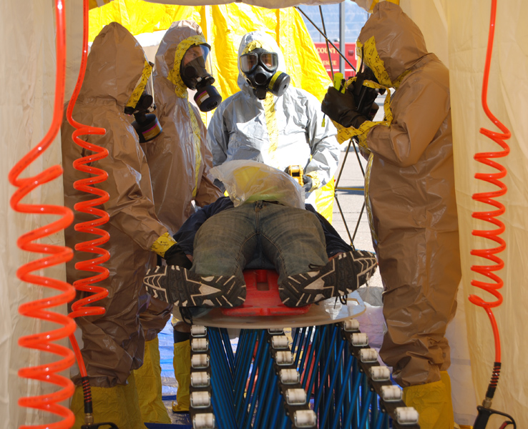
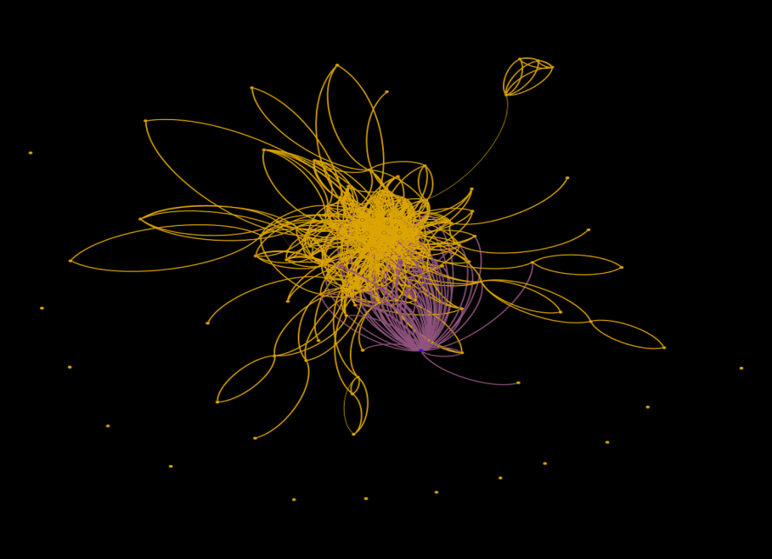
Short bio
Medical
.
+35yrs in military industry
Service: Army Medical Corps
Retired: Aug 2012
Rank: Brigadier General (MD)
Medical Specialty
Allergy & Clinical Immunology (BCert)
+20yrs of hospital experience
Head of Department of Allergy & Clinical Immunology, Army General Hospital of Athens
CBRNE
Brig Gen (ret’d)
Ioannis (John) Galatas, MD
+10yrs CBRNE experience (planning, Ops)
Author, 2004 Olympic Games CBRN Defense Plan
Commandant, Olympic Hospital CBRN Response Unit (2004 Olympiad)
Trained in UK, CH, CZ, SK, IR
Live-agent training (CZ)
Certified CBRN Instructor (Swiss Army)
Editor-in-Chief: CBRNE-Terrorism Newsletter (since Nov 2005)
Intelligence Analysis
Last post: Head, Department of Asymmetric Threats, Intel Analysis Branch, Joint Military Intelligence Service, Hellenic National Defense General Staff
MA degree: “International Terrorism, Organized Crime & Global Security” – Coventry University, UK (Nov 2010)
PhD cand (2012-): Department of Forensics & Toxicology, Athens’ Medical School

Slide 3
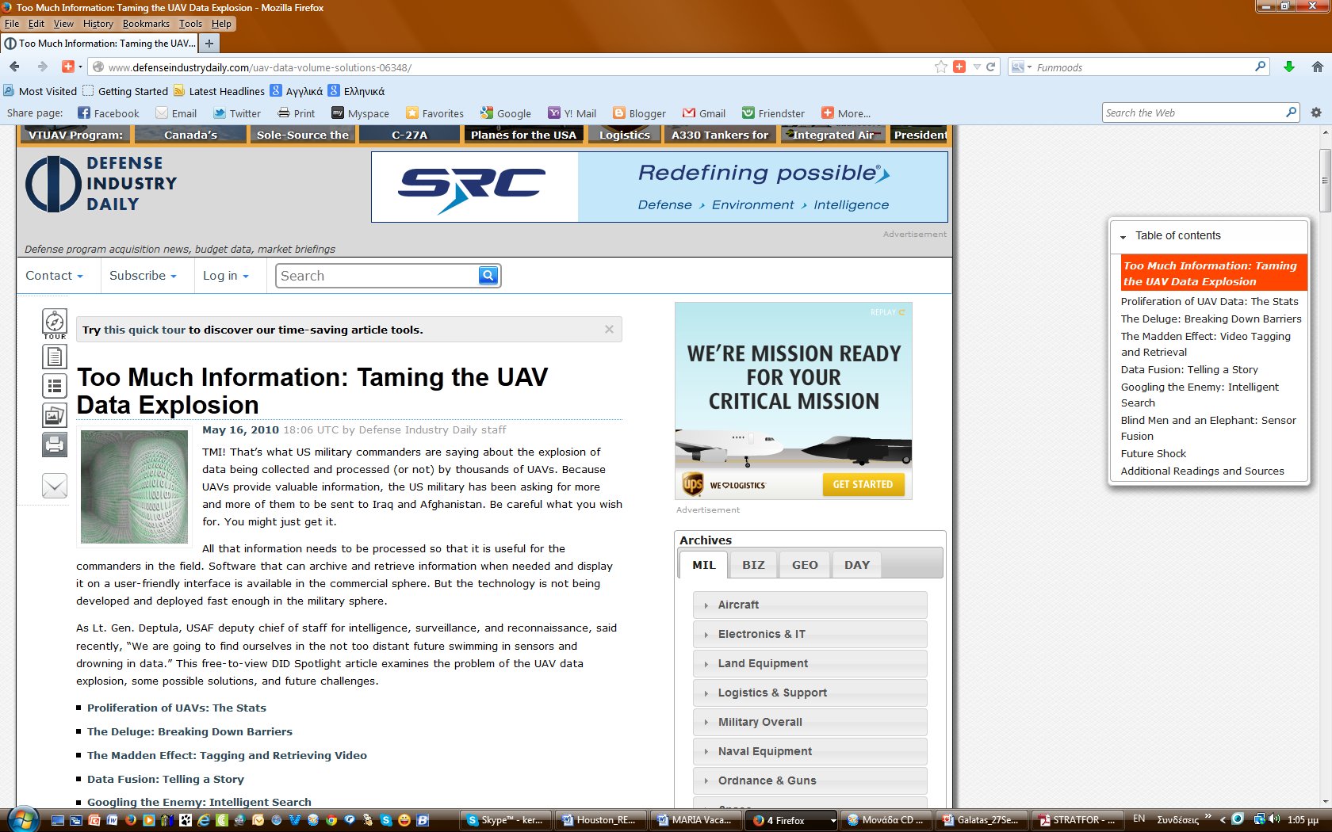
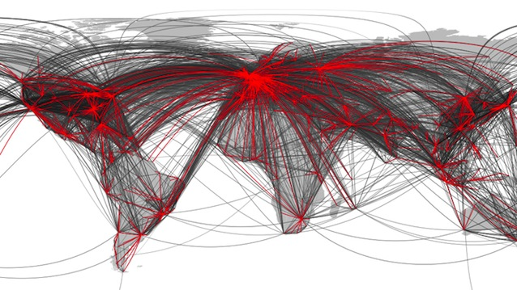

Why connecting the dots?
2010
2009
US UAVs alone generated
24 years’ worth of video
if watched continuously !
2011
New UAV models
are expected to produce
30 times as much information !
“We are going to find ourselves in the not too distant future swimming in sensors and drowning in data.”
Lt Gen Deptula, USAF – Deputy Chief of Staff IS&R
http://www.defenseindustrydaily.com/uav-data-volume-solutions-06348/

Slide 4
Outline
GTA
Terrestrial
GTA
Natural
T-GTA
Man-made
T-GTA
Extra
Terrestrial
GTA
Combined
T-GTA
Governance
T-GTA

Slide 5
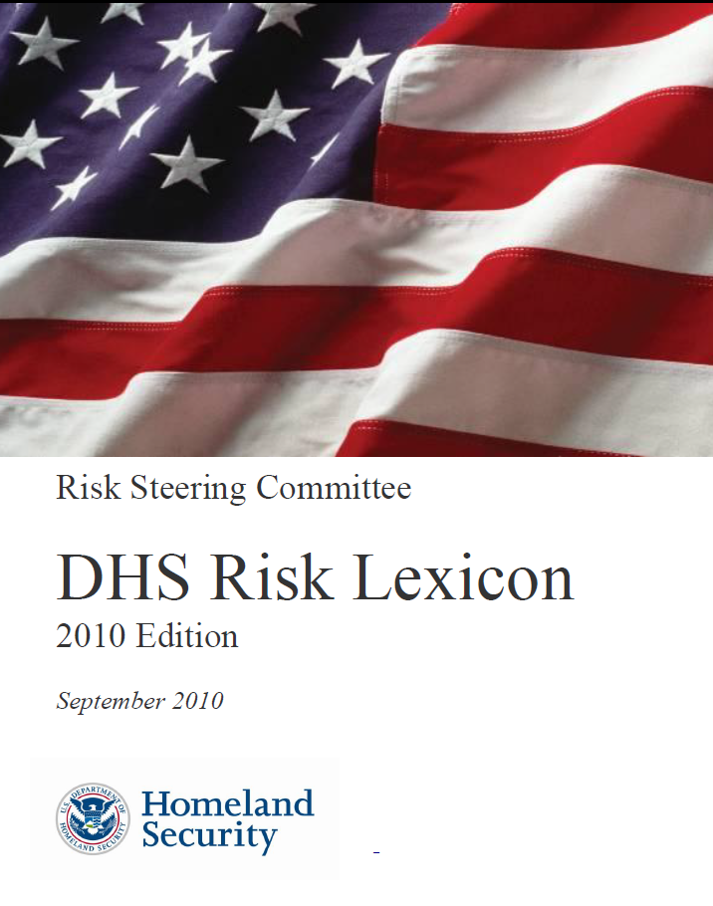
Definitions
THREAT
Natural or man-made occurrence, individual, entity, or action that has or indicates the potential to harm life, information, operations, the environment and/or property
NOTE
For the purpose of calculating risk, the threat of an intentional hazard is generally estimated as the likelihood of an attack (that accounts for both the intent and capability of the adversary) being attempted by an adversary;
For other hazards, threat is generally estimated as the likelihood that a hazard will manifest.
THREAT ASSESSMENT
Process of identifying or evaluating entities, actions, or occurrences, whether natural or man-made, that have or indicate the potential to harm life, information, operations and/or property
Example ►Analysts produced a threat assessment detailing the
capabilities of domestic and foreign terrorist organizations
to threaten particular infrastructure sectors.
http://www.dhs.gov/dhs-risk-lexicon

Slide 6
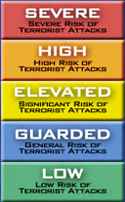




Visualization of threat assessment
Imminent Threat Alert
Elevated Threat Alert
Sunset Provision
SEVERE
HIGH
ELEVATED
GUARDED
LOW
Severe Risk High Risk Elevated Risk General Risk Low Risk

Slide 7



EXTRATERRESTRIAL
GTA

Slide 8

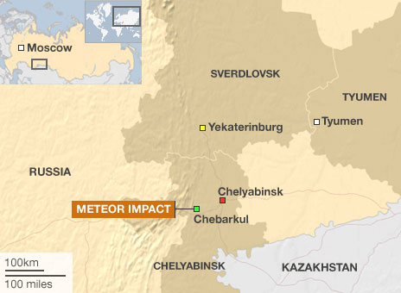
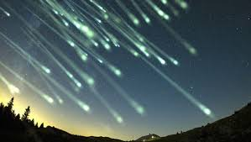
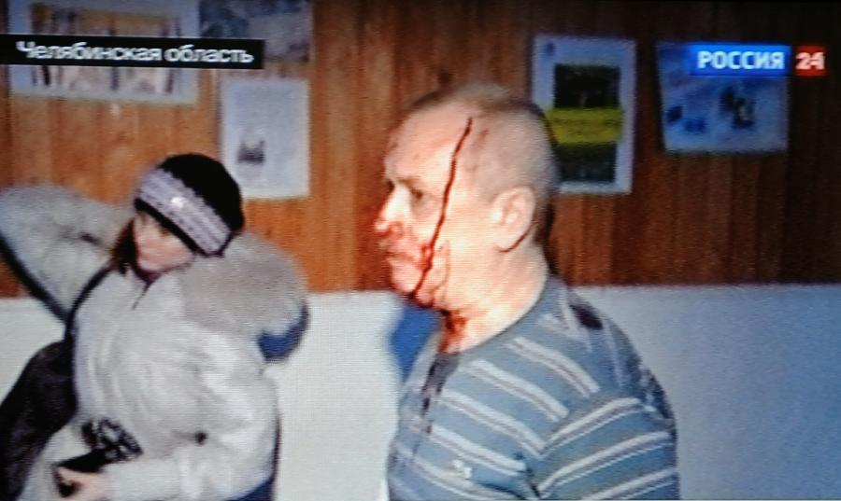
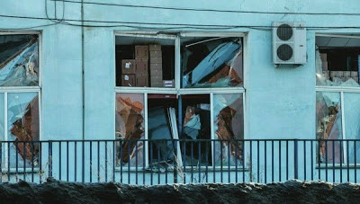
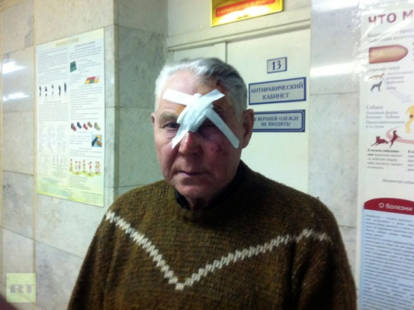
Meteor attack
15 February 2013
►Undetected (?) asteroid entered Earth's atmosphere
over Russia
Size: 17-20m
Initial mass: ~10,000T
Speed: over 41,000 mph (X60 speed of sound)
Chelyabinsk meteor exploded at 76,000 feet
Energy released: ~440 kilotons of TNT
X20–30 Hiroshima bomb
~1,500 people (331 children) injured (broken windows)
~ 7,200 buildings in six cities
Area temperature: −15°C (5°F)
Previous event: Tunguska meteor, Siberia forests (1908)

Slide 9

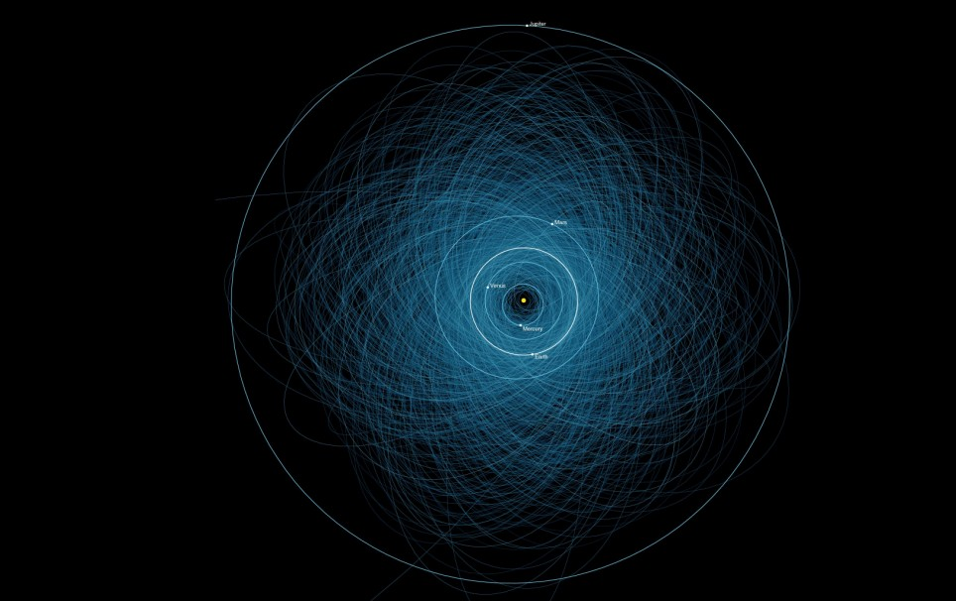
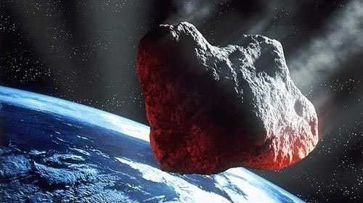
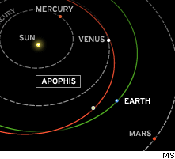
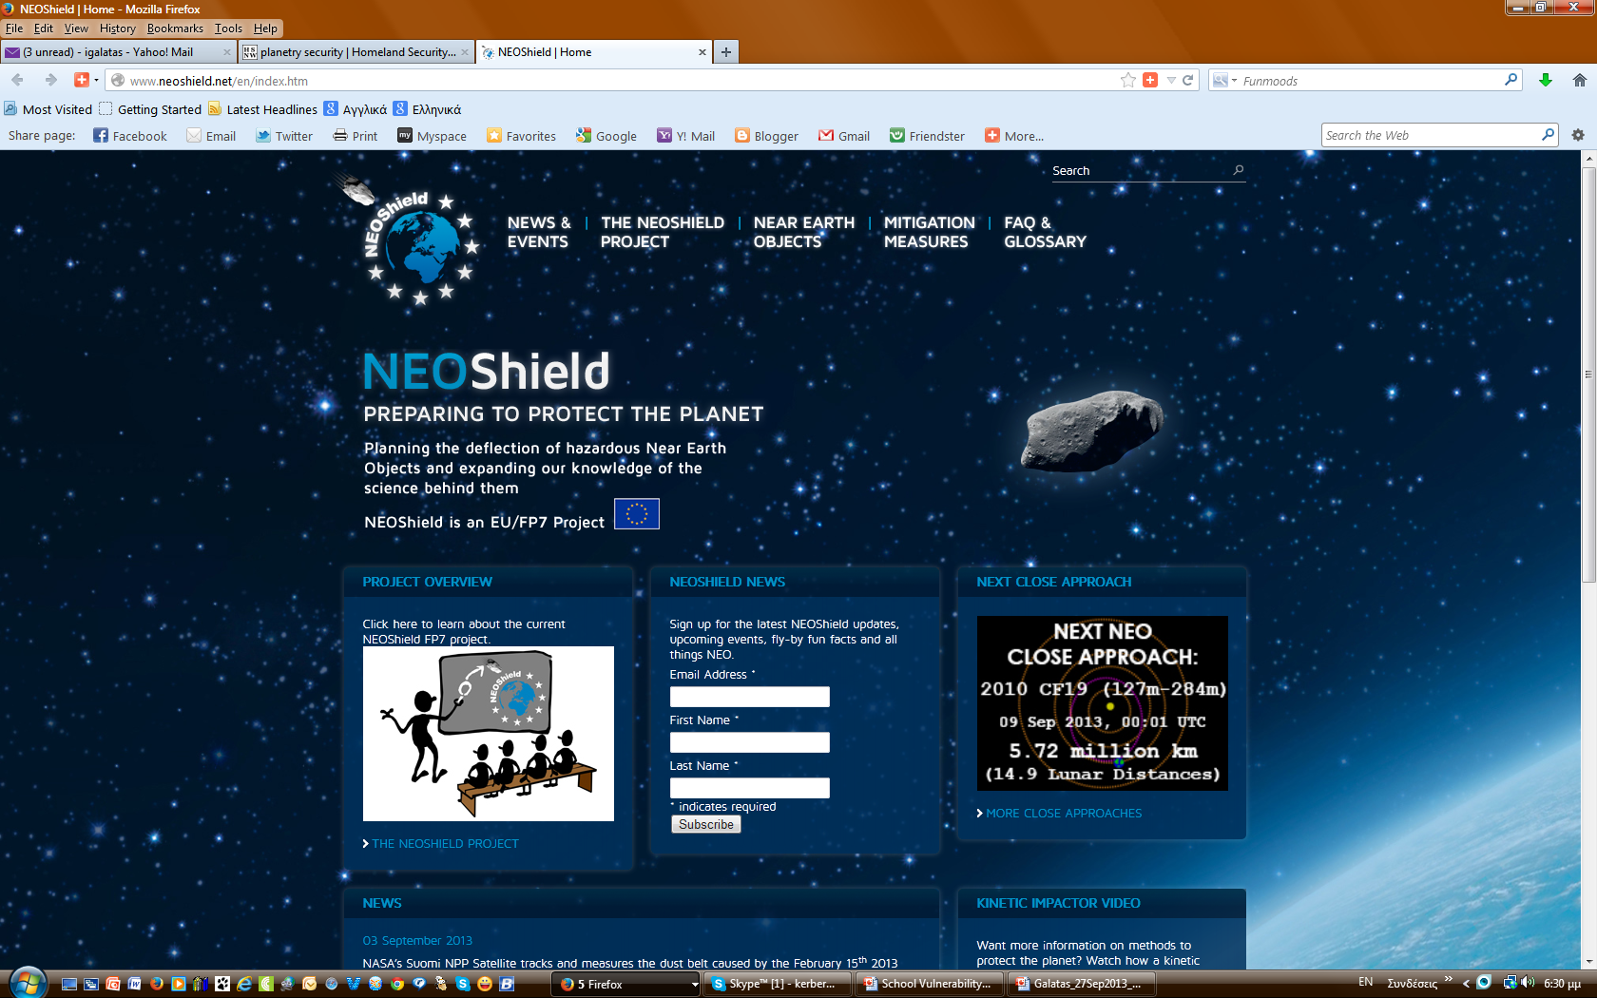

Asteroid attack
August 2013
99942 Apophis
2029 close encounter with Earth
IF passes through a gravitational keyhole (800 m – ½ mile wide)
Future impact ► April 13, 2036
GUARDED
www.neoshield.net
DE
FR
UK
US
ES
RU
Known Potentially Hazardous Asteroids
Number : over 1,400 (as of early 2013)
Size : at least 460 feet / 140 meters
Orbit : close to the Earth's orbit

Slide 10
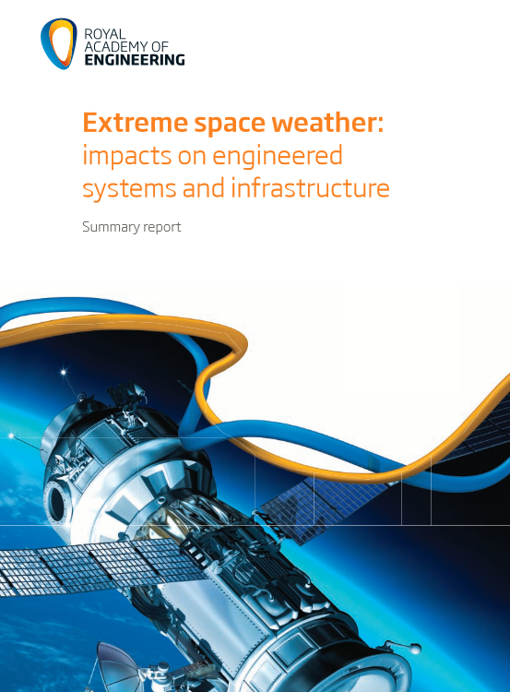
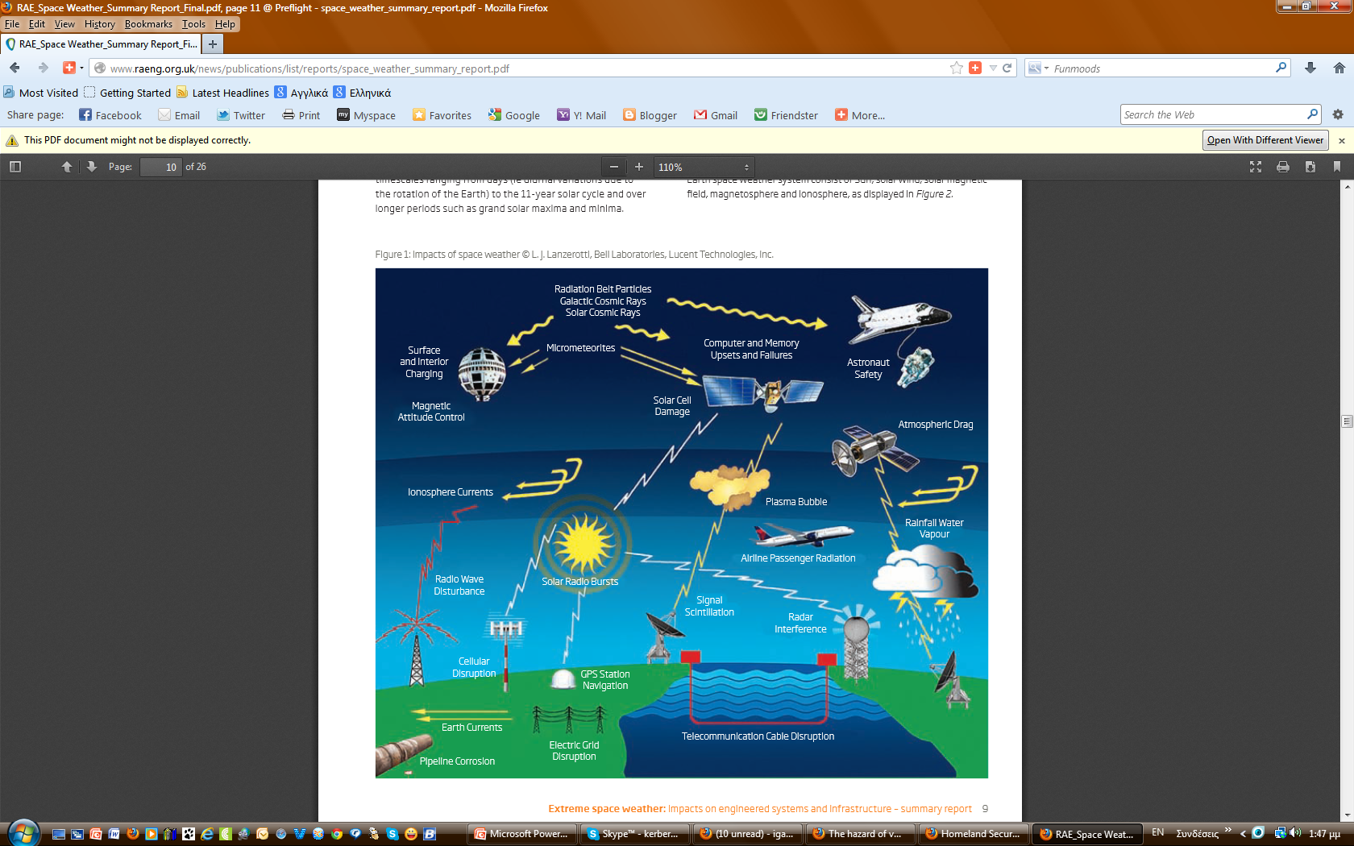

Solar storm
Electricity grid
Damages
6 super grid transformers in England & Wales
7 grid transformers in Scotland
Repair time: weeks-months (= electricity interruptions)
Aircraft passenger and crew safety
Passengers & crew airborne
 additional dose of radiation up to 20 mSv
►in excess of the 1 mSv annual limit for the public
►~X3 times dose from a chest CT scan
 increased cancer risk of 1 in 1,000 (lifetime risk: 30%)
GUARDED
Cellular and emergency communications
UK’s commercial cellular communications networks
 resilient; not reliant on GNSS* timing (US)
UK ‘s TETRA** emergency communications network
 dependent on GNSS.
February 2013
* Global Navigation Satellite System; ** Terrestrial European Trunked Radio Access

Slide 11

TERRESTRIAL
GTA

Slide 12



combined
GTA
natural
man-made

Slide 13
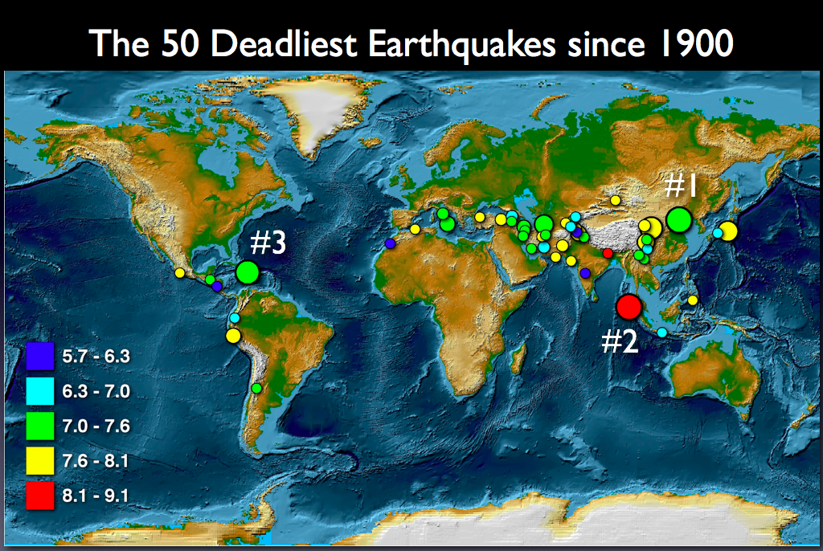
Earthquakes
#1 — Tangshan, China M 7.5; 1976 ►255,000 deaths;
#2 — Sumatra M 9.1; 2004 ►228,000 deaths;
#3 — Haiti M 7.0; 2010 ►222,000 deaths

Slide 14
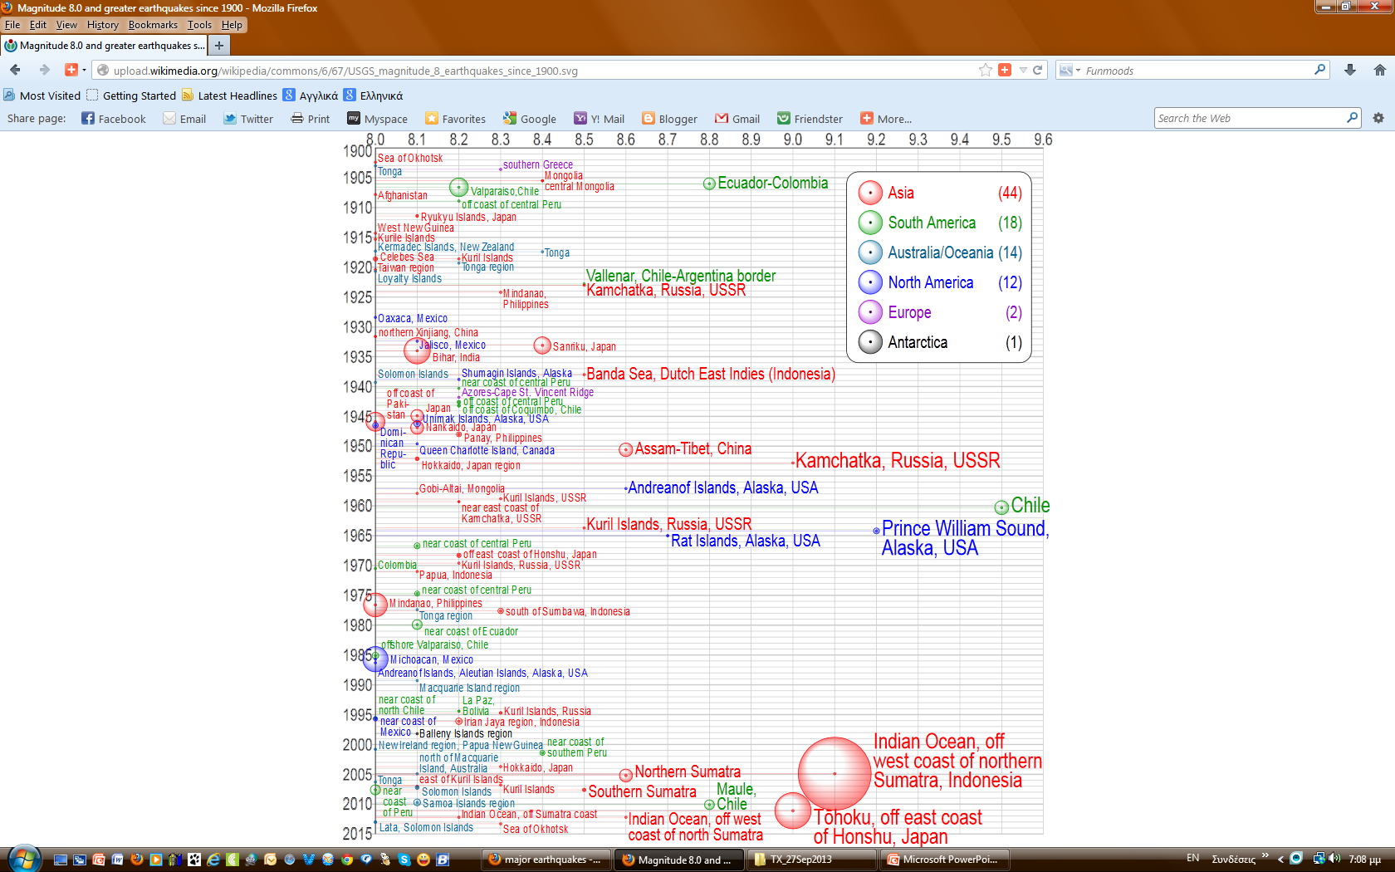
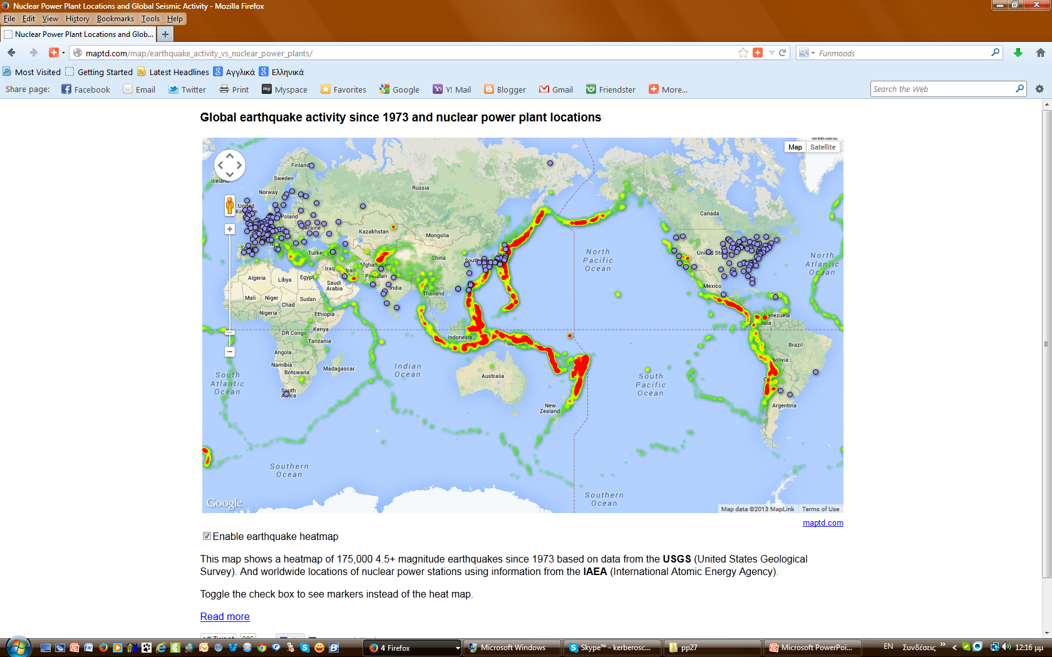
Earthquakes
ELEVATED
HIGH
Bubbles
are linearly proportional
to their respective fatalities
http://earthquake.usgs.gov/earthquakes/eqarchives/year/mag8/magnitude8_1900_date.php

Slide 15
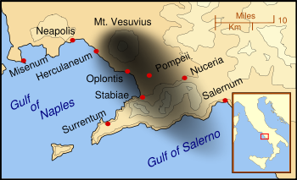
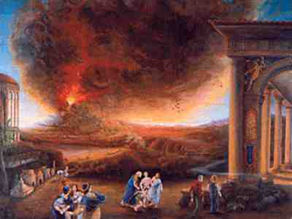
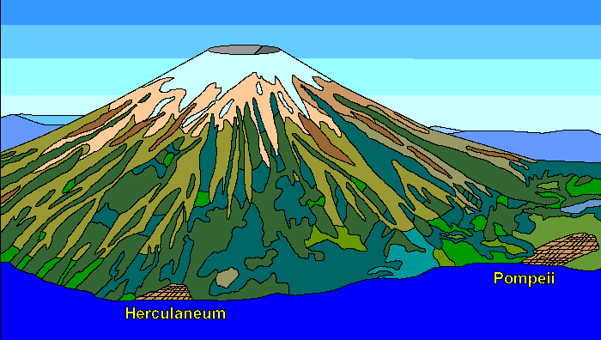
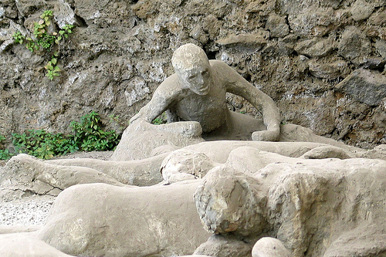
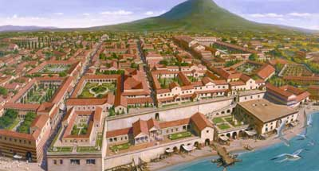
Volcanic eruptions
AD 79

Slide 16
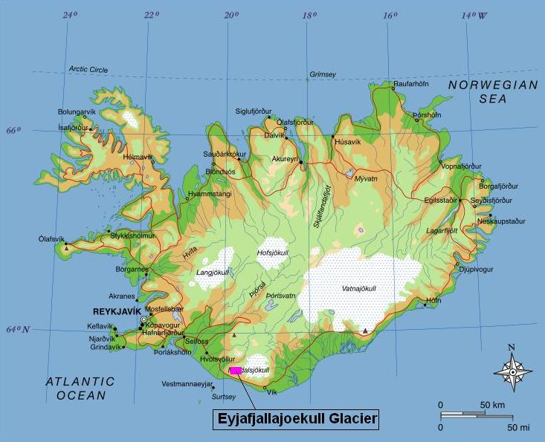

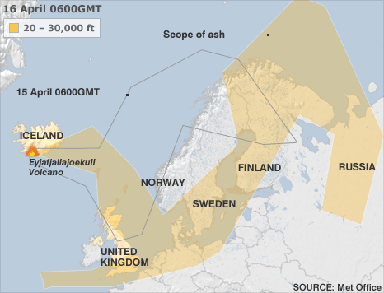
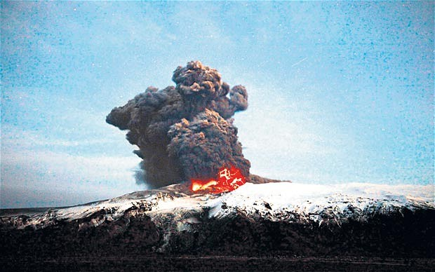
Volcanic eruptions
2010
Iceland: eruption of Eyjafjallajökull volcano
Activity: Dormant for 200 yrs
Eruption: relatively small
Ash: enormous affecting air travel (14-20 April)
Affected areas: NW Europe
Consequences
20 countries closed their airspace to commercial
jet traffic
>100,000 travelers affected
End of activity: October 2010
Airlines: $200 million a day
 Not insured for this type of loss
Travel industry: $5-10 billion a week
Density of dry volcanic ash
Dry ►1.4g/cm^{3;} Wet ► 2g/cm³

Slide 17
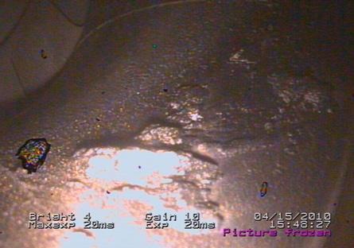

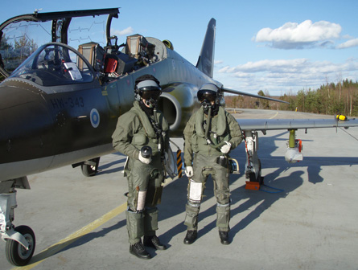
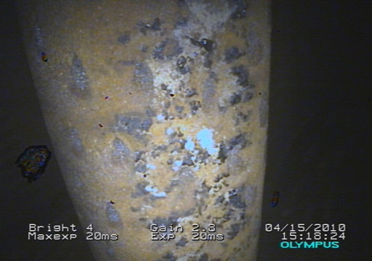
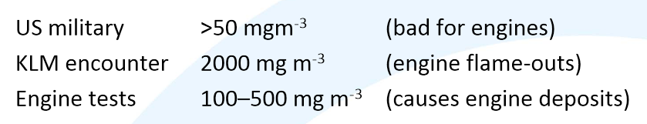
Volcanic eruptions
15 Apr 2010
5 Finnish Air Force F-18 Hornet fighters were involved in a training exercise just hours before the imposition of airspace restrictions due to the ash cloud spreading from Iceland’s volcanic eruption.
http://earth.eo.esa.int/workshops/Volcano/files/4_PrataTalk1.pdf
Volcanic ash damages aircraft engines
engine failure due to:
(1) erosion of compressor blades;
(2) plugging of cooling circuits,
(3) accumulation on turbine nozzles
http://www.mi2g.com/cgi/mi2g/frameset.php?pageid=http%3A//www.mi2g.com/cgi/mi2g/press/190410.php

Slide 18
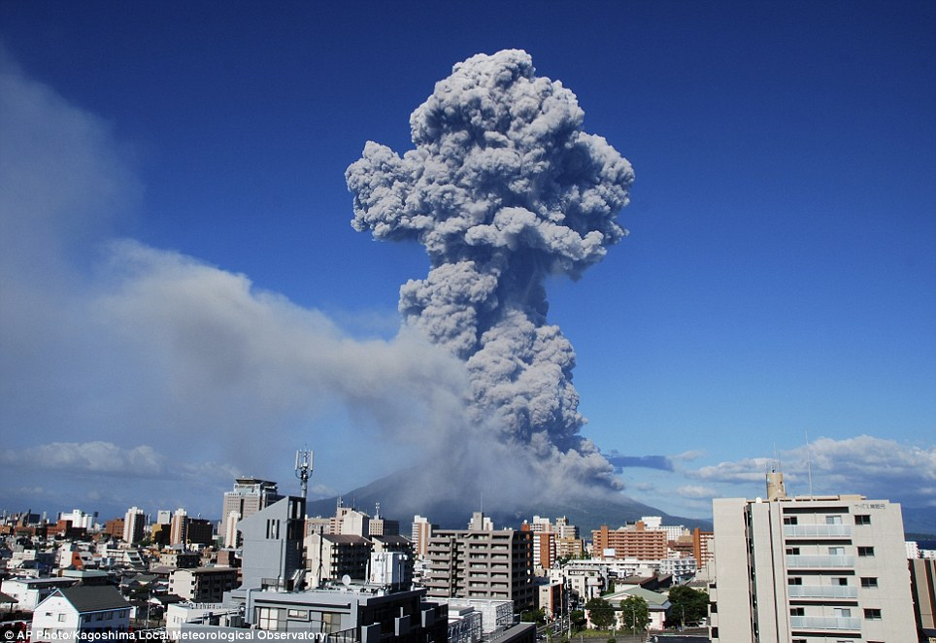
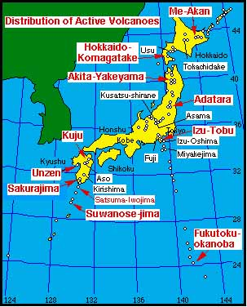
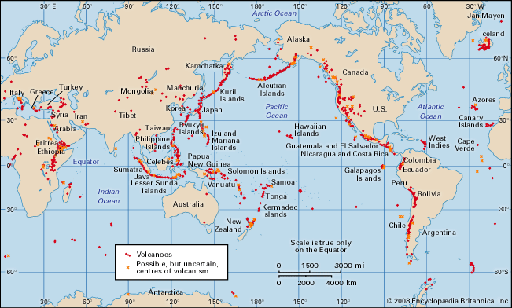
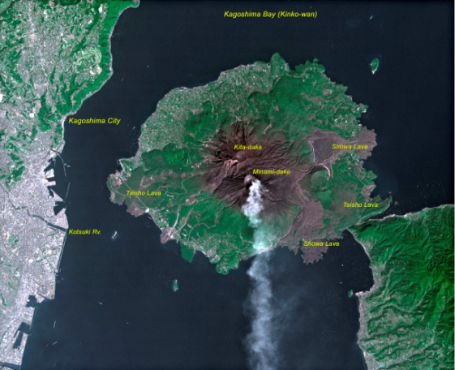
Volcanic eruptions
19 Aug 2013 – Sakurajima volcano (Japan)
GUARDED

Slide 19
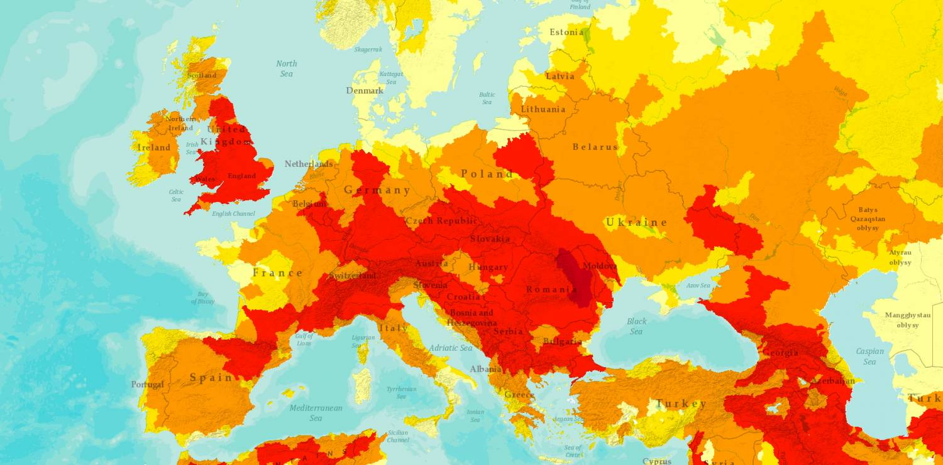
Floods
2013

Slide 20
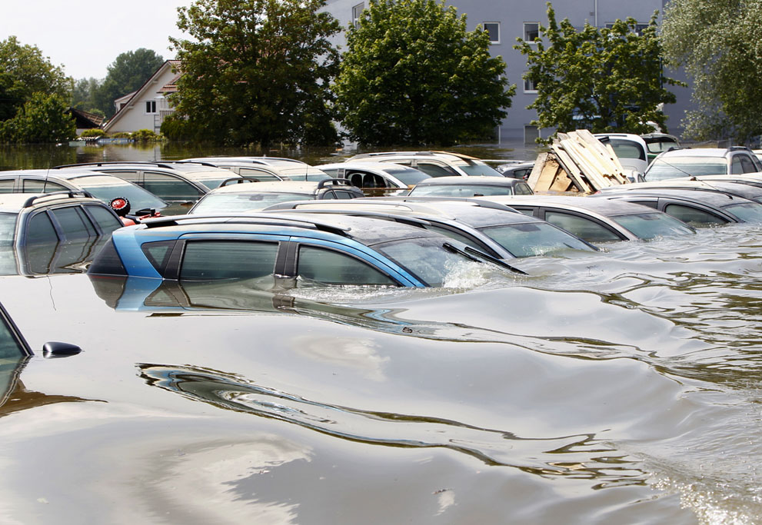
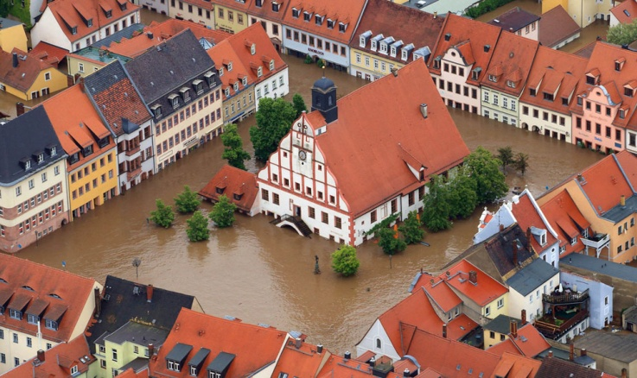
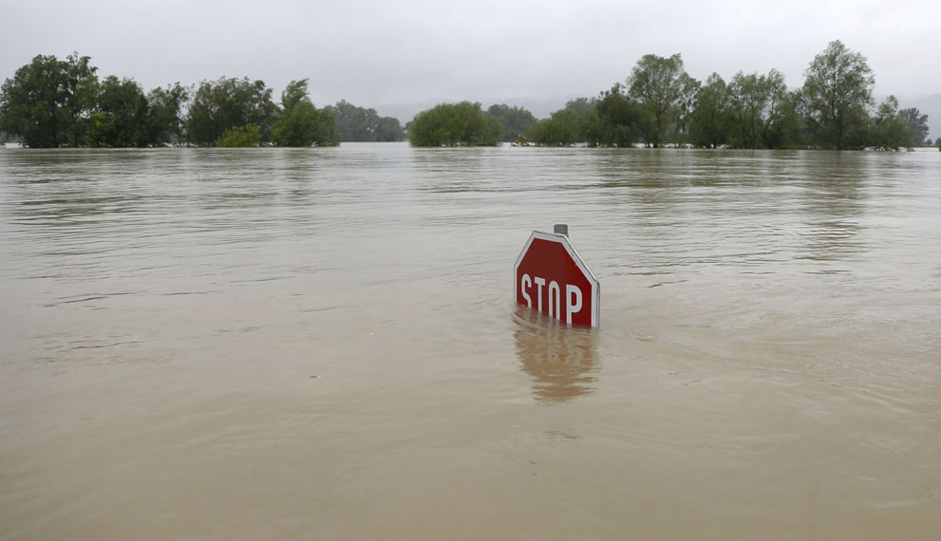
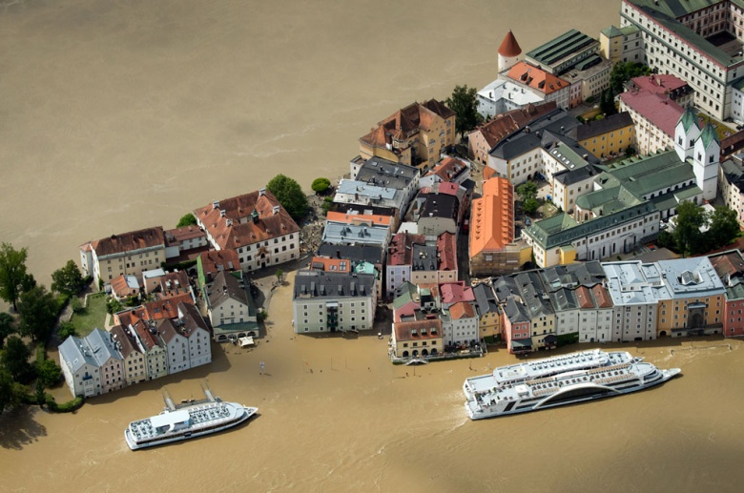
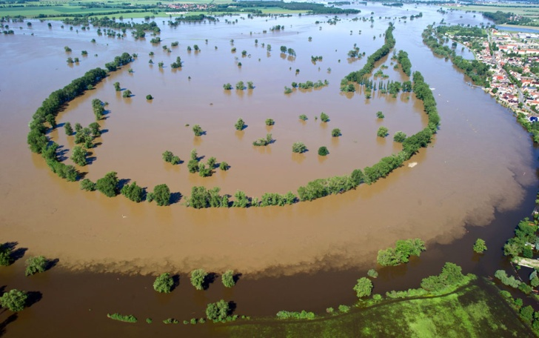
Floods
June 2013
Heavy rainfall over Europe;
Many rivers past their flood stage;
Countries affected: Germany, Austria, Switzerland, Hungary,
Slovakia, Poland, Czech Republic;
►Death toll: 18 people;
Evacuation: tens of thousands

Slide 21
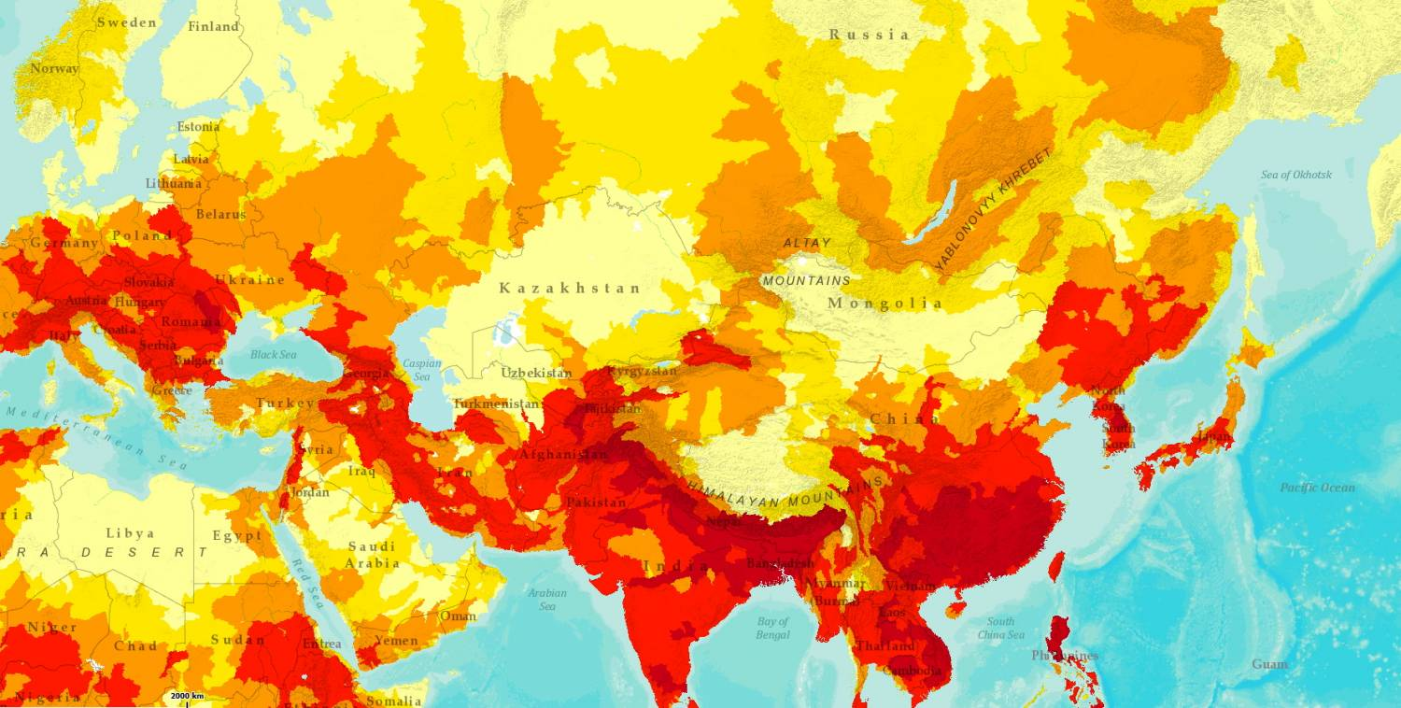
Floods
2013

Slide 22
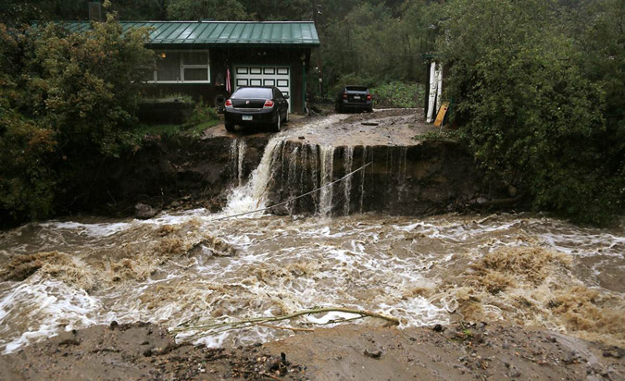
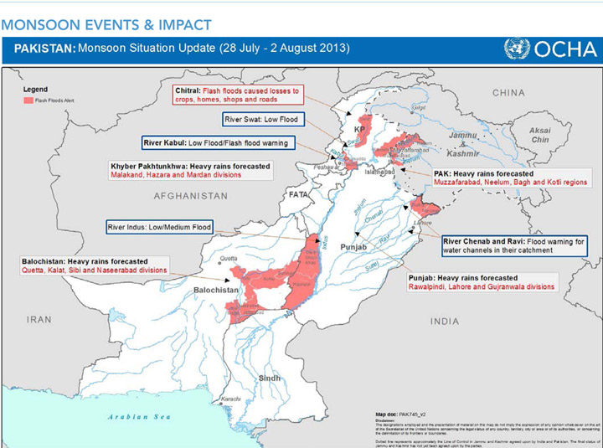
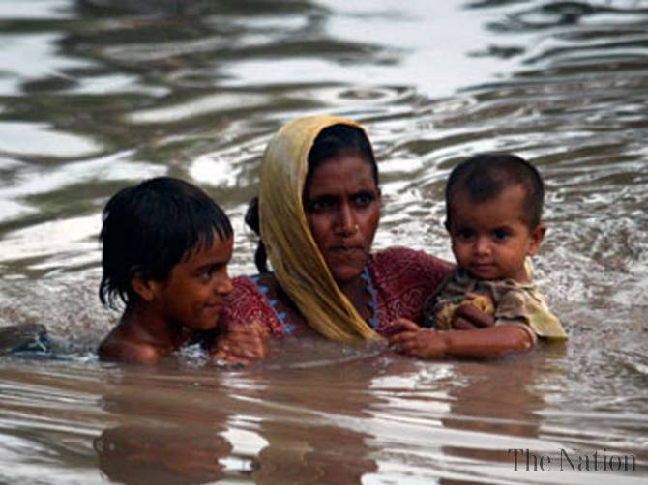
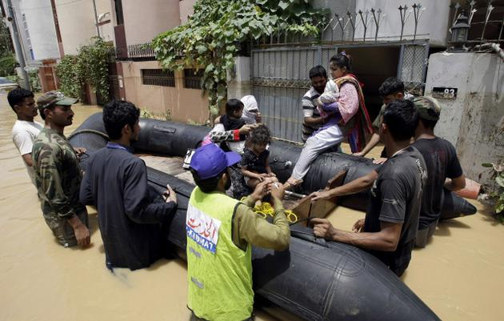
Floods
13 Sept 2013
Colorado
4 dead; 172 missing
23 Aug 2013
Pakistan floods/monsoons
165 killed; 855 injured;
770 villages affected
1.3 mil displaced;
266 relief camps in flood-hit areas (15,000 people);
Army support

Slide 23
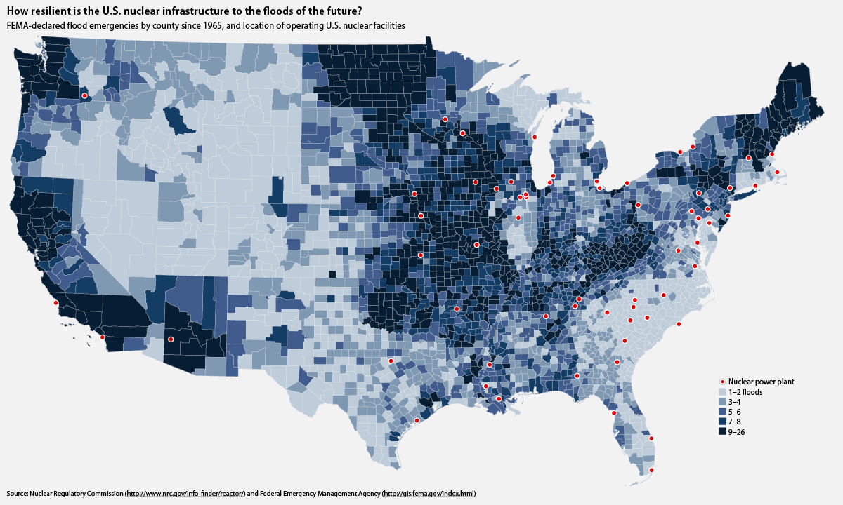
Floods
ELEVATED
HIGH
NP

Slide 24
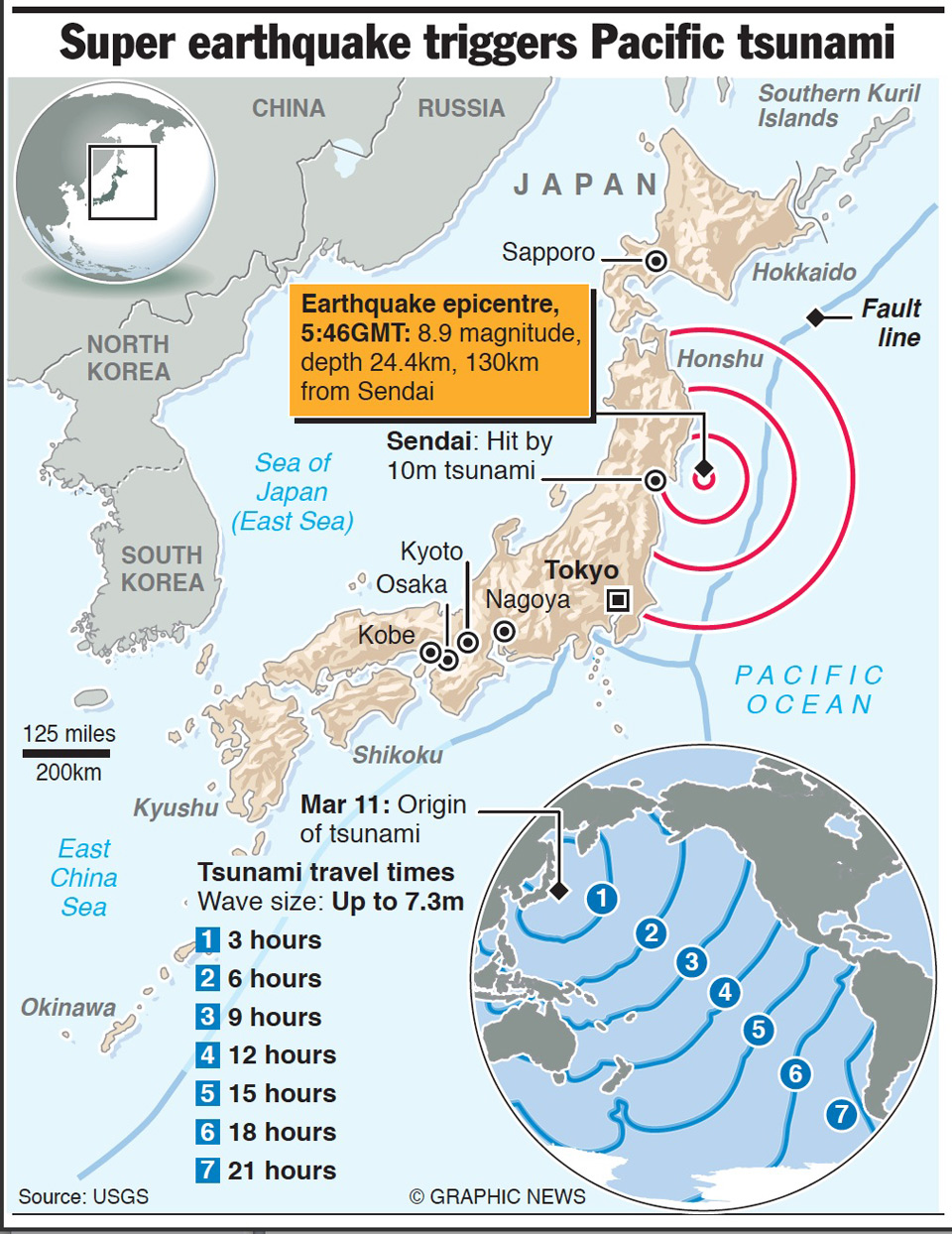
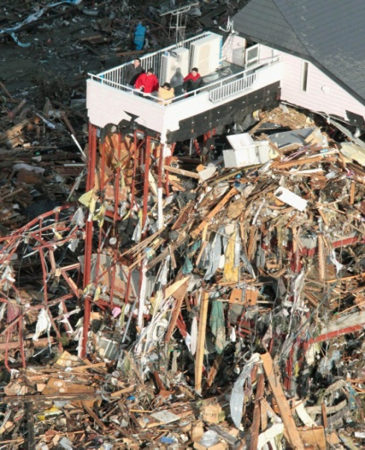






Tsunamis
11 March 2011
Fukushima
15,883 dead
6,145 injured
2,667 missing
129,225 buildings totally
collapsed
Angra (BR)
Diablo, CA
?
HIGH
NP
Heysham, (UK)

Slide 25






Tsunamis
Santorini or Thera Volcano is situated in the eastern Mediterranean Sea, about 120 km north of Crete Island;
Catastrophic eruption: Late Minoan IA period in the middle part
of the 2nd millennium BCE
Crete

Slide 26


Tsunamis
ELEVATED
GR
Santorini Island & volcano

Slide 27


Tsunamis
2013
http://pubs.usgs.gov/of/2013/1170/a/pdf/of2013-1170a.pdf

Slide 28






River tsunami
23 Aug 2013
GUARDED

Slide 29






Hurricanes & storms
Hurricane Katrina
Formed : 23 Aug 2005
Dissipated : 30 Aug 2005
Winds : 175 mph (280 km/h)
Deaths : 1,836 (confirmed)
Affected : 7 States
Damages : $108 billion

Slide 30



Hurricanes & storms
The 350 miles of levees that surround the city have been raised and strengthened (reversed “T” shape) by U.S. Army Corps of Engineers
Cost: $15 billion

Slide 31









Hurricanes & storms
Hurricane Sandy
Formed : 22 Oct 2012
Dissipated : 31 Oct 2012
Winds : 115 mph (185 km/h)
Fatalities : 296 (148 direct, 138 indirect)
USA
Affected : 24 states
 entire eastern seaboard from Florida to Maine and
west across the Appalachian Mountains to Michigan
and Wisconsin, with particularly severe damage in
New Jersey and New York
New York City (Oct 29): flooding streets, tunnels and subway lines and cutting power in and around the city.
US Damage: $65 billion (2013 USD)
ELEVATED
Increased flooding may cost the world $1 trillion by 2050
Published: Monday, 19 Aug 2013 | 4:23 AM ET
By: John Roach
Flood damage in the world's major coastal cities may top $1 trillion a year by 2050 due to rising seas and subsiding land, according to a new study.
The startling figure is "not a forecast or a prediction," but rather a means to "show that not to adapt and not to improve protection is impossible," Stéphane Hallegatte, a senior economist with the World Bank in Washington, D.C., and the study's lead author, told NBC News. "We have to do something."
http://www.cnbc.com/id/100970937
Sept 2013
Mexico
When Ingrid met Manuel
►17 dead

Slide 32






Tornadoes
May 2013 Moore tornado
Moore, Oklahoma
Wind velocity: 210 mph (340 km/h)
Width: 1.3 miles (2.1 km)
On ground: 39 min
Death toll: 25
Injured: 377
Homes destroyed: 1,150 (+ 2 schools)
Damages: $2 billion (estimate)
ELEVATED

Slide 33




Wildfires
◄ California's Cedar Fire (2003)
Dry summers + seasonal gusts (Santa Ana & Diablo winds);
Ignition point: Began after a lost hunter lit a small signal fire
in the Cleveland National Forest, just 25 miles
from San Diego
Damage: > 280,000 acres
 ~30,000 within the city limits of San Diego
The largest single fire in California's recorded history.
#3
California’s 2007 Fires
Displaced: nearly 1 million people
Razed at least 1,500 homes in the San Diego area alone;
Area covered: >500,000 acres
 from Santa Barbara County to the U.S.-
Mexico border.

Slide 34



Wildfires
Greece: Aug 2007 (750,000 acres; 78 fatalities)

Slide 35






Wildfires
17 July 2010
VARNAVAS, ATTICA
HIGH
Before
FIGHTING 10M HIGH FLAMES
After

Slide 36




Climate change
Climate change and extreme weather events put pressure on the supply of resources that communities depend upon like water and food production.
March 22
Imagine what life would be like, if US had to start looking for water sources in other locations, or if the weather changed so drastically that crops would not grow.
Environmental Protection Agency (EPA)
Earth's average temperature has risen by 1.4 degrees over the past century, and is projected to rise another 2 to 11.5 degrees over the next hundred years, as direct result of the human population and their lifestyles.
"It is estimated that already in India 600,000 children die every year from dirty water and that rural industry is suffering because of a lack of access to water. As the climate changes and becomes more volatile, some areas that enjoyed lots of rain will get drier, areas that enjoyed little rain may get more and temperature fluctuations will grow more severe!"
Philippe Cousteau

Slide 37



Climate change
2012

Slide 38





Climate change
We assess that a water-related state-on-state conflict is unlikely during the next 10 years.
We judge that as water shortages become more acute beyond the next 10 years, water in shared basins will increasingly be used as leverage; the use of water as a weapon or to further terrorist objectives also will become more likely beyond 10 years.
http://www.transboundarywaters.orst.edu/publications/publications/ICA_Global%20Water%20Security%5B1%5D%20%281%29.pdf

Slide 39


Climate change
Waterborne diseases
 cholera
Disease-transmitting
vectors
 mosquitoes
►Dengue, malaria
Skin infections
Trachoma
 blindness
ELEVATED
HIGH

Slide 40






Ice melting

Slide 41







Ice melting
March 2013
US Navy Admiral Samuel J. Locklear III
Commander of U.S. Forces Pacific
GUARDED
http://governor.delaware.gov/orders/EO41.pdf
http://www.climatesciencewatch.org/2013/03/10/commander-of-u-s-forces-pacific-climate-change-is-top-threat/

Slide 42







Snow storms
February 2013
Winter Storm Nemo (Blizzard of 2013)
Formed : 7 Feb 2013
Dissipated : 20 Feb 2013
Max snow : 40 inches (100 cm)
Highest gust : 102 mph (164 km/h)
Fatalities : 18
Powerful winter storm developed from combination of two areas of low pressure
Affected regions ► NE US and parts of Canada
Storm later crossed the Atlantic Ocean and affected Ireland and the UK.
GUARDED
Snow left 700,000 customers without electricity at the height of the storm

Slide 43





Extreme heat
40C (104F)…
May – August 2013 - Japan
>53,000 hospitalized
338 died (78% over 60yrs old)
 75% in AC houses!
41.0C (105.8F)
20 August 2013
Research by the London School of Hygiene and Tropical Medicine found that between 540 and 760 deaths could be attributed to the ongoing spell of hot weather.
2003 European heat wave
14,802 heat-related deaths (mostly elderly);
French National Institute of Health
http://www.time.com/time/magazine/article/0,9171,477899,00.html
32.2C (90F) …
GUARDED

Slide 44


Drought & desertification

Slide 45






Drought & desertification
Princeton University
“The process of fertile land transforming into desert typically as a result
of deforestation, drought or improper/inappropriate agriculture”
HIGH

Slide 46

Demographics
GUARDED
HIGH

Slide 47




Pandemics
Pandemic (from Greek pan "all" + demos "people") is an epidemic of infectious disease that has spread
through human populations across a large region ►multiple continents or worldwide
Widespread endemic disease that is stable in terms of how many people are getting sick from it is not a pandemic.
1-3
4-6

Slide 48




Pandemics
Recognized : around 1969
HIV infection rates : 25% (S+E Africa)
S Africa : 29.1% in pregnant women
UN fatality projections (by 2025)
31 mil – India; 18 mil – China; 90-100 mil – Africa
Ongoing pandemic: AIDS/HIV

Slide 49
Pandemics
Pandemics and notable epidemics through history Cholera Influenza Typhus Smallpox Measles Tuberculosis Leprosy Malaria Yellow fever Unknown causes | Concern about possible future pandemics Viral hemorrhagic fevers Antibiotic resistance SARS Influenza  H5N1 (Avian Flu) | Biological warfare
Sweating sickness ("English sweating sickness" or "English sweate" (Latin: sudor anglicus)
 a mysterious and highly virulent disease that struck England, and later continental Europe,
in a series of epidemics beginning in 1485
Last outbreak: 1551, after which the disease apparently vanished;
Onset of symptoms: dramatic and sudden, death often occurring within hours;
Cause: remains unknown ►it has been suggested that an as yet unknown species of hantavirus
pulmonary syndrome was responsible for the outbreak.

Slide 50



Pandemics
October 2010 – peacekeeping troops of UNs Haitian mission, MINUSTAH, unknowingly carried cholera into the country. Because of inadequate water and sanitation facilities at the MINUSTAH base in the Haitian town of Méyè, sewage from the base contaminated the Artibonite River, the largest river in Haiti and one the country’s main water sources.
July 2011 - Cholera spread through the country, infecting one new person per 1min.

Slide 51




Pandemics
2012

Slide 52






Future pandemics

Slide 53





Future pandemics ?
2005

Slide 54





Future pandemics ?
Veracruz, Mexico
Apr 2009 – Aug 2010
284,500 fatalities (estimate)
18,000 lab confirmed

Slide 55




Future pandemics ?
Severe acute respiratory syndrome (SARS)
Viral respiratory disease of zoonotic origin caused by the SARS coronavirus (SARS-CoV).
November 2002 – July 2003 : outbreak in Southern China
Fatalities : 8,273 cases and 775 deaths reported in multiple countries
Majority of cases : Hong Kong (9.6% fatality)
37 countries in early 2003

Slide 56




Future pandemics ?
SARS-like: Middle East respiratory syndrome coronavirus (MERS-CoV)
Apr 2009 ►
http://www.thelancet.com/journals/laninf/article/PIIS1473-3099%2813%2970204-4/fulltext

Slide 57





Future pandemics ?
H7N9 is a new bird flu subtype of Influenza A (avian flu )
 "H7" viruses normally circulate amongst birds
FIRST case ►Taiwan – April 24, 2013
Since that time:
135 confirmed H7N9 cases, 44 deaths (kill rate: 33%);
Dual infections from multiple strains of bird flu have also been reported;
British Medical Journal reports the virus can be transmitted via human contact;
National Institutes of Health reports the virus is capable of airborne transmission;
H7N9 virus may also be spread through human feces
►fears the virus could be spread through sewage pipes
in the same way SARS in Hong Kong (2003 outbreak)
Still no vaccine for the virus, though efforts are underway
GUARDED
CHINA

Slide 58


Nature’s
Revenge?

