Slide 1
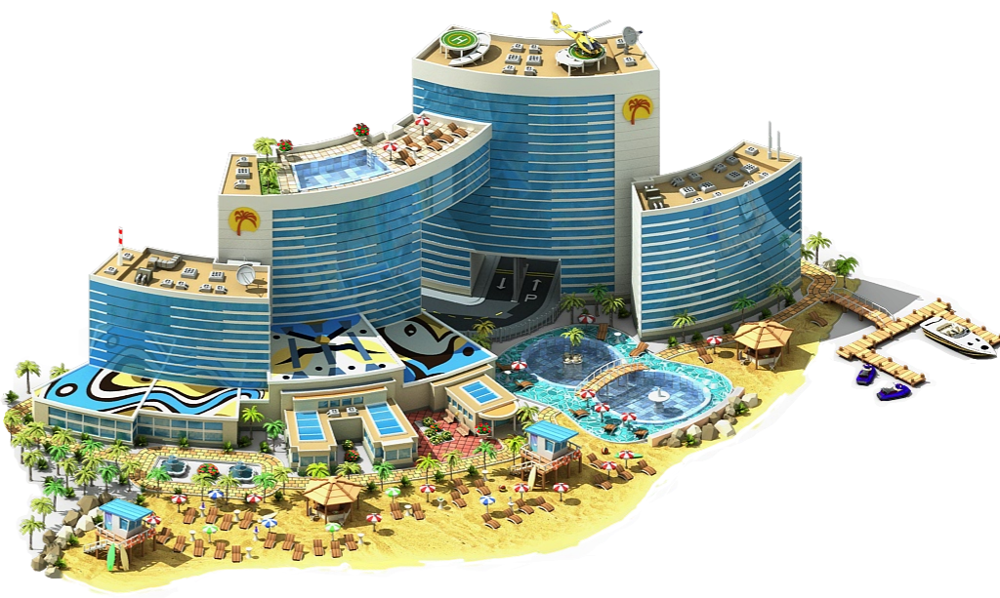
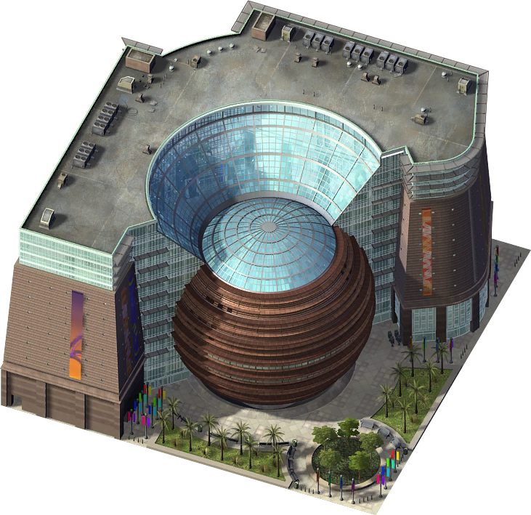
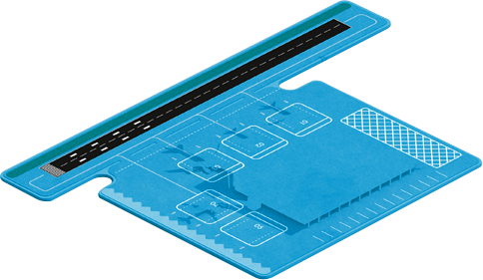
April 3, 2014
CBRNE Hardening
of Soft Targets
Airports, Shopping Malls & Luxury Hotels
Brig Gen (ret’d) Ioannis Galatas, MD, MA, MC
Consultant in Allergy & Clinical Immunology
CBRNE Planner & Instructor
Senior Asymmetric Threats Analyst
Athens. Greece

Slide 2
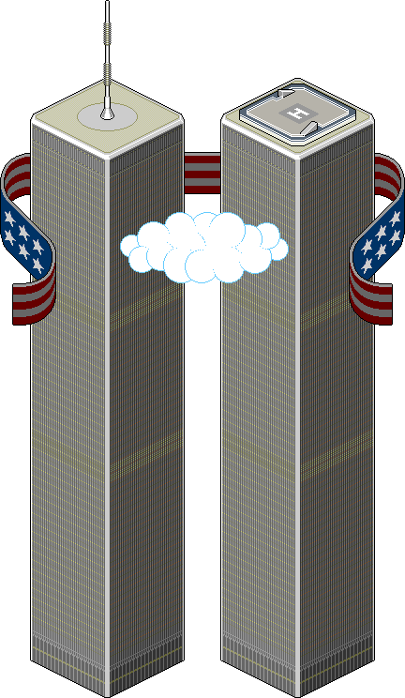
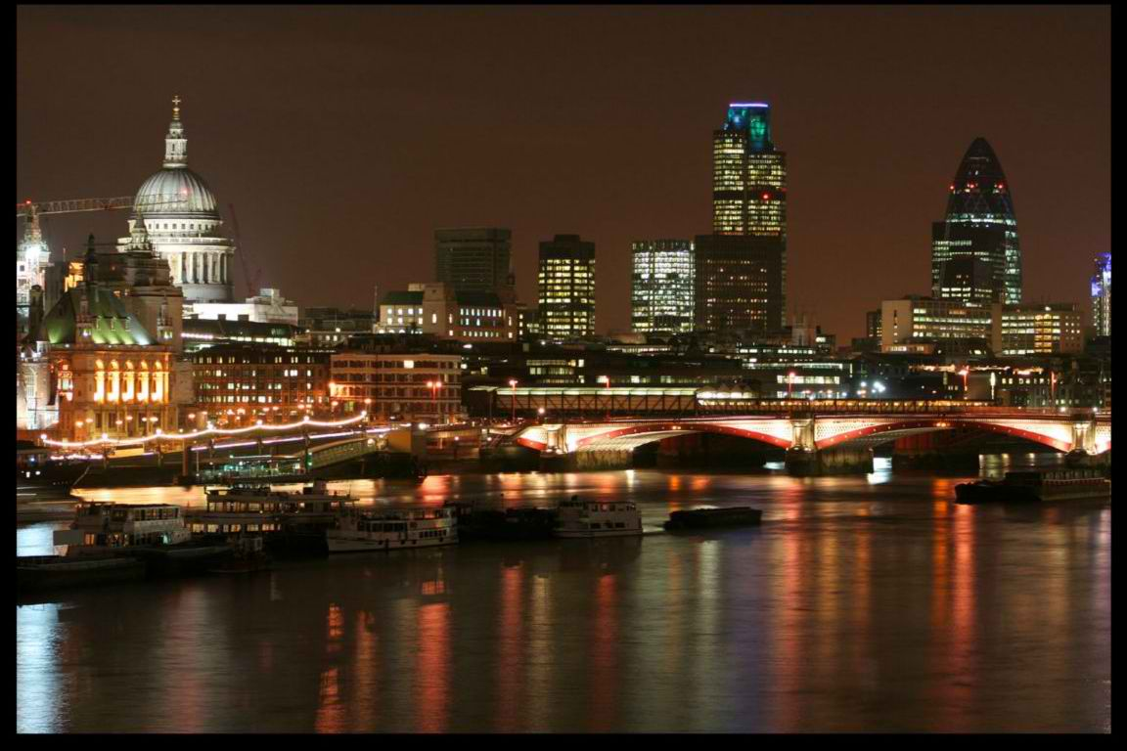
C₂BRNE threats
NBC
CBRNe
Explosives
BWAs
Dirty
bomb
Epidemics/
Pandemics
Nuclear
weapons
C₂BRNe
New
emerging
diseases
Nuclear
accident
Cyber
HAZMAT
Chemical
accidents
CWAs
EMP*
* ElectroMagnetic Pulse

Slide 3
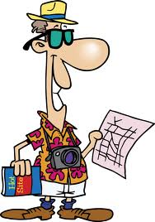
Targeting
Mass transportation
Airports & Harbors
State/residential buildings
State & Industrial infrastructure
Malls & Shopping streets
Sporting venues & events
Hotels & Resorts
Cultural/Religious facilities
Water & Sewage
Electronic/IT communication
Hospitals

Slide 4
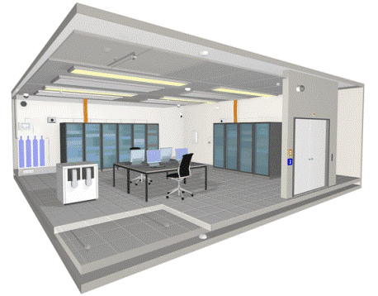
Possible scenarios
R,E
C,B,E
C,R,E
C
B
R
N
E
virus
2014
C₂

Slide 5
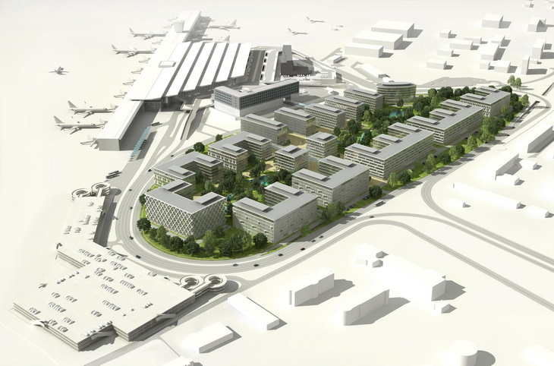
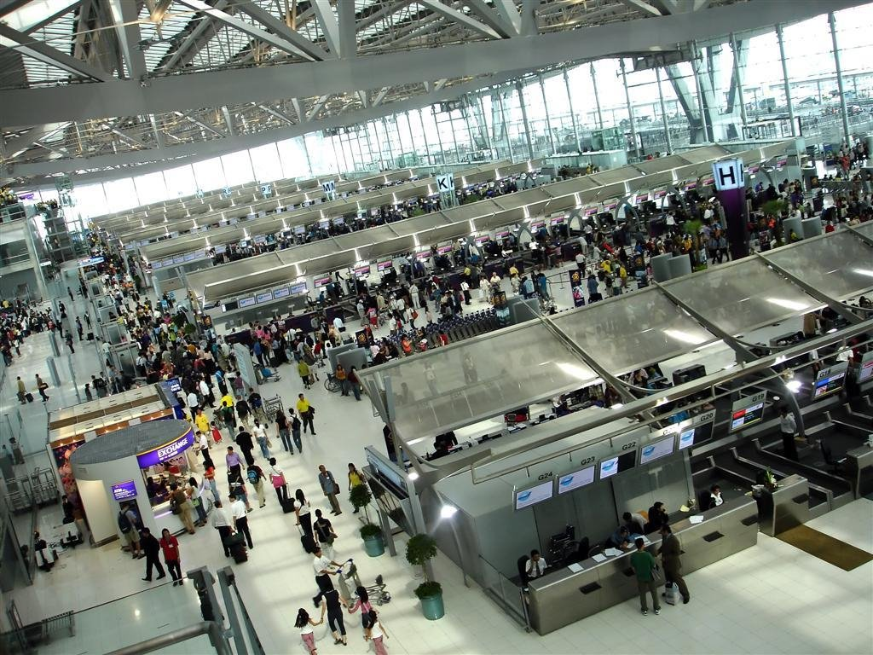
Design vs. Hardening
Pre-emptive measures
Structural
Specialized
equipment
Post-construction measures

Slide 6
Design vs. Hardening
AMBULATORY
ADS
●
●
NON-AMBULATORY
MAIN
GATE
●
R
T
●
●
CD/V
D
●
UD
AL
●
D
●
FAS
Personnel
ONLY
ED
●
D
V
●
●
Underground
waste collection
pool
AL
D
ED
●
Personnel
ONLY
V
T
CS
●
●
T
ED
R = recording
UD = undressing
CD/V = contaminated clothing
& valuables
D = decontamination
FAS = First Aid Station
V = verification of decon
RD = red-dressing
T = triage
AL = air-lock
ADS = ambulance decon station
CS = control station (CCTV)
RD
●
H
●
EXIT
MAIN
HOSPITAL
AREA

Slide 7
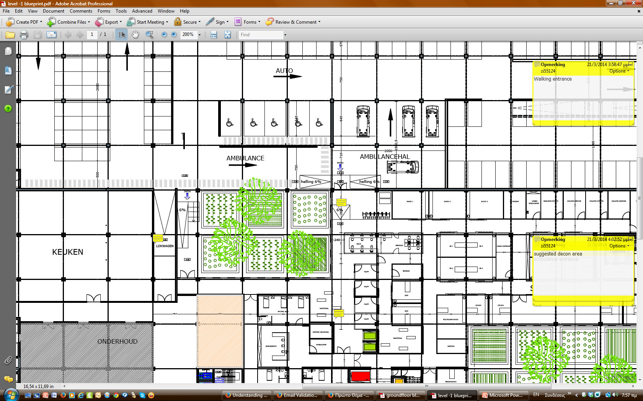
KITCHEN

Slide 8
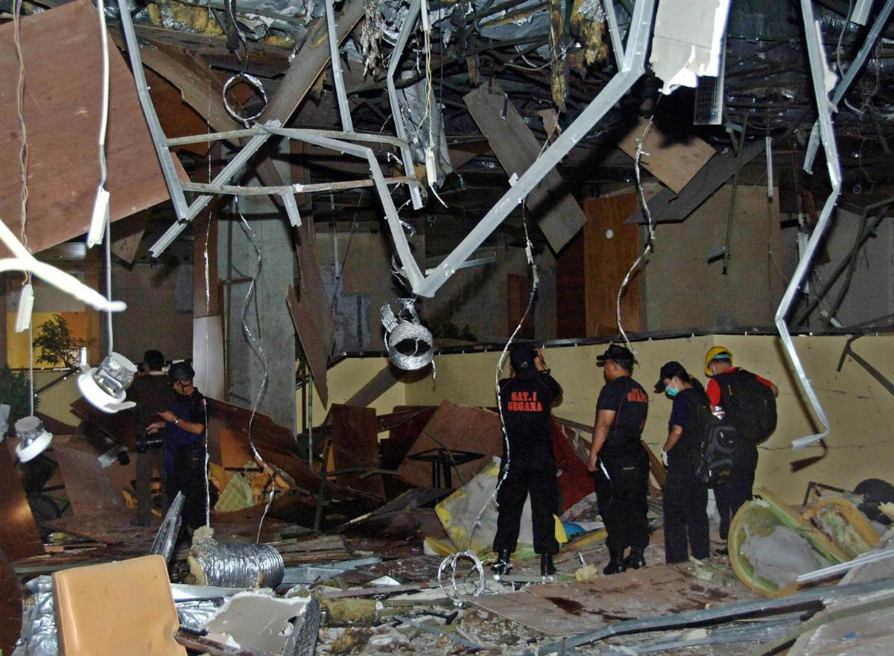
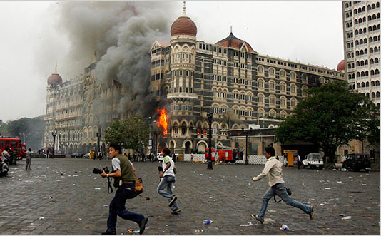
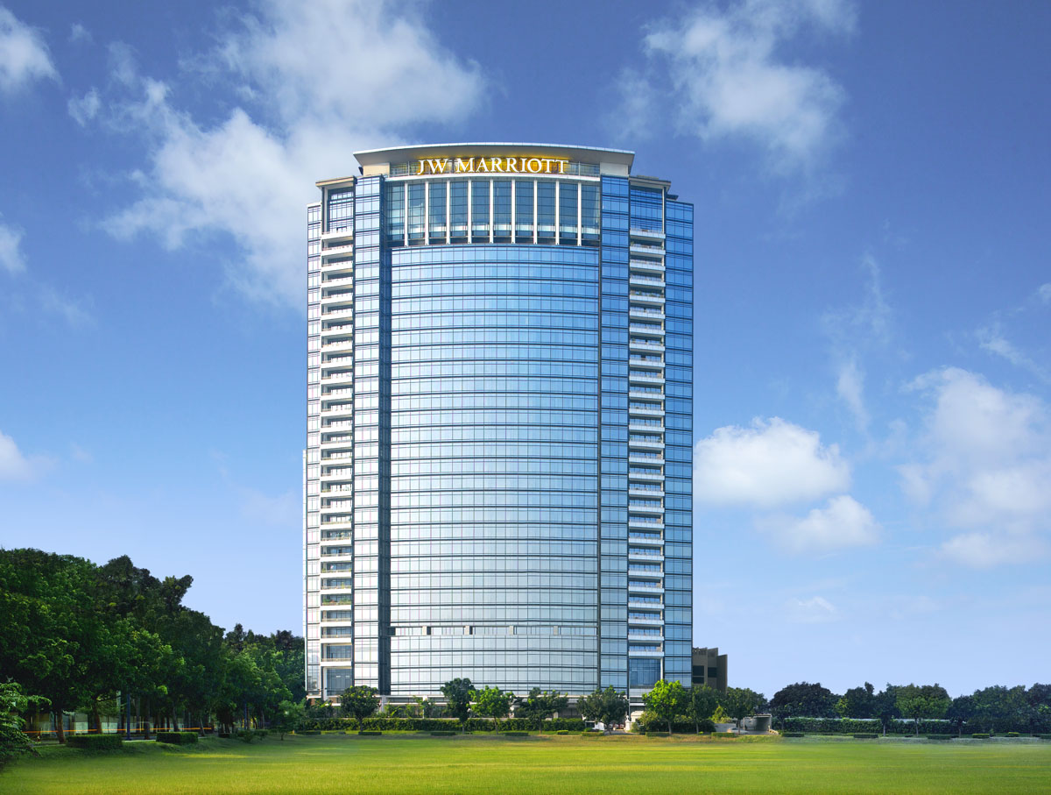
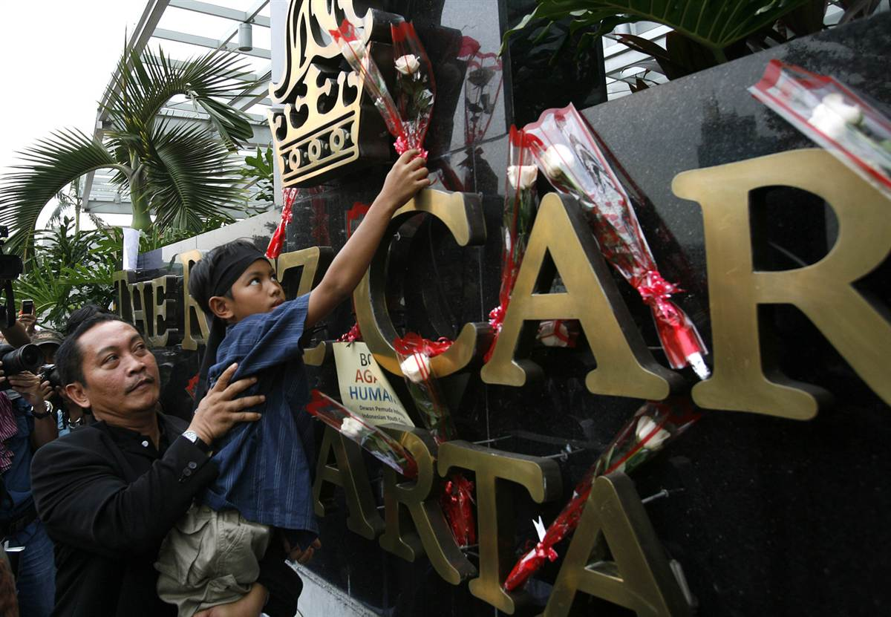
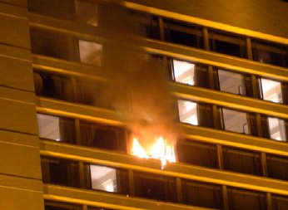
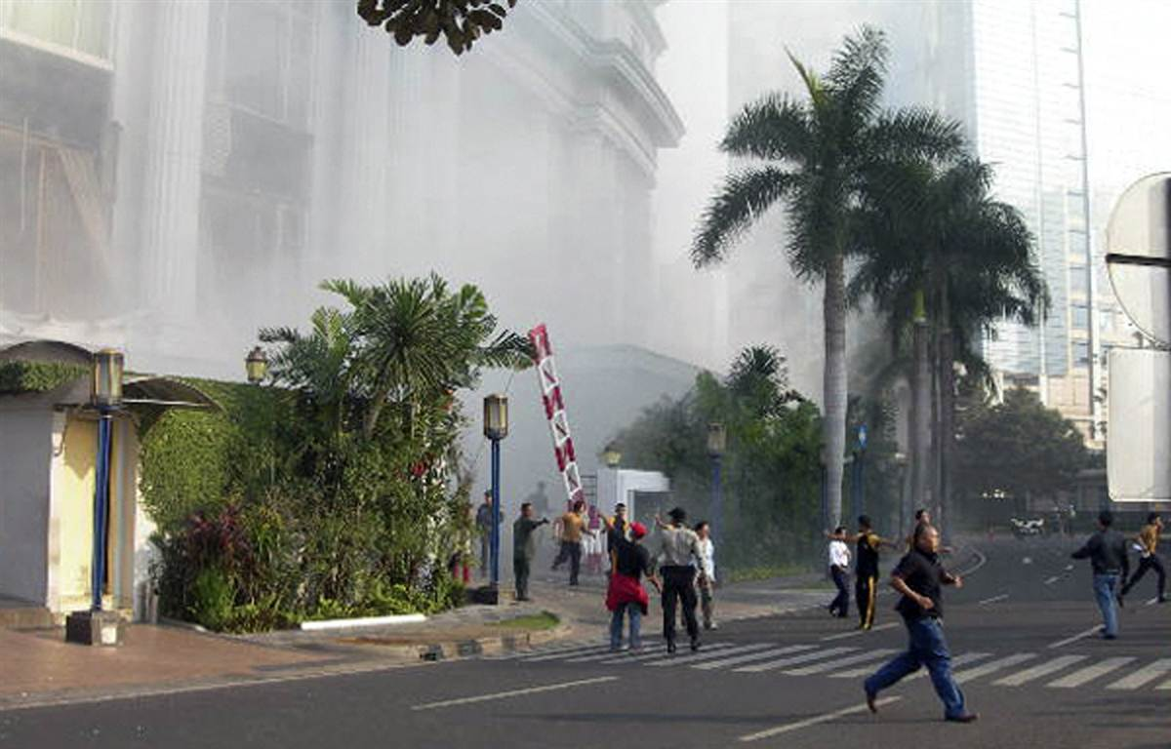
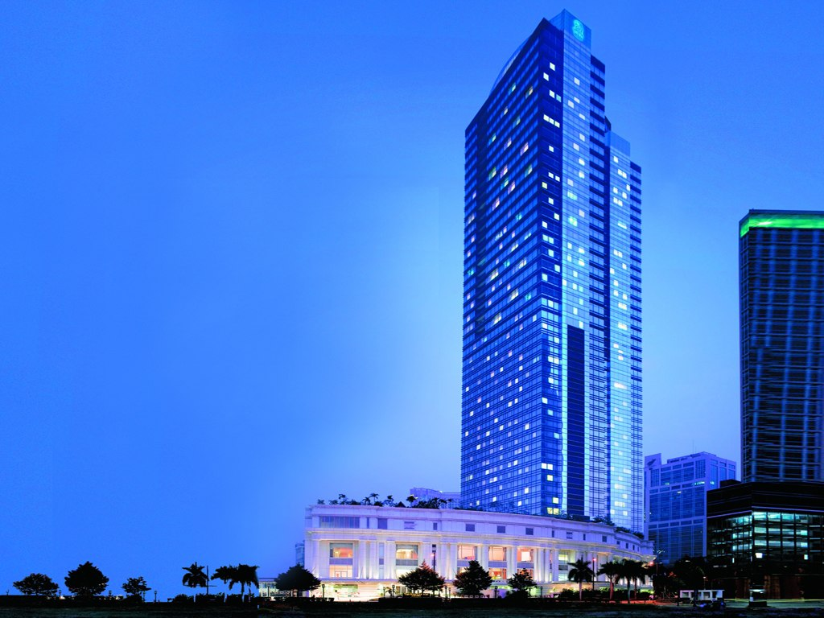
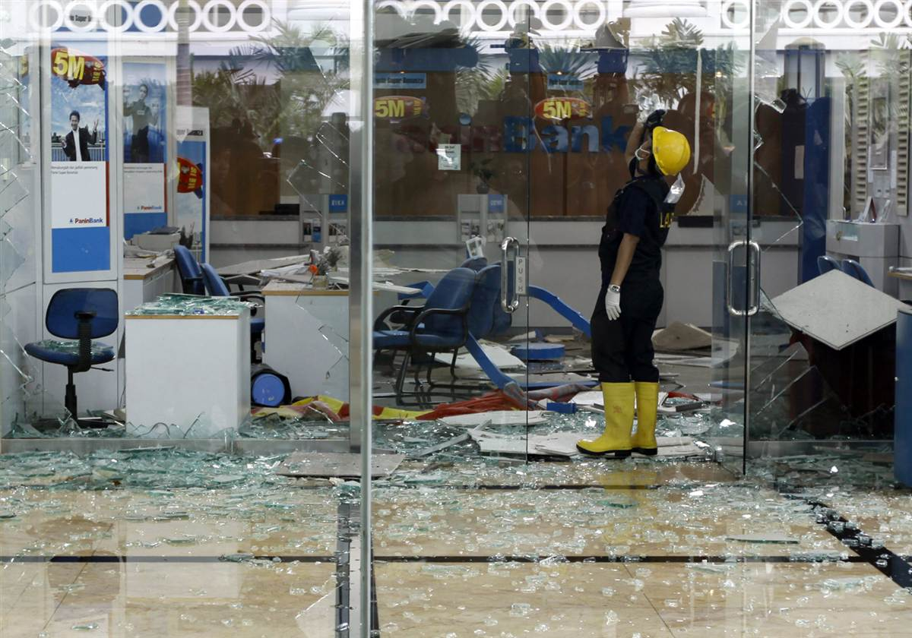
Terrorism
17 July 2008
JW Marriott
& Ritz-Carlton
Jakarta, Indonesia
26-29 Nov 2008
Taj Hotel
Oberoi Hotel
Mumbai, India

Slide 9
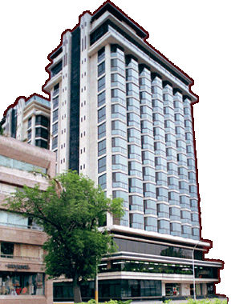
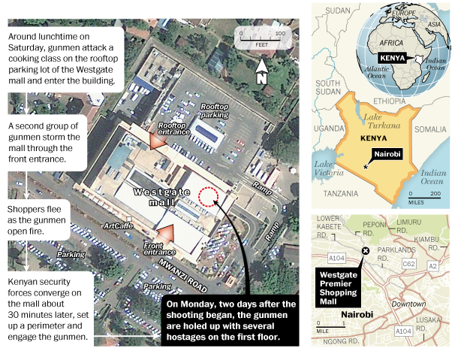
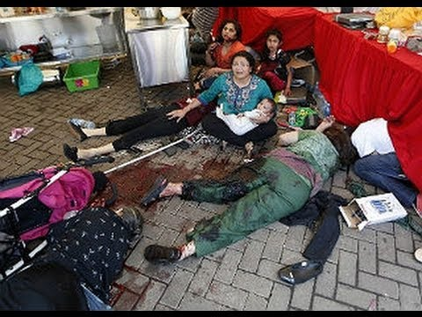
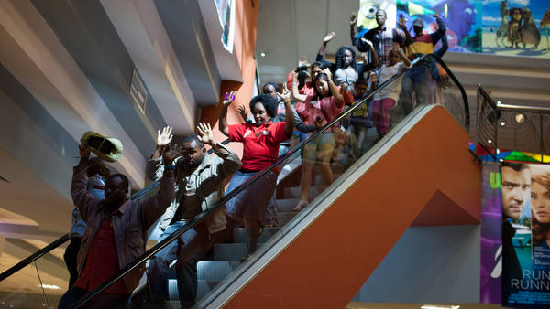
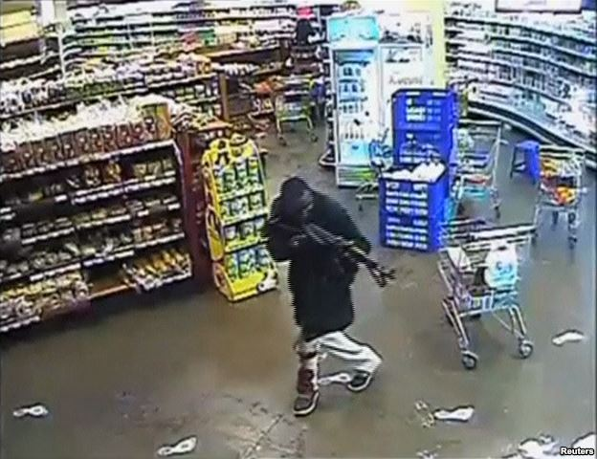
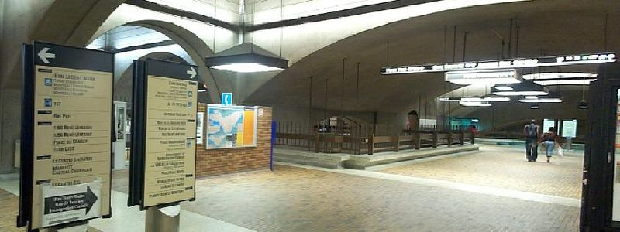
Why soft targets?
21 Sept 2013
Symbolic targets of Western affluence and influence
 attract foreign diplomats, businesspeople, tourists, and local elites;
Soft targets presenting few obstacles to determined terrorists since:
are open environments with multiple points of entrance and egress;
have a constant flow of traffic (guests and visitors, staff, merchants, and delivery people);
are easy for pre-attack reconnaissance, with floor plans, photos, and panoramic video clips of public areas often available over the Internet.
A 5-star property attack = an attack on an embassy
 casualties, widespread panic, and extensive media attention – all of which are a boon to recruitment.
Changing organizational composition of terrorist groups
 lack the resources and training to mount a successful attack on a Western embassy or airline
 turned their attention to easier targets – i.e. hotels
72 killed
(5 attackers)
Shopping malls
Confined (although big) space;
Trends ►Underground (Canada); above ground (Russia);
vertical construction;
Mass gathering (working hours) – international shoppers;
Heart of local or wider community;
Symbol of financial prosperity
32km

Slide 10
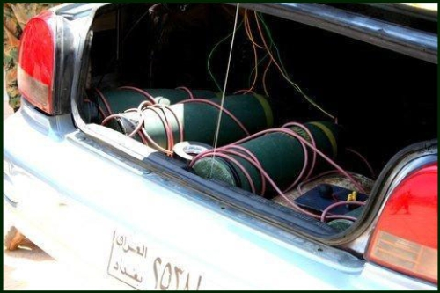
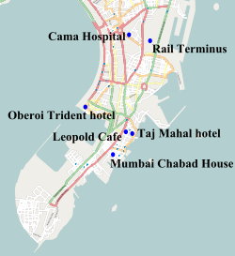
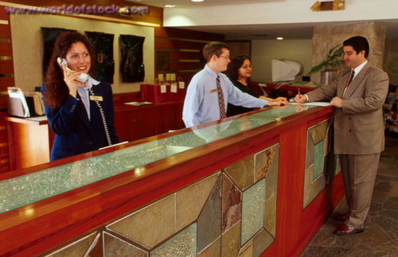
Mode of operation
Between 9/11 and 2005
Preferred mode of attack was the vehicle-borne improvised explosive device (VBIED) driven by a suicide bomber:
2002 bombings of the Sheraton and Marriott hotels in Karachi;
2003 attack on the JW Marriott in Jakarta;
2004 assault on the Hilton Hotel and Casino in Taba, Egypt.
After 2005
Hotels began to harden their perimeter defenses.
Terrorists have sought out new and innovative modes of attack:
2008 Mumbai attacks were an obvious attempt to thwart such defenses;
2009 twin suicide attacks on the JW Marriott and Ritz Carlton in Jakarta, carried out by a pair of JI operatives, one of which had checked in as a guest days prior to the attack

Slide 11
Mindset
It will not happen to us!
We are far away from the front lines of War on Terror;
Statistical perception:
 Brian Jenkins (2009): fewer than 500 hotel guests worldwide have been killed by terrorists
over the past 40 yrs (total global hotel population: ~10million)
Cost of counter-terrorism/CBRNE hardening can be high;
Presence of visible security measures may undermine the welcoming ambiance that luxury hotels work hard to cultivate and drive away guests;

Slide 12
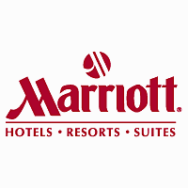
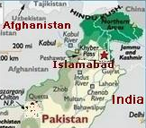
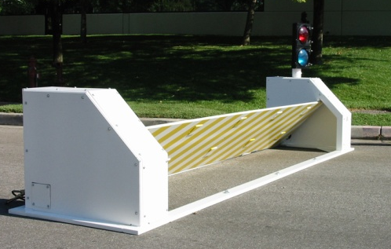
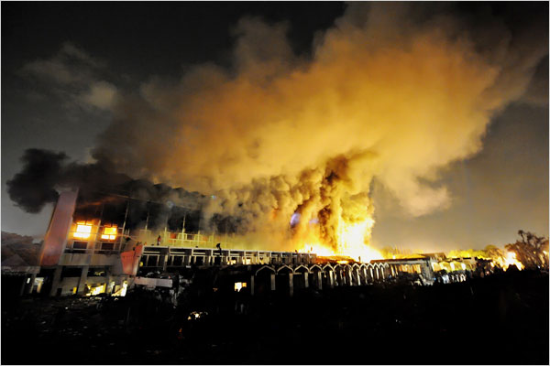
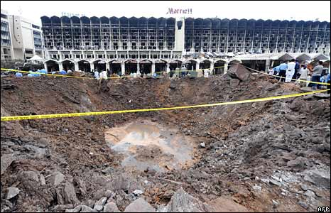
Marriott International experience
September 2008
Marriott Hotel in Islamabad (“the world’s most protected hotel”)
had formidable antiterrorism systems in place:
60 security officers on duty;
Four bomb sniffing dogs;
62 security cameras monitored by 3 security officers;
Under-vehicle cameras;
Walk-through metal detectors to screen everyone entering the building;
Entrance gate with Delta Barrier (drop-down & hydraulic barrier) – manned by shotgun-armed security officers;
Hotel was 132 ft from the vehicle inspection point
A suicide bomber detonated his charge after his vehicle slammed into the Delta Barrier. The blast from the powerful 1,320 pound bomb ripped a 25X60 ft crater in front of the hotel, destroyed most of the upper floor rooms of the property, and ignited
a blaze that burned for two days.
►56 people died; 270 injured
BUT without hardening, casualties might exceed 1,000!

Slide 13
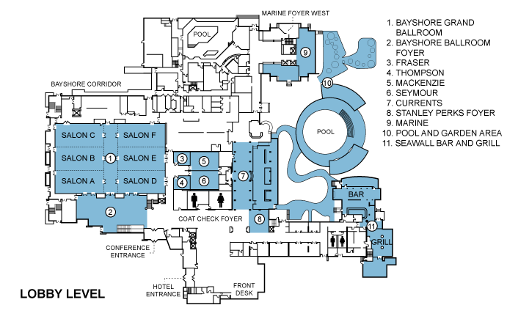
Target Hardening
Preventing attacks is largely impossible once they have reached their operational stage;
Target hardening also entails more subtle methods that often go undetected:
Limitation of public disclosure of nonessential information about a property such as building diagrams;
Dispatching both plainclothes security officers and uniformed “greeters” to lobby areas to discreetly look for individuals casing buildings or taking suspicious photographs of entrances or CCTVs;
Terrorists often seek employment at hotels as cover for conducting surveillance
 rigorous background checks (criminal records)

Slide 14
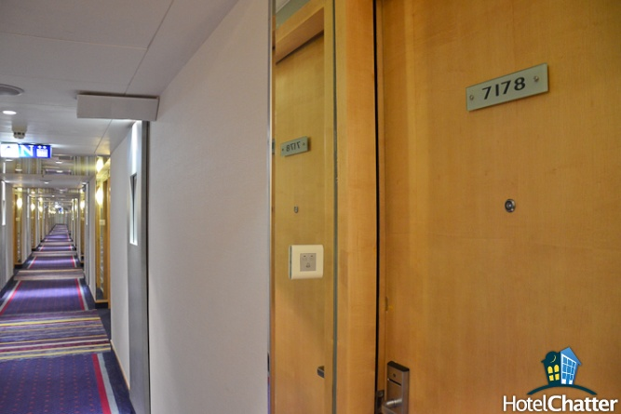
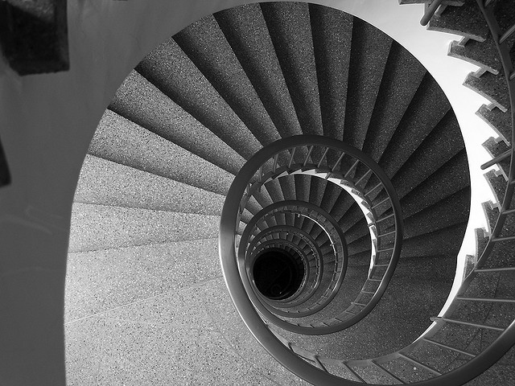
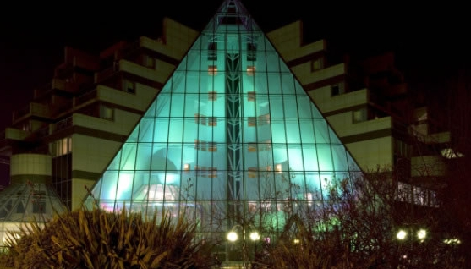
Designing with Security in Mind
Existing properties are built with aesthetics, convenience, and cost uppermost in mind – not safety from suicide bombers, urban guerrillas or new emerging threats;
Built-in features make them vulnerable to Mumbai-style assaults including long hallways, spiral staircases, and towering atriums;
Usually are situated close to busy streets, giving terrorists easy access, or within close proximity to embassies or government buildings, leaving them vulnerable to collateral damage from attacks directed elsewhere;
Requirements for hotels to be built in high threat locations include:
Shatter-resistant window films;
Walk-through metal detectors;
Exterior security cameras;
Hydraulic barriers; and
Bomb-sniffing dogs.
Modern technologies
allow detection of
CWAs, explosives
& narcotics

Slide 15
Designing with Security in Mind
Business travel managers inquire terrorism-related issues before recommending specific properties, such as:
whether blueprints have been provided to security officials;
whether secondary communication systems exist for guests trapped inside rooms in the event of an attack;
whether hotel staff have been trained in evacuation techniques; and
what surveillance systems are in place to assist authorities in the event of an incident
“People visiting (high risk) environments aren’t looking for the softest beds now,
or the best meeting space;
they’re looking for the best security.
If you invest in security,
you’ll get the customers.”
(Meyers, 2009)

Slide 16
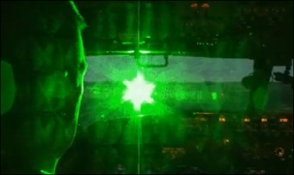
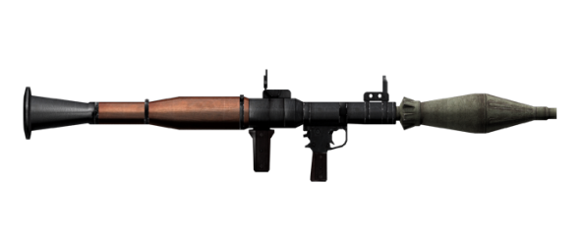
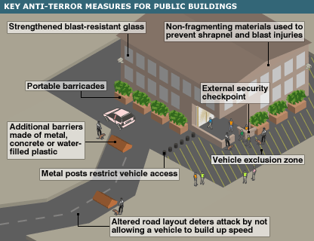
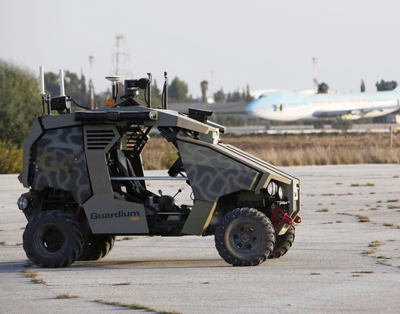
Designing with Security in Mind
1st line
of defense
2nd line
of defense
3rd line
of defense

Slide 17
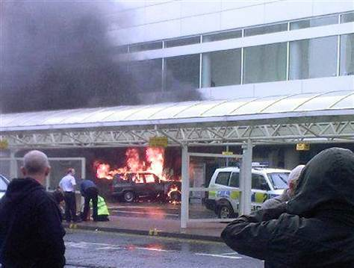
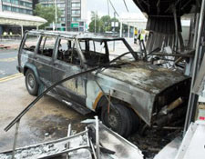
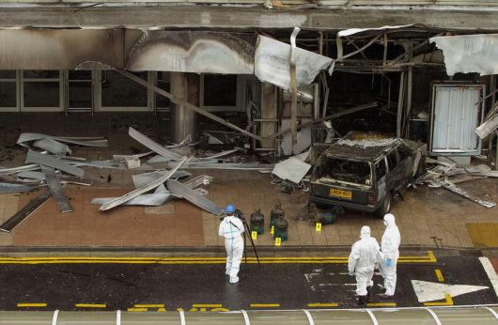
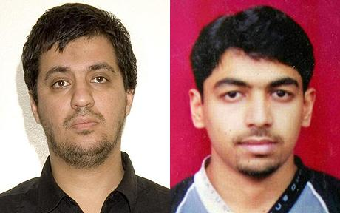
Designing with Security in Mind
30 June 2007
Glasgow International Airport
Dead: 1 (suicide bomber)
Non-fatal injuries: 5

Slide 18
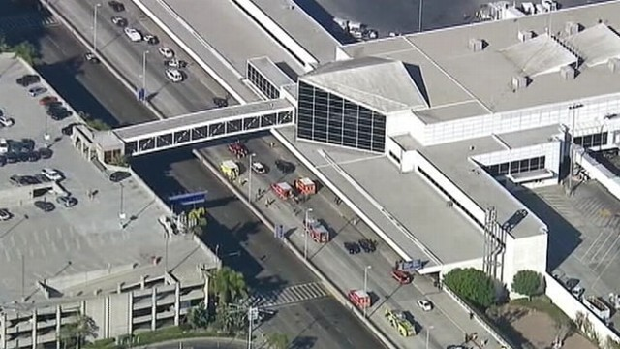
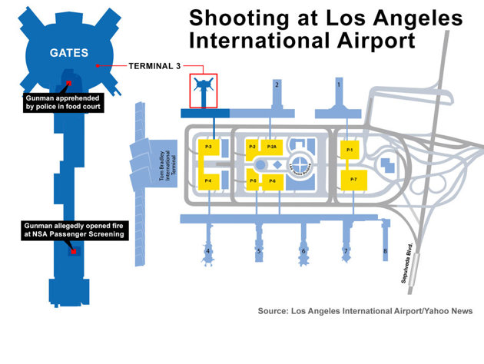
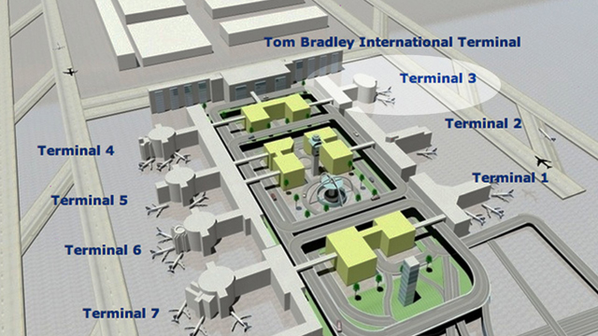
Designing with Security in Mind
1 Nov 2013
LAX Intern Airport
Dead: 1 TSA officer
Wounded: 7
ATC Tower

Slide 19
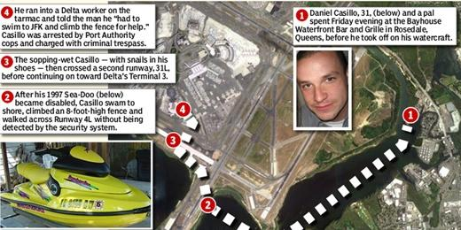
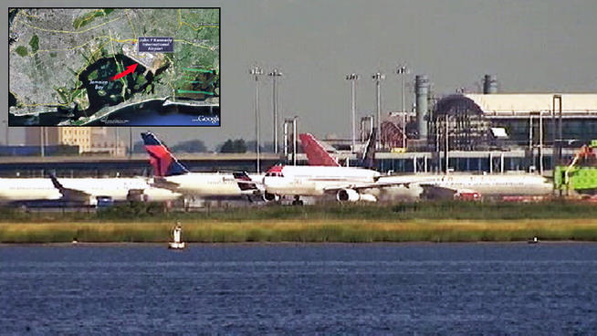
Designing with Security in Mind
13 Apr 2012
JFK International Airport
►Jet skier’s break through $100 mil security system

Slide 20
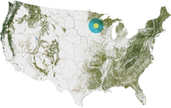
Designing with Security in Mind
Human screeners
Minneapolis
40 mil people annually

Slide 21
CBRE attacks
Like explosive threats, CBRE threats may be delivered externally or internally to the building.
External ground-based threats may be released at a stand-off distance
from the building or may be delivered directly through an air intake;
Internal threats may be delivered to accessible areas such as the lobby,
mailroom, or loading dock, or they may be released into a secure area
such as a primary egress route;
►There may not be an official or obvious warning prior to a CBR event.
There are 3 potential “silent” methods of CBR(E) attacks:
A large exterior release originating some distance away from the building (includes delivery by aircraft)
A small localized exterior release at an air intake or other opening in the exterior envelope of the building
A small interior release in a publicly accessible area, a major egress route, or other vulnerable
area (e.g., elevator lobby, mail room, delivery, receiving and shipping, etc.)

Slide 22
E-scenario
Alfred P. Murrah Federal Office Building (1995)

Slide 23
E-scenario
More than 90% of injuries
following an explosion
are caused
by flying shards of glass
Bomb-proof
wallpaper
Bomb Blast
Mitigation Film

Slide 24
R-scenario
http://www.gizmag.com/nuclear-bomb-damage-map-nuke/12097/
200 – 500 REM
500 – 800 REM

Slide 25
C-scenario

Slide 26
C-scenario
TICs

Slide 27
CR-scenario
Shelter
in place/room

Slide 28
CR-scenario
Expandable Cabinet Shelter
Total building protection
8 sec
Inflatable tent-in-a-room
6-35 people

Slide 29
Escape hoods
Personnel
CN

Slide 30
C-scenario
Flame resistant;
Resistant to acids, solvents, bleaches, fuels and other chemicals;
Activated carbon layer;
Visor made of temperature resistant polymer (>200⁰C);
Integrated filter layers in the hood;
Weight (full cape): ~3 kg;
Vacuum sealed
Escape cape

Slide 31
Improvise !
Mass decontamination

Slide 32
Design !
Decon
pergola
Pop-up decon poles

Slide 33
B-scenario
1984
Rajneeshee bioterror attack
Food poisoning of 751 individuals in The Dalles, Oregon, USA;
Deliberate contamination of salad bars at ten local restaurants with salmonella;
Followers of Osho had hoped to incapacitate
the voting population of the city so that
their own candidates would win the 1984
Wasco County elections;
First and single largest bioterrorist attack in US history;
One of only two confirmed terrorist uses of biological weapons to harm humans since 1945;
45 people were hospitalized.
Bhagwan Shree Rajneesh
(Osho)

Slide 34
B-scenario
2013

Slide 35
Contamination of Water Supplies
B-scenario
Significant contamination following attack with aerosolized toxins unlikely;
Dilution in reservoir or lake would result in nontoxic exposure;
Usual methods of water treatment (chlorination, filtration) effective vs. viruses, bacteria, most protozoa;
Potential risk: contamination near end-user

Slide 36
B-scenario

Slide 37
B-scenario
smallpox
2013
UK
5
Eradicated
1979
2
weeks
Notes:
http://www.nature.com/srep/2013/130717/srep00810/full/srep00810.html

Slide 38
B-scenario
Bioterrorist

Slide 39
B-scenario
Fixed or deployable?

Slide 40
B-scenario
NEGATIVE
pressure
Isolation shelter
SARS
IV A,B,C
H1N1
H5N1
MERS CoV

Slide 41
Concluding thoughts…
Cannot Bother Right Now
CBRN
Can Be Really Nasty!

Slide 42
Thank you for your attention!
Better
prepared
than
sorry!
“You have to be lucky all the time.
We have to be lucky only once!”

Slide 43
CBRNE-Terrorism Newsletter
Editor-in-Chief
BG (ret’d) Ioannis Galatas, MD
igalatas@yahoo.com
2
www.cbrne-terrorism-newsletter.com
Monthly publication
Free download
Read by
First Responders in more than
80 countries
Distributed to more than 700
institutions, defense
companies, universities,
think-tanks, government agencies
August
2013
►Latest issue: March 2014

