Slide 1
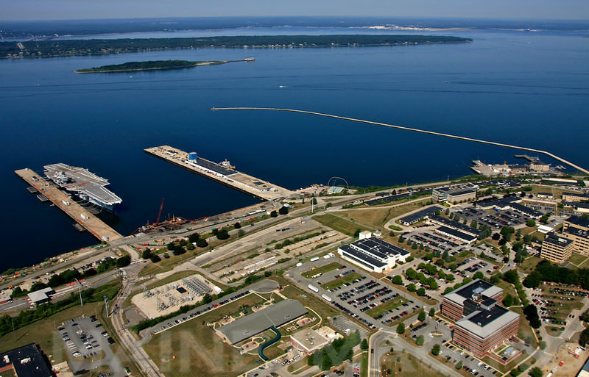

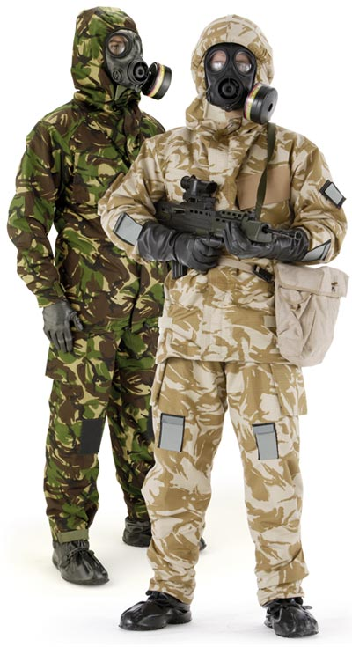

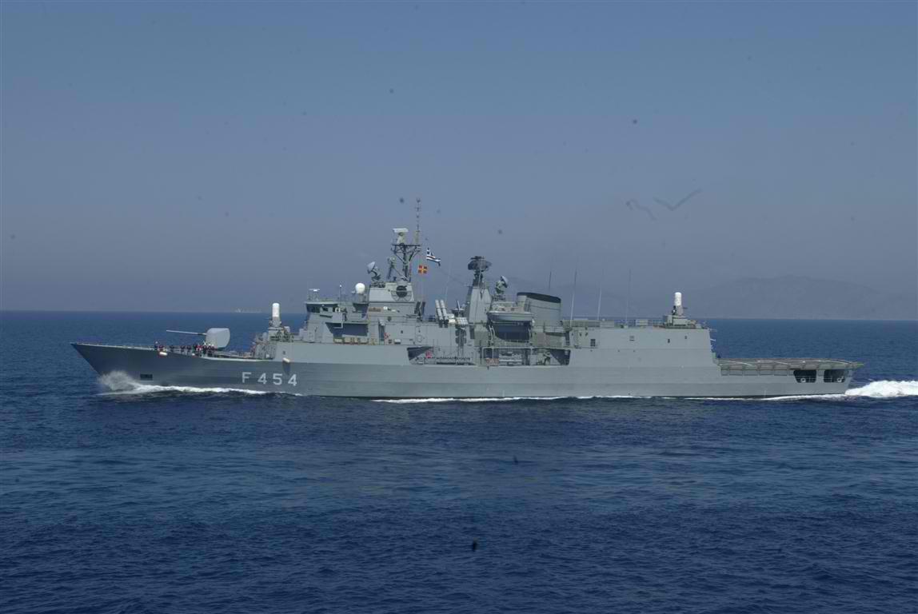

26 September 2012
London, UK
Managing
CBRNe Casulaties
on Ship and on Shore
BG (ret’d) Ioannis Galatas, MD
Consultant in Allergology & Clinical Immunology
Medical/Hospital/Op CBRNE Planner
Senior Asymmetric Threats Analyst
Athens, Greece

Slide 2


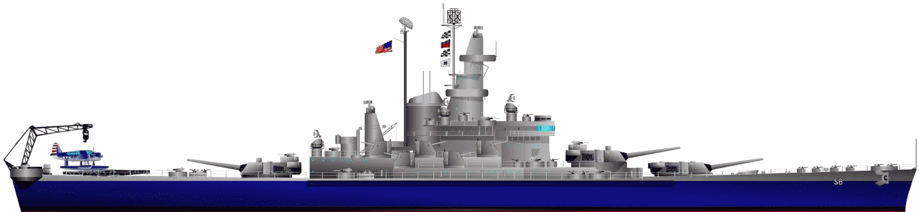
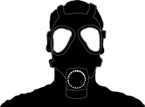
OUTLINE
CBRN threats in maritime environment
Managing CBRN casualties on ship
Managing CBRN casualties on shore
Are we ready?
Conclusion and proposals

Slide 3



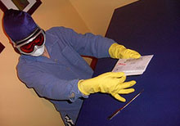
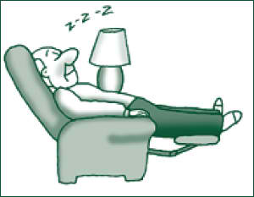

HISTORY CIRCLE
NBC
CBRNe
Can’t
Bother
Right
Now
?

Slide 4

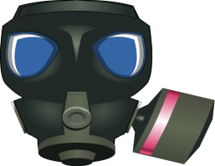


NEW CONCEPT
NAVAL
CBRNE DEFENSE
MEDICAL NAVAL
CBRNE DEFENSE

Slide 5


THREATS (Urban)
Explosives
Biological
warfare
agents
Dirty
bomb
Epidemics/
Pandemics
Nuclear
weapon
CBRNe
New
emerging
diseases
Nuclear
accident
TICs
Chemical
accidents
Chemical warfare
agents
Cyber
EMP*
*ElectroMagnetic Pulse

Slide 6
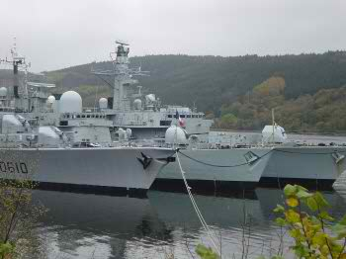
THREATS (Naval)
Explosives
Biological
warfare
agents
Dirty
bomb
Epidemics/
Pandemics
Nuclear
weapon
CBRNe
New
emerging
diseases
Nuclear
accident
TICs
Chemical
accidents
Chemical warfare
agents
Cyber
EMP*
*ElectroMagnetic Pulse

Slide 7
CASUALTIES MANAGEMENT
On Shore
C | ☑
B | ☑
R | ☑
N | ☑
On Ship
C | ☑
B | ☒
R | ☒
N | ☑

Slide 8

On Ship

Slide 9
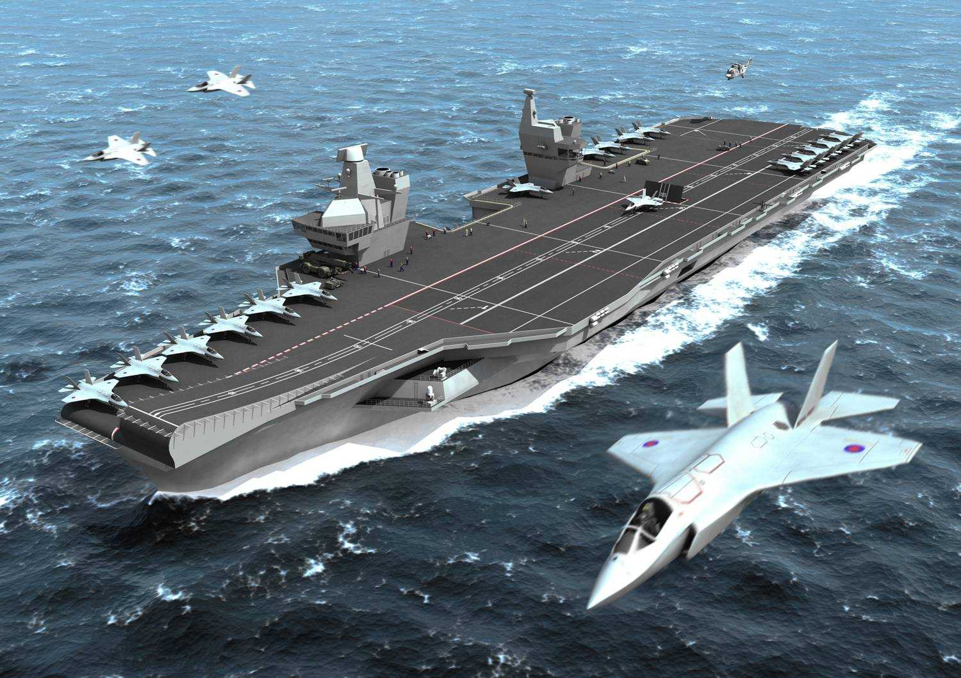
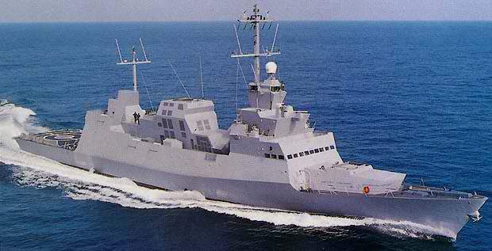
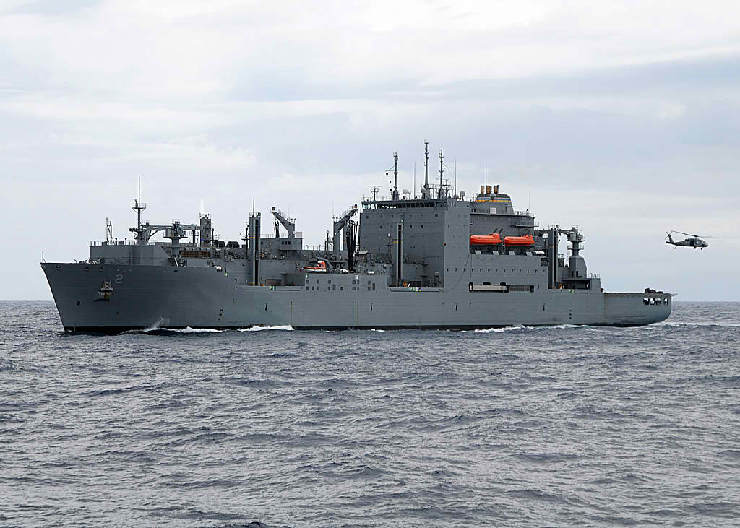
ON SHIP

Slide 10
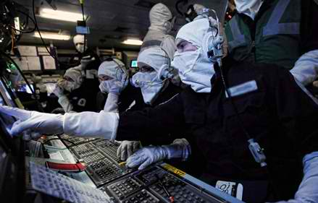
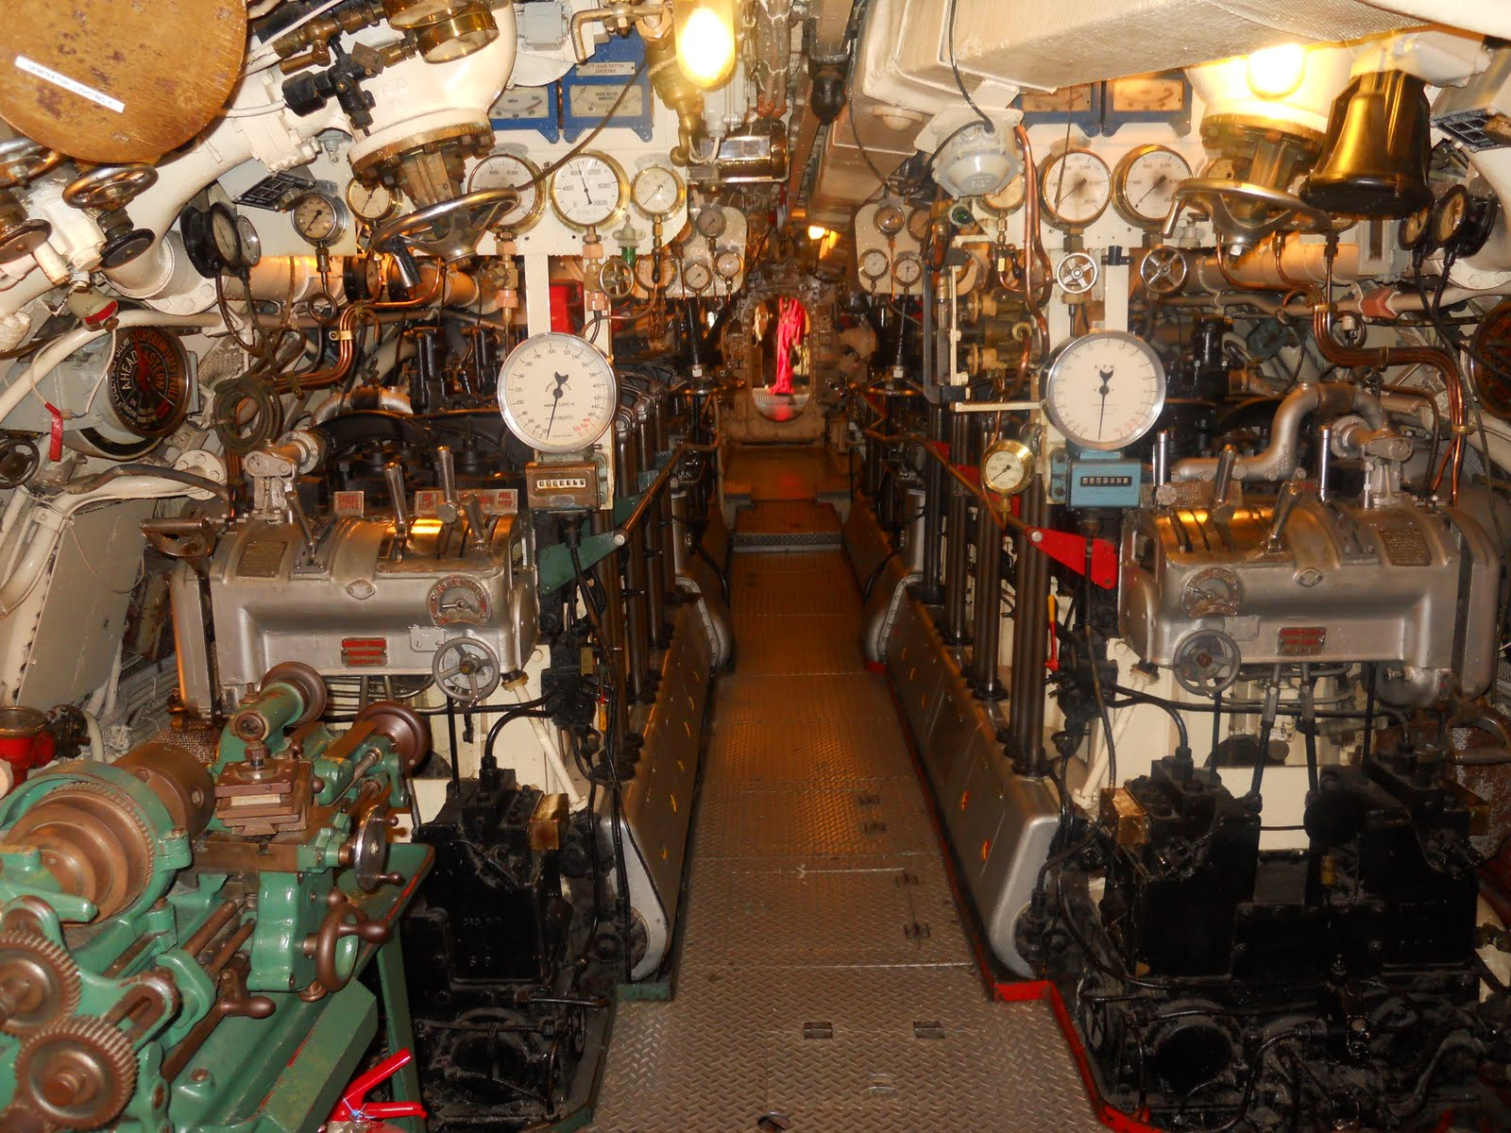
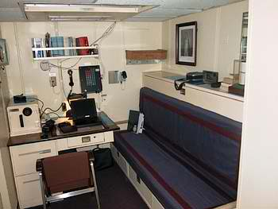
ON SHIP (Inner quarters)
Previous generations’ vessels have no CBRN protection
Modern battleships are CBRN-proof
 NATO STANAG 4447 for filter efficiency
➲ Utilize standard 300m³/hr NATO Naval filter

Slide 11
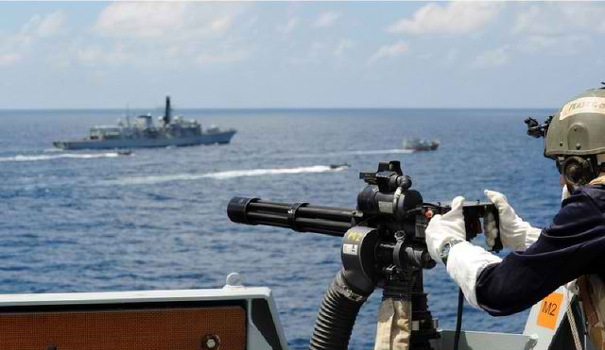

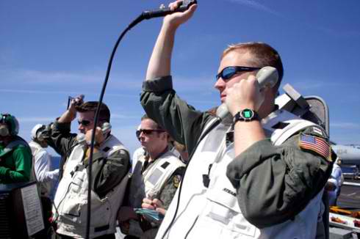
ON SHIP (On deck)
Crew
Sensitive equipment
Weaponry
Aircrafts, helicopters
Deck floor

Slide 12
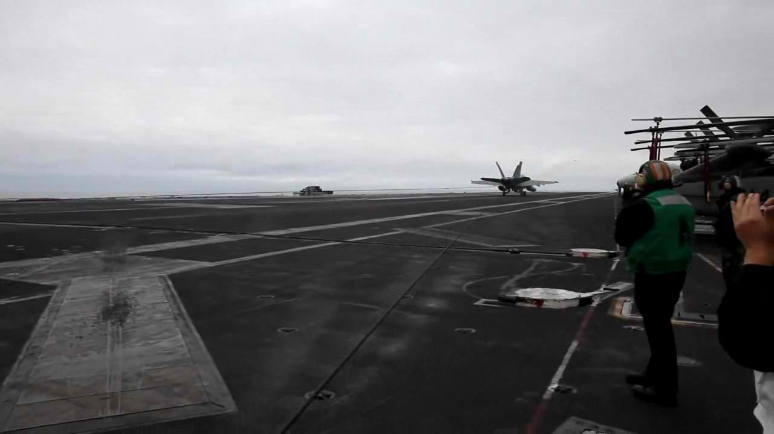
ON SHIP (On deck)
One person = Simplicity
One machine = Effectiveness
One product = Cost
Less water = Environmental care

Slide 13

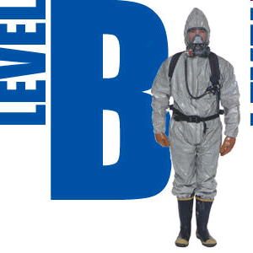
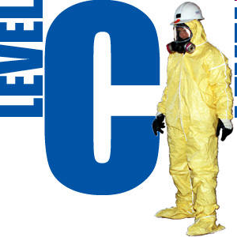

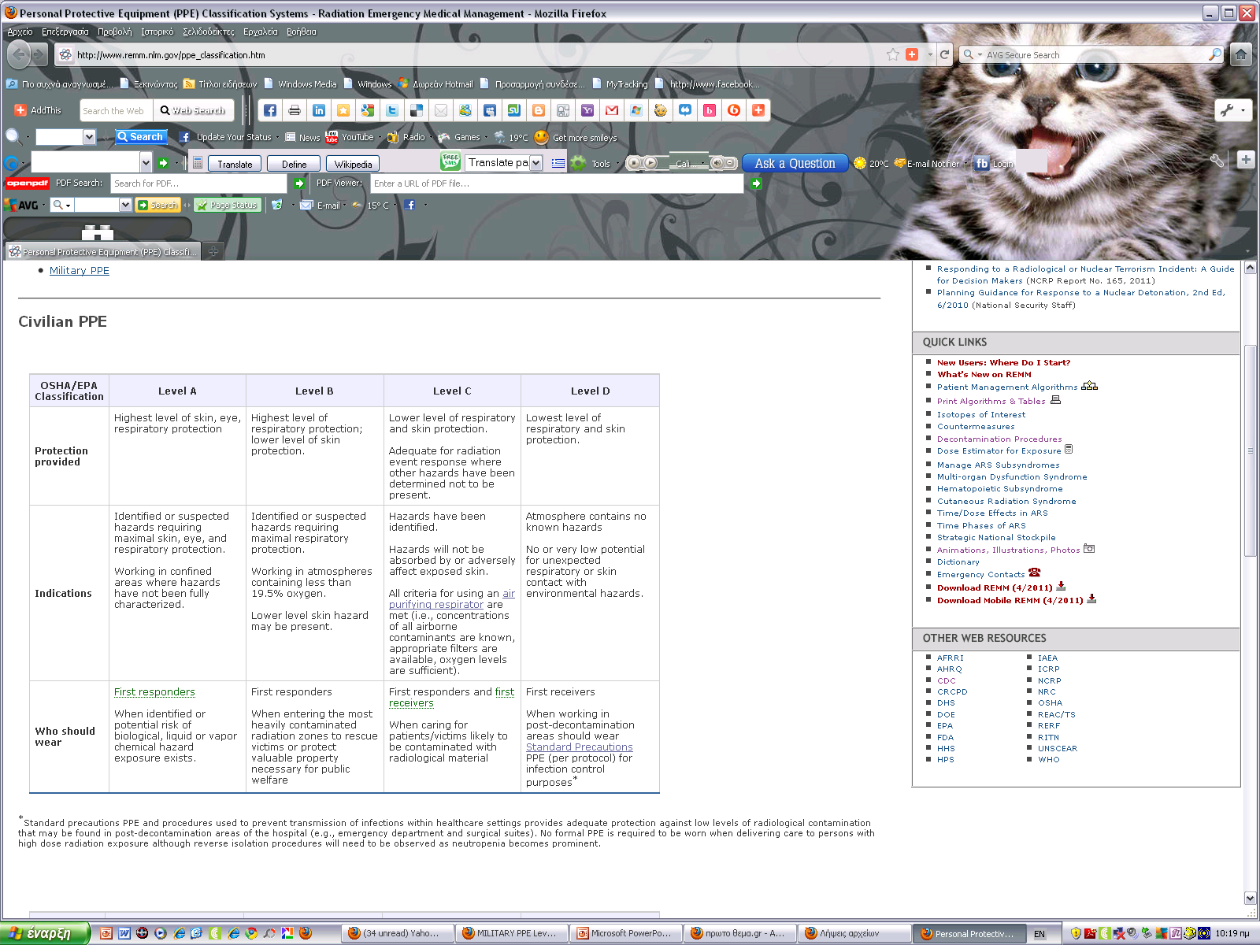
ON SHIP (On deck)

Slide 14

ON SHIP (On deck)

Slide 15


ON SHIP (Sensors)
Currently
50 vessels have received the new bio-agent systems
 Automatically detect a potential pathogen, sound the alarm, classify the material inside
in 15 minutes and prepare a specimen for further laboratory analysis
By 2016
Half of its ships (~130) equipped with fast-acting systems to detect and analyze potential C/BWAs
By 2018
Sensors with near-instantaneous chemical agent detection capabilities on its full surface fleet
 Installation began in 2011 and 35 ships are due to receive the technology in 2012.
➲ Equipping each vessel with the technology is a three-week process that costs hundreds
of thousands of dollars
U.S. Army: interested in use of "omniphobic" materials
"It is envisioned that omniphobic treated protective clothing will help to protect the skin from contact with solid and liquid TICs, petroleum, oil, and lubricants, CWAs, and bacteria and viruses, thus effectively providing enhanced CB protection"
Omni is a Latin prefix meaning “all” or “every”
Phobos (φόβος) is a Greek word meaning “fear”

Slide 16
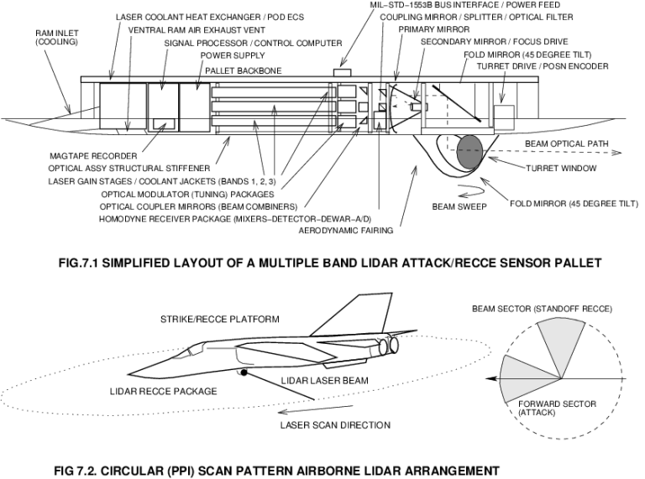
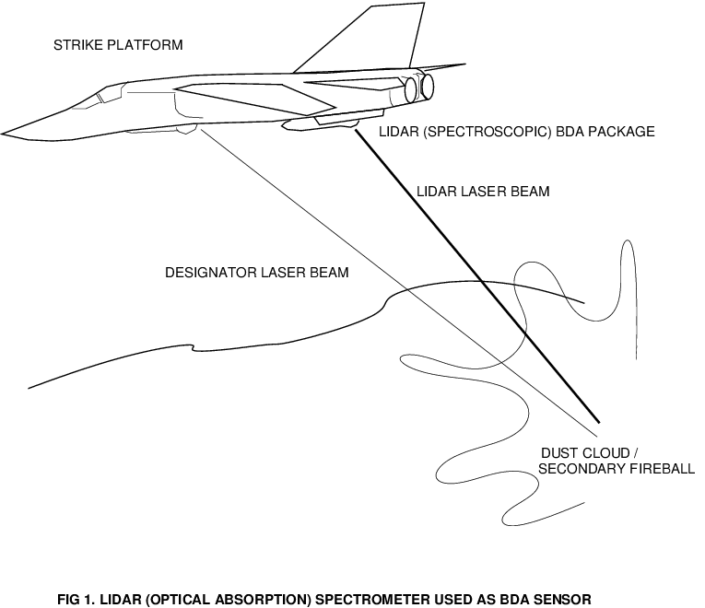
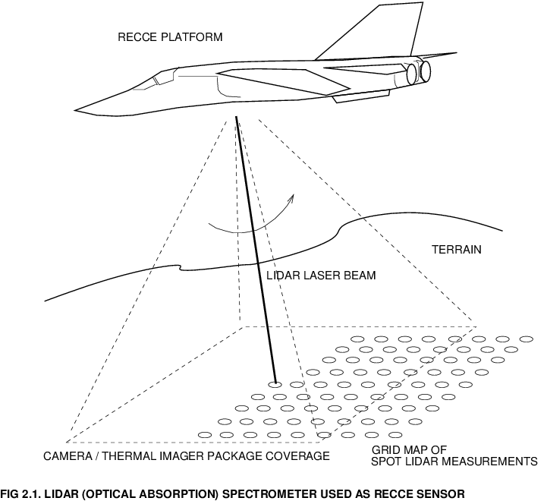
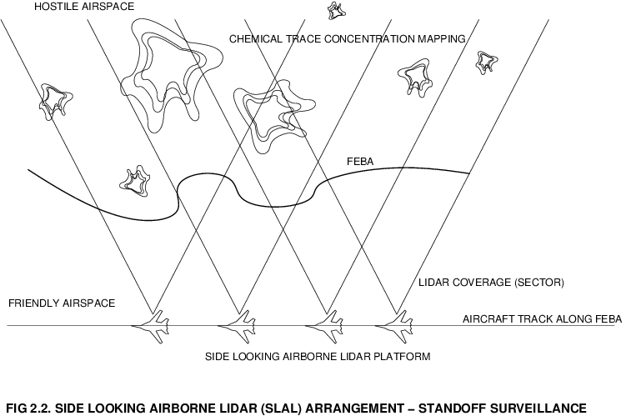
ON SHIP (Sensors)
Laser Remote Sensing Lidar technology

Slide 17
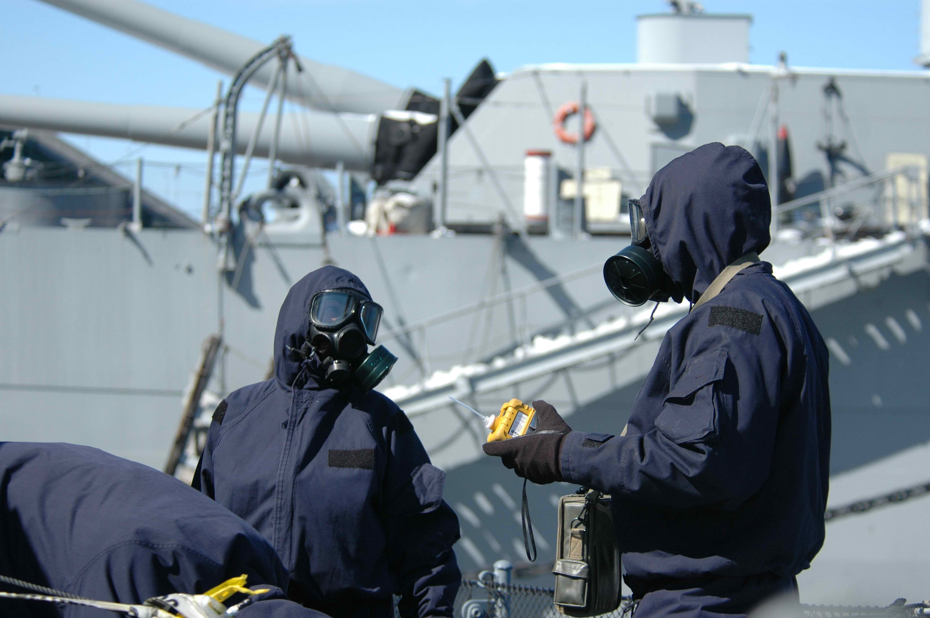
ON SHIP (On deck)

Slide 18
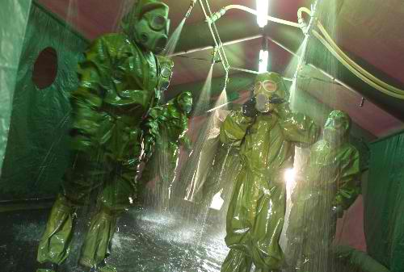
ON SHIP (On deck)

Slide 19
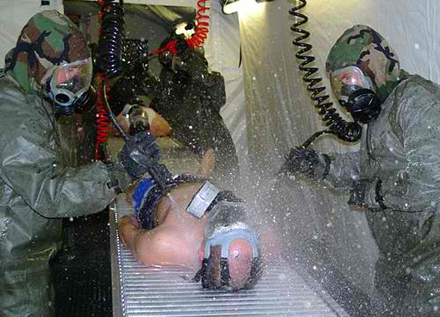
ON SHIP (On deck)

Slide 20

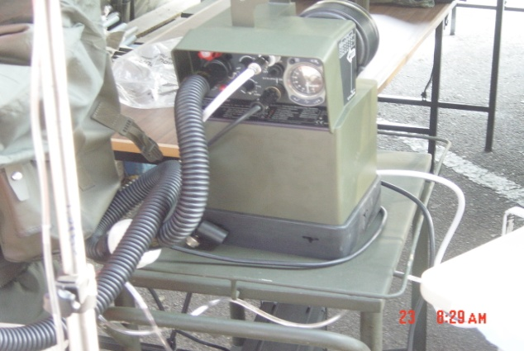
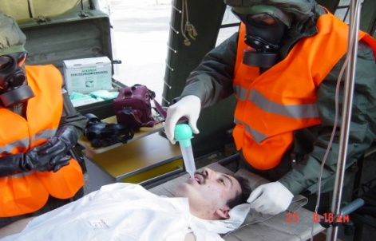
ON SHIP (On deck)

Slide 21
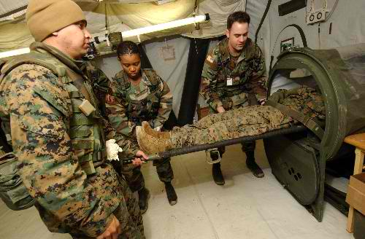
ON SHIP

Slide 22
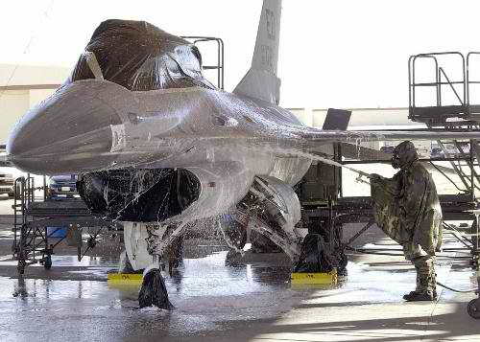
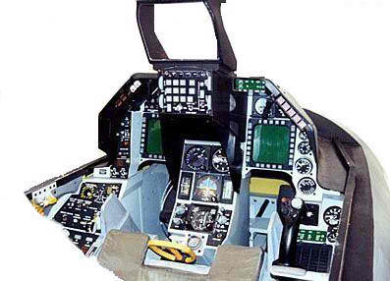
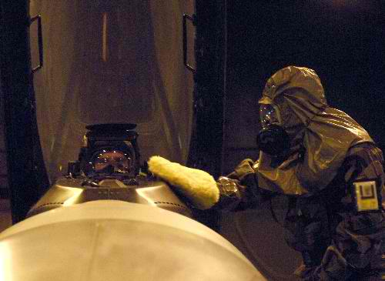
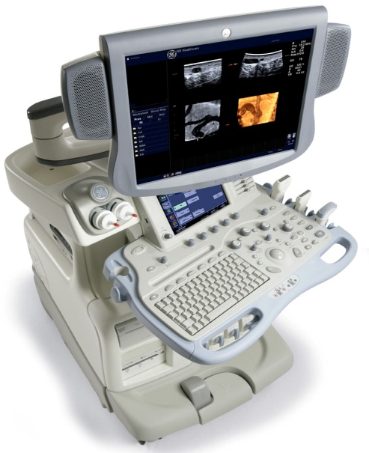
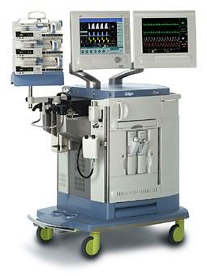
ON SHIP (On deck)

Slide 23
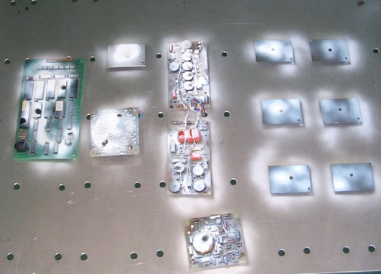
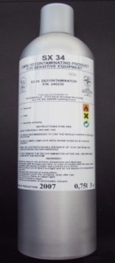
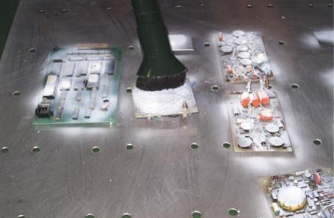
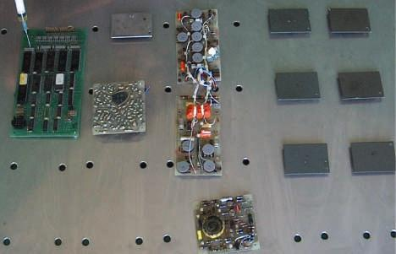
ON SHIP (On deck)
Decontamination Procedure
SX34 is sprayed directly on the surface like a paint;
The surface appears covered with a thick white layer;
After 20 min of reaction time it is possible to remove the layer using the dedicated vacuum cleaner;
If the decontamination is complete the surface will appear perfectly clean;
If whitish patches remain, repeat the treatment with SX34 until clean.
After application of SX34
SX34
Removal residues
After decontamination

Slide 24
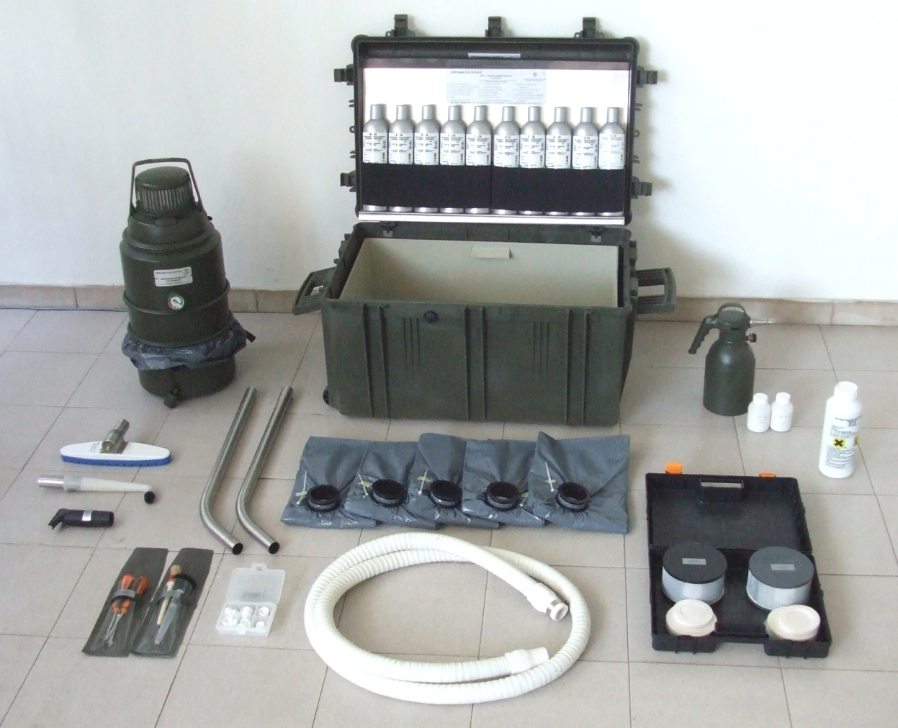

ON SHIP (On deck)
SX 34
P/N 958090183
NSN 6850-15-203-0545
N° 01 Deco Vacuum (weight 9,5 kg. – 20,9 lbs. - 220÷240V. - 50÷60HZ – 1200W) – p/n 958090185 – Nato Stock Number 7910-15-203-0547;
N° 01 storage / transportation box, drop shock resistant – p/n 958090189– Nato Stock Number 7910-15-203-0547;
N° 10 canisters (0,75l capacity each) of SX34 decontaminant –p/n 958090184 (n. 1 canister p/n 240230 – Nato Stock Number 6850-15-203-0546).
N° 01 HEPA and N°1 ULPA filter – p/n 958090186.
N° 05 bags for collection of contaminated materials – p/n 958090187.
N° 06 various accessories for access to those “hard to reach” places – p/n 958090188.
N° 2 brushes – p/n 958090198.
N. 10 nozzles (– Nato Stock Number 4230-15-110-6900) – p/n 958090199.
N. 1 decontamination/detoxification system PSDS1,5 MIL – p/n 240425 – resistant to acids as foreseen in STANAG 4360 - Nato Stock Number 6850-15-203-0548.
N. 2 containers for correct dosage of the detoxification / decontamination product BX24 – (Nato Stock Number 6810-15-149-4789) - p/n 958090037.
N. 1 bottle (1 kg.) of detoxifying /decontaminating product BX 24 (Nato Stock Number 6810-15-149-4789)– p/n 075054036.
N° 1 Removable decontamination box (p/n 958090242) for Deco Vacuum hose.
1
3
2
12
9
10
6
5
11
8
7
4

Slide 25
On Shore

Slide 26


ON SHORE (Base)
Secure
perimeter
Secure
perimeter
DECON
RULE
of 16
1st Responders
Casualties
VERIFICATION
TEAM
ENTRY
POINT
Control
perimeter
Control
perimeter
DETECTION
TEAM
BOMB SQUAD
FIRST AID
STATION
SAMPLING
TEAM
ENTRY
POINT
COMMAND
POST
Ambulances
Sample transportation
vehicle
Temporary
operational
vehicles
PARKING
Control
perimeter
STRESS
DEBIEFING
STATION
Police escort

Slide 27
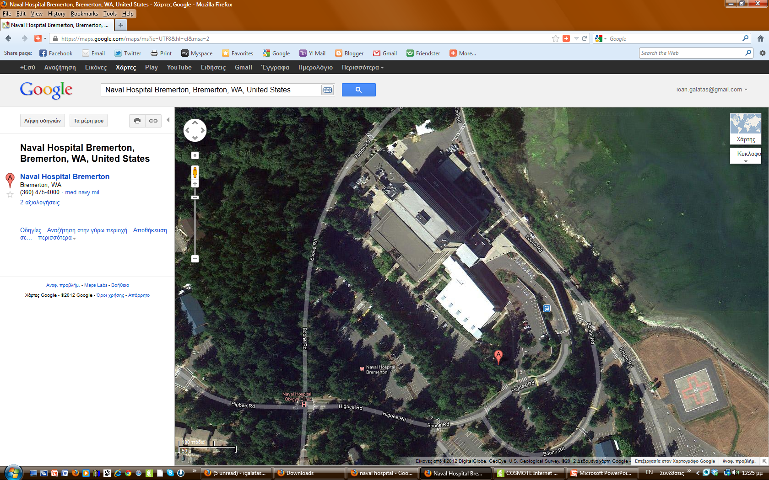
ON SHORE (Hospital)
Fence?
Secure ground entrances?
Military Hospital
Civilian Hospital
Security personnel?
◆ PPE, training?
Medical personnel?
◆ PPE, training?
◆ Deployed or when needed?
Morgue facilities?
◆ Fixed or deployable?
CBRN stockpile?
Decontamination facilities?
Fixed or deployable?
Decon of sensitive equipment ?
Sensitive Data Protection ?
Interoperability of CBRN
procedures & protocols?
Compatibility of CBRN equipment ?

Slide 28
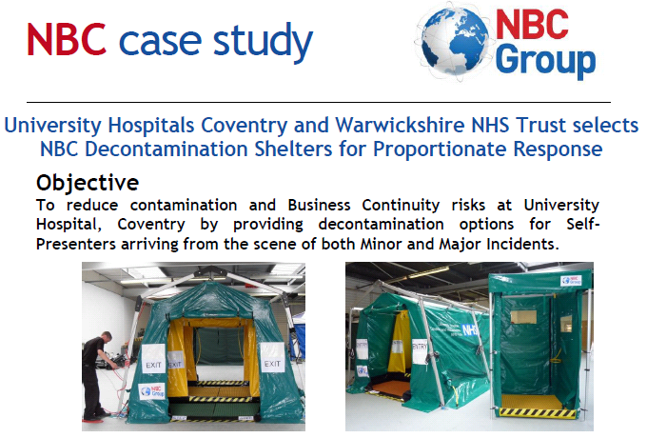
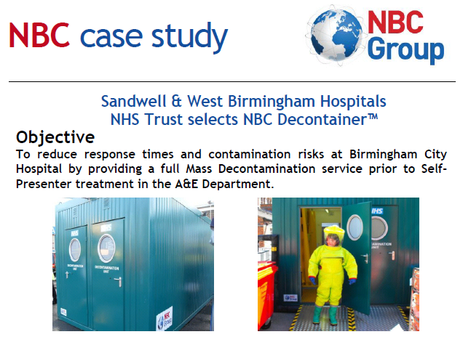
ON SHORE (Hospital)

Slide 29

Hospital
CBRNE
Defense
HOT
ZONE
COLD
ZONE
Support
Station
OUT
Worried
Well
Corridor in/out
HQ
T
EMS
1st Responders
Decon Station
Verification
Station
First Aid
Station
Mass Decon
Station
Mass Decon
Station
Non Ambulatory
Victims
Decon Station
Detection
Station
Decon
Solution
Victims
Triage
Station
-
Physicians
+
Stretcher Parking
Nurses
General Hospital
Medics
Security

Slide 30

Are we
ready ?

Slide 31
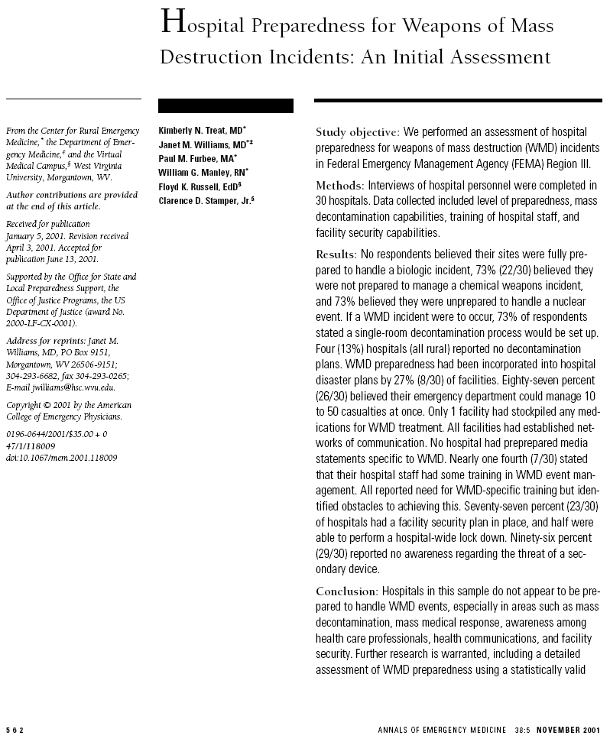
ARE WE READY?
Data* from 30 hospitals
100% of sites not fully prepared for biologic incident
73% not prepared for chemical incident
73% not prepared for nuclear incident
73% would set up a “single room” decontamination
process
13% had no decontamination process
3% (1 hospital) had chemical antidote stockpile
2001
Conclusion
“Hospitals in this sample are not
prepared to handle WMD events”
0% had prepared media statements
25% had “some” training in WMD incidents
77% had facility security plan in place
50% able to “lock down” the facility
4% aware of “secondary device” threat
* Treat KN, Williams JM, Furbee PM, Manley WG, Russell FK, Stamper CD Jr. Hospital preparedness for weapons of mass destruction incidents: an initial assessment. Ann Emerg Med.
November 2001;38:562-565

Slide 32

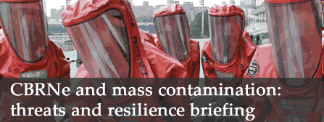
ARE WE READY?
Facilities for chemical decontamination in accident and emergency departments
in the United Kingdom
Emerg Med J 2002;19:453-457
G George, K Ramsay, M Rochester, R Seah, H Spencer, D Vijayasankar, L Vasicuro
Accident and Emergency Department, Horton Hospital, Oxford Radcliffe Hospitals NHS Trust, Banbury, UK
Objective
To audit the facilities for chemical decontamination, with special reference to cyanide poisoning, in all major accident and emergency departments in the UK.
Method
A simple postal questionnaire was used to audit planning, premises, equipment, protection for staff, and stocks of specific antidotes to cyanide poisoning.
Results
227 postal questionnaires from 261 departments (87%) were returned and used:
66% had a written plan;
74% had premises for decontamination;
24% were judged to have satisfactory premises;
64% departments had a shower or hose for decontamination;
26% had a decon trolley suitable for “stretcher” patients;
89% had some PPE for staff;
34% had complete protection;
3% had satisfactory premises/equipment to treat “stretcher” patients and full PPE for staff;
5% were equipped to manage ambulant patients at a similar level;
90% stocked one or more antidotes to cyanide;
34% stocked all four antidotes;
15% held all four antidotes to cyanide and had full protection for staff;
2% had satisfactory premises and equipment to treat “stretcher” patients,
full PPE for staff, and at least three of four antidotes
2002
Conclusions
Most departments had some
equipment for chemical
decontamination. However, there were
major inconsistencies in the range of
equipment held and these limited its
usefulness;
Only a small minority of departments
was satisfactorily equipped to deal with
a serious chemical incident.

Slide 33

ARE WE READY?
Preparation for the next major incident: are we ready?
K Wong, P S Turner, A Boppana, T Coltman, T D A Cosker, S E Blagg, Wycombe Hospital, South Buckinghamshire NHS Trust, Buckinghamshire, UK
Z Nugent, North Middlesex University Hospital, London, UK
Emerg Med J. 2006 September; 23(9): 709–712
34 hospitals & 179 registrars
144/179 (anesthesiologists, emergency medicine, orthopedics,
general surgeons)
68 (47%) not aware of hospital’s major incident plan (MIP)
33 (23%) have read the whole MIP
43 (30%) focus only in their specialty involvement in MIP
77 (54%) certain about their role in the plan
2006
Conclusion
Our study suggests that there is still considerable room for improvement in British hospitals' readiness for a major incident, and that the situation has changed little since similar studies were done from 1994 to 2002;
Urgent investment, education and rehearsal of Major Incident Plans is recommended.

Slide 34
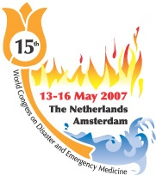
ARE WE READY?
Hospital preparedness
for contaminated patients in Austria
Ziegler A, Emergency Medical Service Vienna, Pandorf Austria
118 acute care hospitals in Austria
Evaluated with the new HPCP Score
(Hospital Preparedness for Contaminated Patients)
Hospitals must NOT rely on on-site decon
Patients will surely bypass EMS
Well documented risks for hospitals include:
➔ secondary contamination of staff
➔ disruption of hospital services
(4) Hospital preparedness for contaminated patients is LOW
(5) Decon facilities and PPE are ABSENT in many hospitals
(6) Contamination topic was included only in 1/3 of the plans
(7) Ability to implement plans is DOUBTFUL
(8) Contaminated-related training and exercises ?
 The exception not the rule!
(9) Awareness of PPE in hospitals is particularly LOW
2007
WORD
ASSOCIATION
ON
DISASTER
AND
EMERGENCY
MEDICINE
Prehosp Disast Med
2007
22(2) s118-s119

Slide 35

ARE WE READY?
Preparedness of emergency departments in northwest
England for managing chemical incidents: a structured
interview survey
BMC Emergency Medicine 2007, 7:20
Jane Williams, Darren Walter, Kirsty Challen
Emergency Department, University Hospital of South Manchester, Manchester, UK
Objective
Since October 2005 acute hospital Trusts have had a statutory responsibility to maintain decontamination capacity. We aimed to evaluate the level of preparedness of Emergency Departments in North West England for managing chemical incidents.
Method
A face-to-face semi-structured interview was carried out with the Nurse Manager or a nominated deputy in all 18 Emergency Departments in the Region.
Results
16/18 departments had a written chemical incident plan;
 7/18 had the plan available at interview;
18/18 had a designated decontamination area;
 11/18 felt that they were adequately equipped;
12/18 had a current training programme for chemical incident management;
3/18 had no staff trained in decontamination;
13/18 could contain contaminated water from casualty decontamination;
6/18 could provide shelter for casualties before decontamination.
2007
Conclusions
We have identified major inconsistencies
in the preparedness of North West
Emergency Departments for managing
chemical incidents;
Nationally recognized standards on
incident planning, facilities, equipment
and procedures need to be agreed and
implemented with adequate resources;
Issues of environmental safety and
patient dignity and comfort should also
be addressed.

Slide 36
ARE WE READY?
Emergency departments (EDs) in the United Kingdom (UK) are not prepared for emerging biological threats and bioterrorism
Mohammad Anathalleeª, Andrew Curpheyª, Nick Beeching^{b}, Simon Carleyª, Ian Crawfordª , Kevin Mackway-Jonesª
ªEmergency Medicine Research Group, Department of Emergency Medicine, Manchester Royal Infirmary, ^{b}Clinical Research Group, Liverpool School of Tropical Medicine, Pembroke Place, Liverpool
J Infection 2007; 54(1) 12-17
Objective
To assess the preparedness of emergency departments (EDs) in the United Kingdom (UK) for the management of potential biological incidents.
Methods
We telephoned all hospitals in the UK listed as having a major ED. We surveyed their ED facilities and procedures for managing patients with infectious diseases. We determined how many of the EDs had an isolation room available and, if present, whether this had an independent ventilation system and separate access from outside the ED. In addition, we determined how many of the EDs would isolate patients with suspected cases of chickenpox, tuberculosis (TB), severe acute respiratory syndrome (SARS) and other suspicious infections.
Results
Data from 203 (79%) of the 257 hospitals approached
49 (24%) had isolation facilities in the ED
 30 (61%) had independent ventilation system and 18 (37%) a separate access from outside the ED
47 (23%) would not isolate patients with suspected chickenpox
37 (18%) EDS would not isolate patients with suspected TB
12 (6%) EDS would not isolate patients with suspected SARS
55 (27%) EDS would not isolate patients with other suspicious infections
Conclusion
EDs in the UK are not prepared for emerging biological threats and bioterrorism;
With current facilities and procedures it is highly likely that an infectious agent will spread to staff and other patients in any future biological incident.
2007

Slide 37
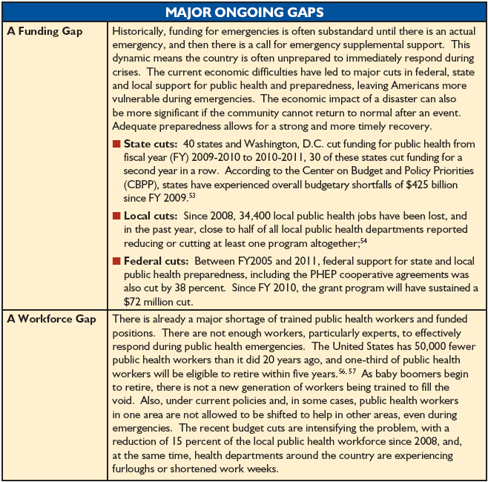
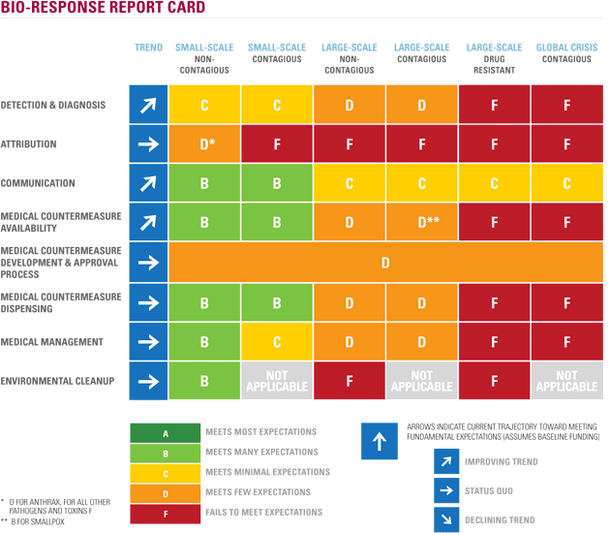
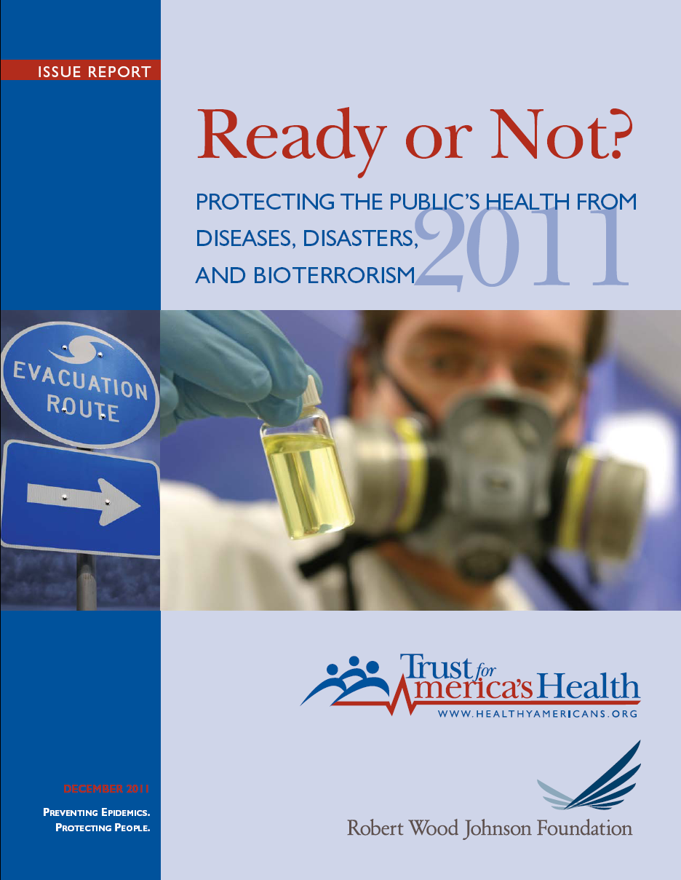




ARE WE READY?
2011
http://www.wmdcenter.org
MAJOR GAPS IN EMERGENCY HEALTH PREPAREDNESS
Gaps in Funding and Infrastructure
A Surveillance Gap
A Workforce Gap (-50.000)
Gaps in Vaccine and Pharmaceutical R&D
and Manufacturing
A Surge Capacity Gap
Gaps in Community Resiliency Support
healthyamericans.org/reports/bioterror10/

Slide 38












ARE WE READY?
2005
2008
What is the ETHREAT project about ?
www.ethreat.info
Planning and developing an educational package
incorporating the knowledge and training material
necessary to empower
European Front-Line Health Professionals,
including armed forces health personnel,
to rapidly, clinically recognise
and adequately respond
to modern public health threats,
like attacks with
Chemical, Biological and Radiological agents

Slide 39


ARE WE READY?
QUESTIONNAIRE 1
European Front Line Health Professionals (E-FLHP)
 531 responders
 22 countries
Is there a CBRN Plan available?
Yes (50.6%)
No (49.4%)
Known person-of-contact (POC) in case
of deliberate incident?
Yes (32.9%)
No (67.1%)
Last CBRN training conducted:
<6 mo (19.5%)
12 mo (12.6%)
24 mo (18.2%)
36 mo (4.8%)
>48 mo (17.7%)
Never (27.3%)
Confidence in usage of personal protective equipment (PPE):
Low/Very low (17.3%)
High/Very high (28.5%)
Access of PPE in workplace:
Low/Very low (9.5%)
High/Very high (35.9%)
N/A: 54.2%
80.5%
No PPE: 54.6%

Slide 40




ARE WE READY?
Level of knowledge regarding:
ANTHRAX Poorly/Very poorly (32.5%)
Well/Very well (64%)
No (3.5%)
VHF Poorly/Very poorly (35.9%)
Well/Very well (57.6%)
No (6.5%)
NERVE AGENTS Poorly/Very poorly (52%)
Well/Very well (42.9%)
No (5.2%)
MUSTARD Poorly/Very poorly (52.4%)
Well/Very well (34.7%)
No (13%)
B
C

Slide 41






ARE WE READY?
QUESTIONNAIRE 2
European CBRN Experts/Professionals
93 responders
16 countries
What proportion of FLHP in your country is adequately
prepared to recognize and manage:
Biological incidents
0% - 24% 25% - 49% 50% - 74% 75% - 100% Do not know | 42.9% 17.5% 15.9% 4.8% 19%
Chemical incidents
0% - 24% 25% - 49% 50% - 74% 75% - 100% Do not know | 38.1% 23.8% 12.7% 6.3% 19%
Radiological incidents
0% - 24% 25% - 49% 50% - 74% 75% - 100% Do not know | 52.4% 17.5% 3.2% 4.8% 22.2%

Slide 42






ARE WE READY?
2010
Editor
Gwyn Winfield
visits
Exercise Milo
to look at London’s preparation for the Paralympic
decontamination
Autumn 2010
29 June 2010
East London
Planned by HPA
Participants:
London Ambulance Service
Homerton Hospital,
City and Hackney PCT,
NHS London
London Fire Brigade and
Metropolitan Police Service
300 players
96 casualty volunteers
110 support staff

Slide 43







ARE WE READY?
18 March 2012
Leeds City Center (Headrow)
Masked terrorist spraying shoppers with a noxious chemical
2012

Slide 44









ARE WE READY?
?
Training
PPE
Equipment
Strategic distribution
of first aid stockpile
Communications
Top secret or Top gap?

Slide 45
Conclusion
&
Proposals

Slide 46


CONCLUSION - PROPOSALS
Medical/hospital CBRN preparedness both on shore and in ships is in early stages and if not addressed properly, it will endanger personnel lives operating in real CBRN environment – both urban and naval
International CBRN industry should work closely with naval medical authorities in order to evolve, modify and adapt current/future equipment and procedures into operational naval environment;
Naval medical personnel should be inspired to actively participate in this field of medical expertise;
Continuous medical CBRN training is the cornerstone for a successful outcome;
National naval authorities should apply pressure and provide support to universities’ medical/nursing schools in order to include “CBRN Medicine” into their teaching curricula

Slide 47




“The nicest thing about not planning
is that failure comes as a complete surprise,
rather than being preceded
by a period of worry and depression.”
Sir John Harvey-Jones
BBC “Troubleshooter”
MEGAQUAKE
January 2011
Preparedness
Working
Scenario
"We must dare to think about 'unthinkable things' because when things become 'unthinkable' thinking stops and action becomes mindless."
James William Fulbright
Arkansas US Senator
MEGATSUNAMI
IT
MIGHT
HAPPEN
TO US
AS WELL!
MEGANUKE
Notes:
Sir John Harvey-Jones MBE (16 April 1924 – 9 January 2008) was an English businessman. He was the chairman of Imperial Chemical Industries from 1982 to 1987. He may have been best-known for his BBC television show, Troubleshooter, in which he advised struggling businesses.
47

Slide 48

Thank you
very much
for
your attention!
igalatas@yahoo.com

Slide 49


Editor-in-Chief
Ioannis Galatas, MD
Have a look at
CBRNE TERRORISM NEWSLETTER
www.cbrne-terrorism-newsletter.com
Complimentary free download
Read in more than 60 countries
Distributed to more than 700 defense
companies, organizations, institutions,
state entities, universities
◆ As of January 2012: bimonthly
Latest
issue
AUGUST
2012

